Slide 1
Empower Girls to Embrace their Digital and Entrepreneurial Potential
Building a Network
Notes:
welcome

Slide 2
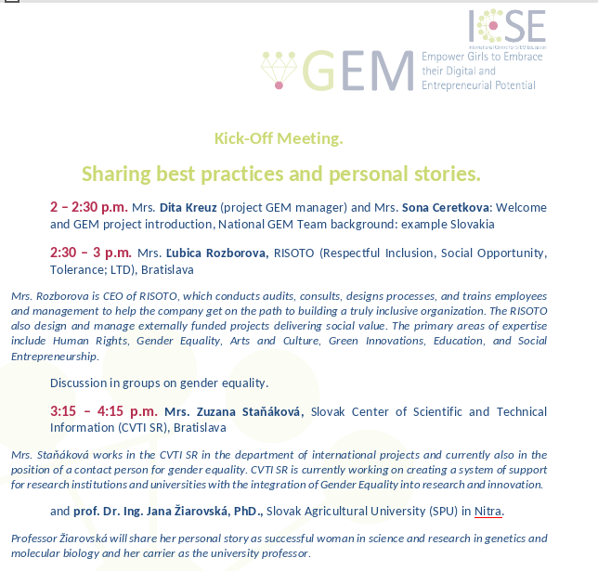
Notes:
During the next couple of hours we will hear 4 informative and inspiring presentations from very experienced speakers in their fields of action. Introducing the speakers…

Slide 3
Why do we need this project?
Notes:
Before we get to the objectives of the project and the frame of the network I would like to step back from the big European picture and share something personal by telling you, that
I am the proud owner of the first place in a contest „what a girl has to know?“. In year 2000 participated in a popular and annual school contest in Latvia, where girls had to compete in showing, how proper girls they are. The disciplines were the following: sewing, cooking, setting the table, making hair…. Meanwhile boys in my class were competing in another contest in the disciplines making a bird house, doing sports and learning how to survive in the nature.
To tell the truth, I wanted to do that as well. But it was the common understanding among the teachers, parents and society in general, that girls do not really do that.
You might say it happend a long time ago, and you are right. There are already a lot of iniciatives that encourage girls to pursue carreer in science, technology, engineering, and math, but there is still a certain herritage left, also:

Slide 4


Gender stereotypes in STEM | Gender4Stem (gender4stem-project.eu)
Digital Education Action Plan (2021-2027) | Education and Training (europa.eu)
Notes:
In form of literature for children that sets the picture of girls, who know how to do make up, create jewelery, bake, plant plants and encourages boys to be tough, do sports, make fire, set a tent and so on.
These are the stereotypes that are still ( when not entirely rule the societies in different European countries) function now, but are still present. For example,
there is the wide (unconscious) belief amongst teachers and students that girls are more hard-working, but have less talent at STEM, while boys are lazy, but more talented at STEM. There is also the belief that languages can be learnt (which is why girls are supposed to be better at languages) while STEM asks for innate talent (which is why boys are supposedly better at STEM). This is illustrated by the Microsoft study (2017) which showed that one of the top factors holding Dutch, German, Finish and Czech girls back from STEM is ‘perceiving that boys will always be better at STEM’. It seems that already at 5 to 6 years, girls implicitly associate mathematics more with boys and language with girls (Tomasetto, Mirisola, Galdi, & Cadinu, 2015).
The general image that boys and girls are innately different is a difficult one. It develops into the stereotype that girls are less suitable for STEM and more talented at humanities, arts and caring professions, while boys are talented at STEM, but usually do not pursue humanities. And it is fuelled by behaviour of parents and teacher, as some studies show. For example, giving girls’ significantly more soft toys like dolls and stuffed animals while ‘boys’ are asked to play with hard toys such as cars and lego. Girls miss a chance to develop interest and abilities for STEM, when they are not exposed to toys promoting spatial awareness, persistence and other technical skills.
This leads to unconscious biases that are mirrored in gender-biased hiring and the publicity of the digital sector (computers are for boys), boys and girls are judged from different standards, eventually, boys and girls are guided to different jobs and educations, even when they have the same grades.
It is then no wonder that girls become less and less self-confident of their STEM skills and are afraid of failing at STEM.
(Gender4STEM_O1A1_Synthesis_FINALE.pdf (gender4stem-project.eu))

Slide 5





53 %
15% in tech sector
17 % in ICT
Notes:
53 % of companies trying to recruit ICT specialists report difficulties in finding qualified people.
Meanwhile for every 1000 women only 24 graduate in ICT-related fields,
15% of tech sector workers in EU are women , Only 17% – 1 in 6 – ICT specialists in the EU is a woman
The potential is not being used. Therefore, this is where GEM steps in:

Slide 6
Notes:
by addressing girls in young age and showing them the complex yet exciting facets of STEM and ICT we hope to interest them in choosing a carrier in these fields, but also to obtain a range of transversal skills and competences. Also, in order to get more women in STEM, the human environment of girls have to get involved. Awareness of the stereotypical thoughts should be raised.
This leads us to the main two objectives of the project that addresses both levels:

Slide 7
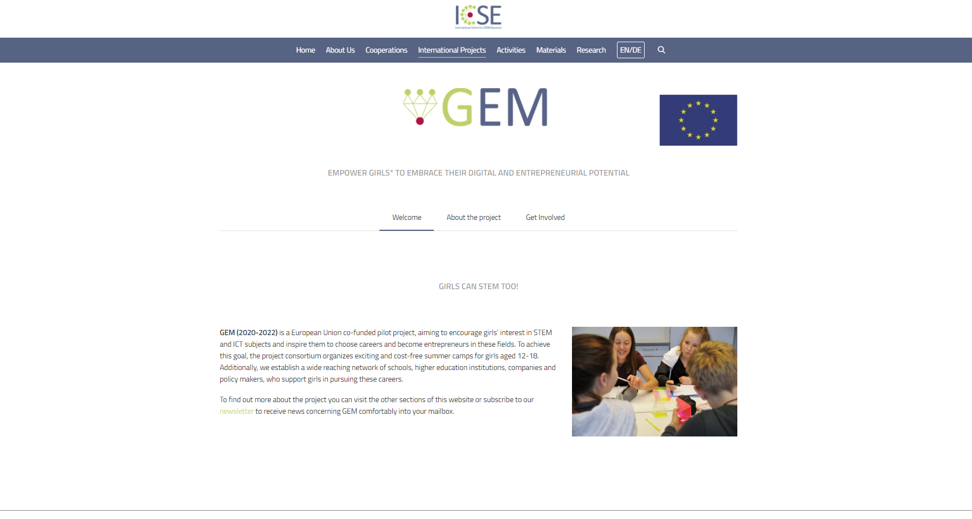
Pilot Project
Objective Nr.1:
To interest girls in STEM/ICT subjects
Objective Nr.2:
To establish societal basis to support girls
Notes:
Pilot project
Co-Funded from the European Commission
Coordinated by the International Centre for STEM Education (ICSE), http://icse.eu/ at University of Education on Freiburg
Together with project consortium:
University of Education Freiburg, Germany,
University of Nicosia, Cyprus,
Charles University, Czech Republic
University of Jaen, Spain
National and Kapodistrian University of Athens, Greece
Vilnius University, Lithuania
University of Malta, Malta
Utrecht University, Netherlands
Norwegian University of Science and Technology, Norway
Jönköping University, Sweden
Constantine the Philosopher University, Slovakia

Slide 8
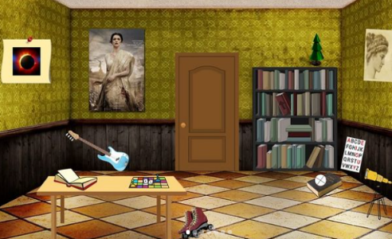
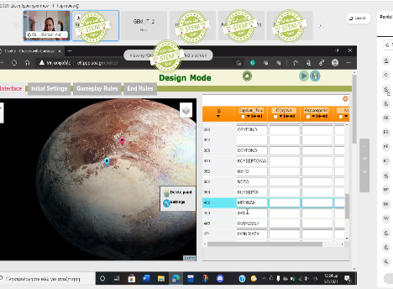
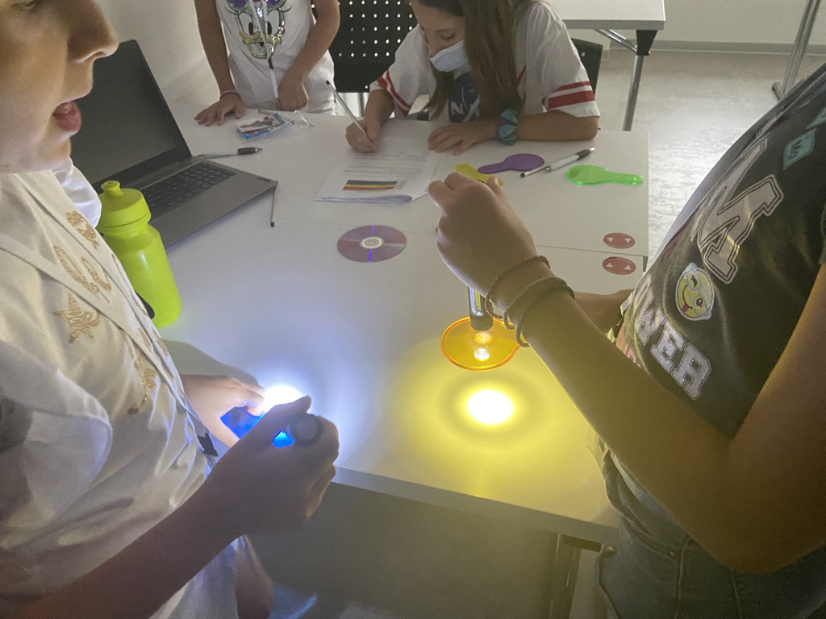
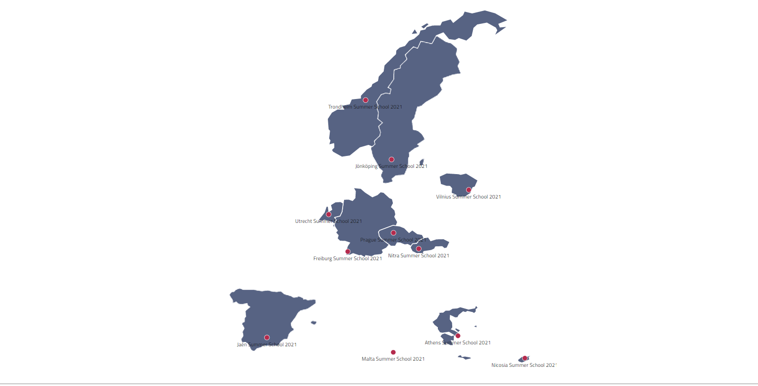
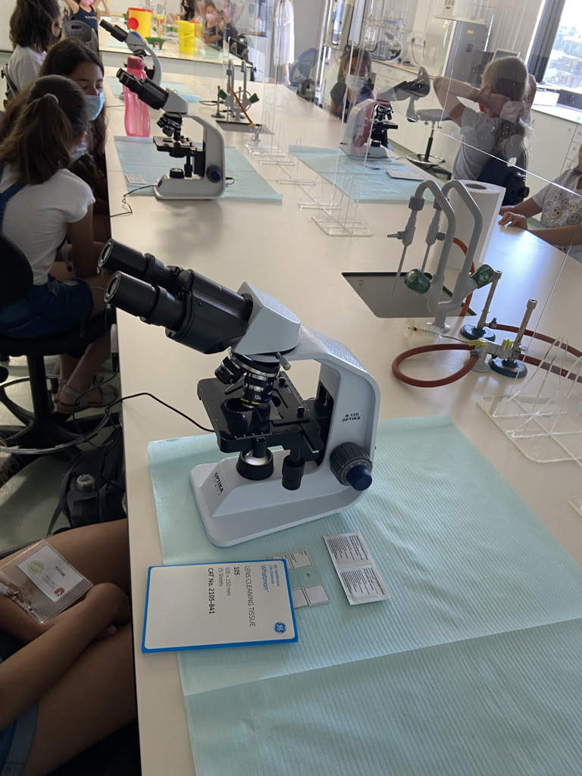
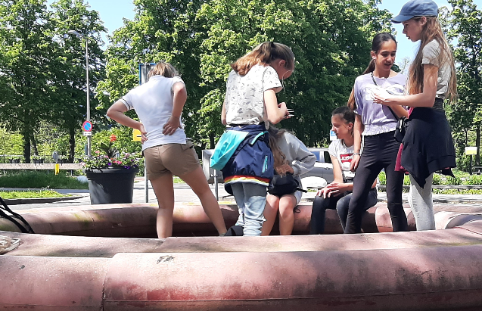
Interest girls in STEM/ICT subjects through Summer Schools in 11 European countries
from the Lab “You can reach… the stars”
things to take with you
from the Lab “Escape Room”
Notes:
We offer two rounds of summer schools for girls, aged 12-18 covering the following dimensions: we provide them with STEM/ICT subject knowledge and motivate further interest in these fields, we show them inspiring role models, girls and women that have achieved a lot, we provide knowledge of world of work and help them develop entrepreneurial mind-sets and transversal skills.
In this framework 10 Summer Schools took place last summer, for example : Mathematical principles such as 'translation' and 'congruence’ were playfully discovered (NL), magnets and use of x-rays, the learned computing skills, made some scientific excursion by observing the landscape and then made terrain research workshop like analysing water quality and measuring the pollution on landscape elements, Girls gave the waste a second life and transformed it into useful and sustainable materials, analyzing its life cycle and building their own green roof in the laboratory, found out How Substances around us are separated in a Chemical Laboratory, summer school on colors with relation to all STEM fields.
Also, as this is a pilot project, it is up to European Commision if this is maybe going to be used for another call of projects to reach wider range of girls all around Europe.

Slide 9
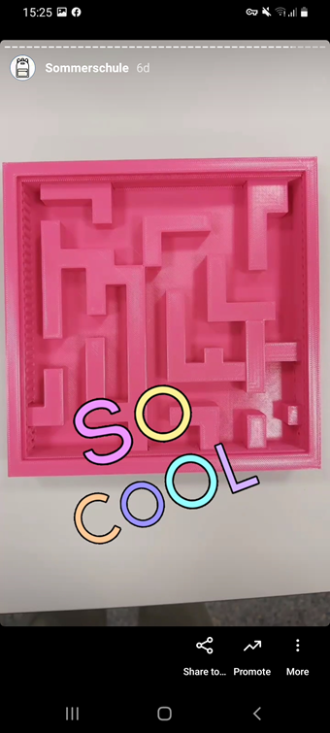
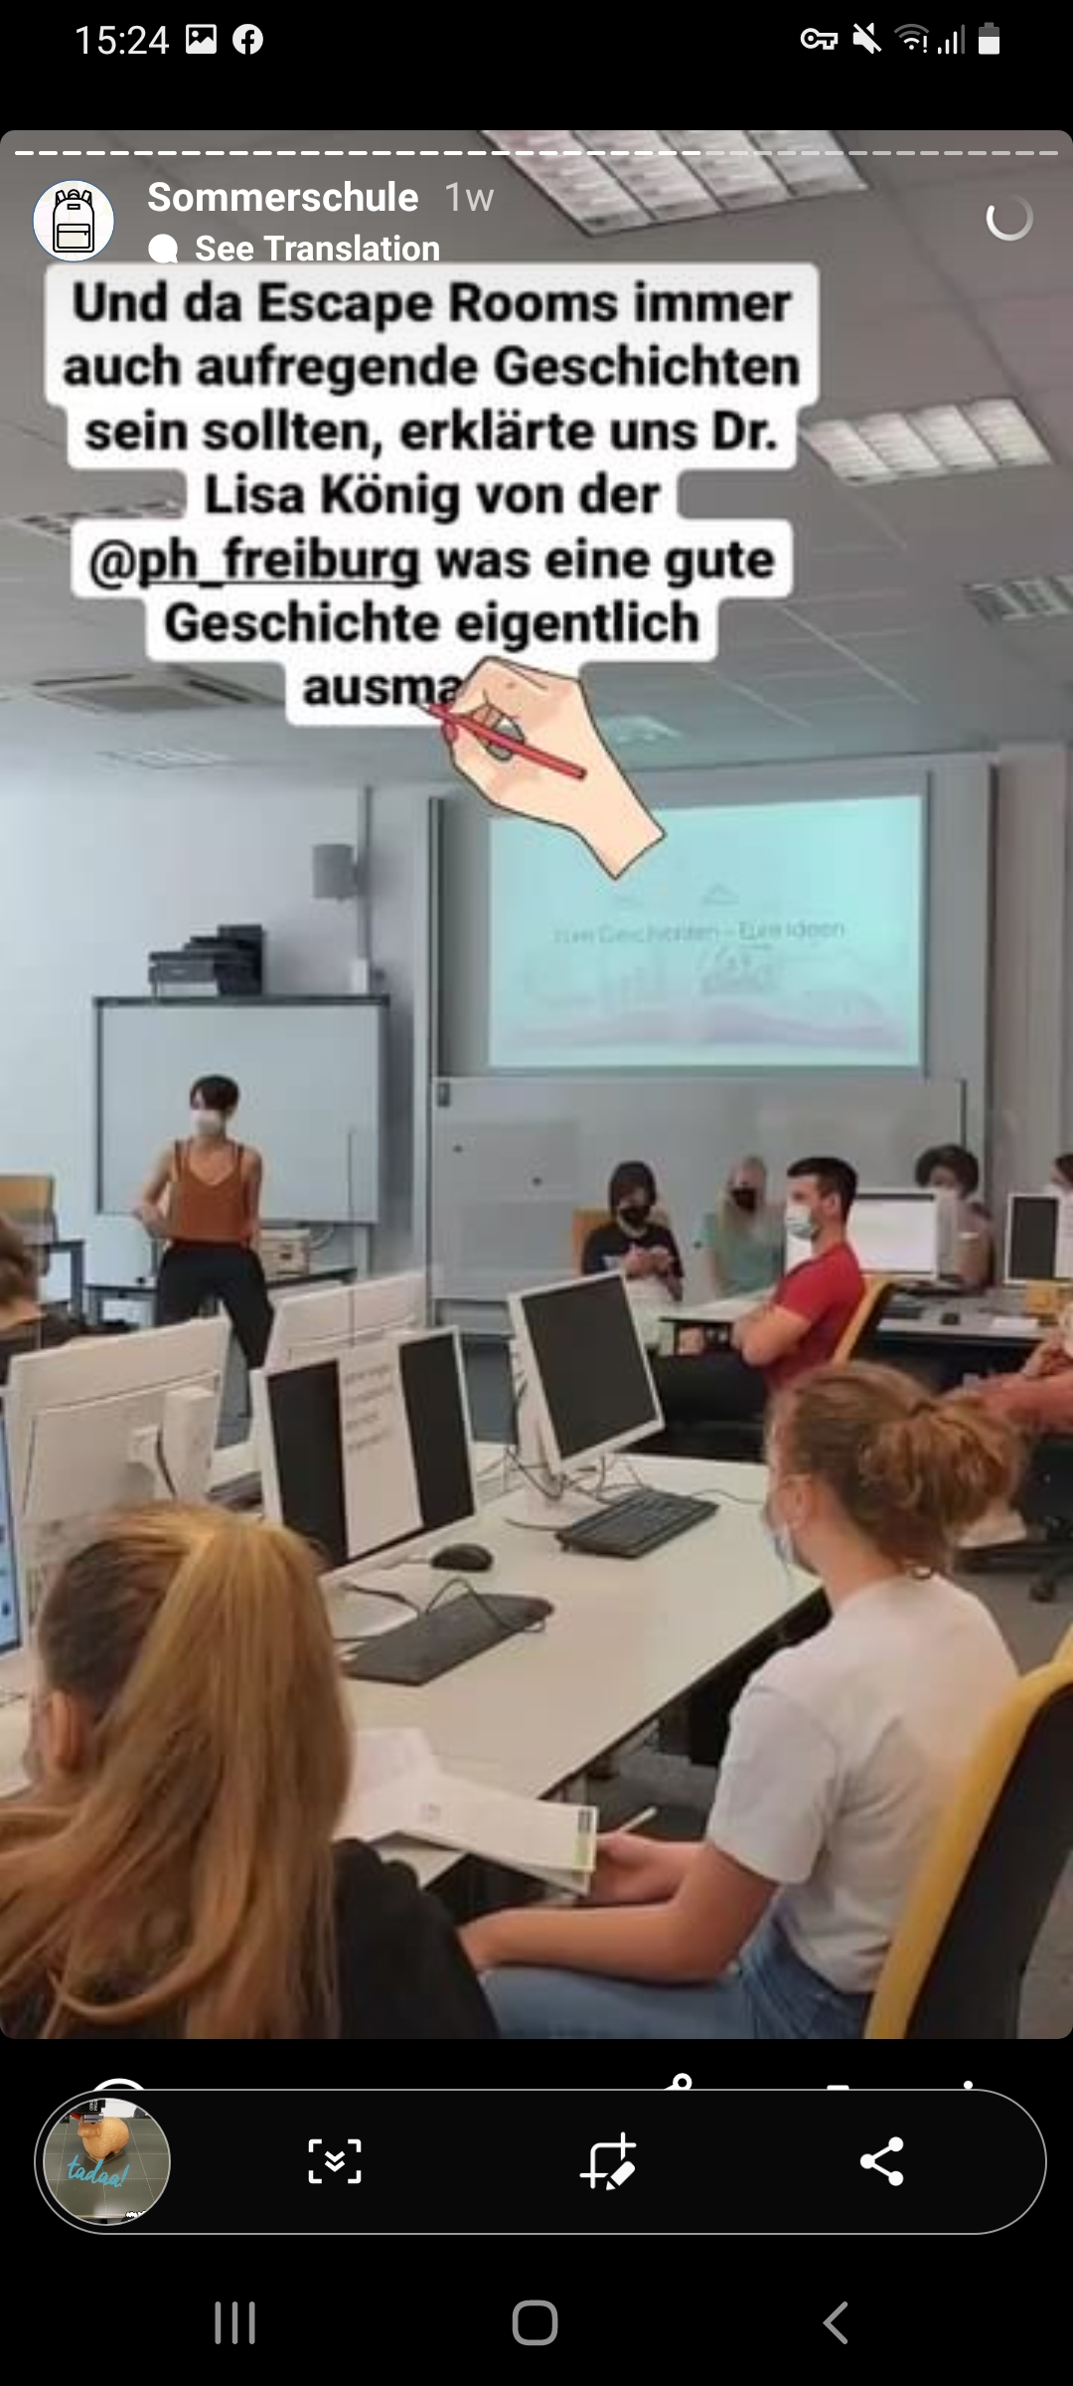
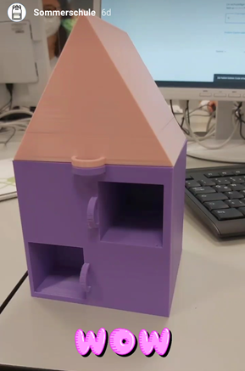
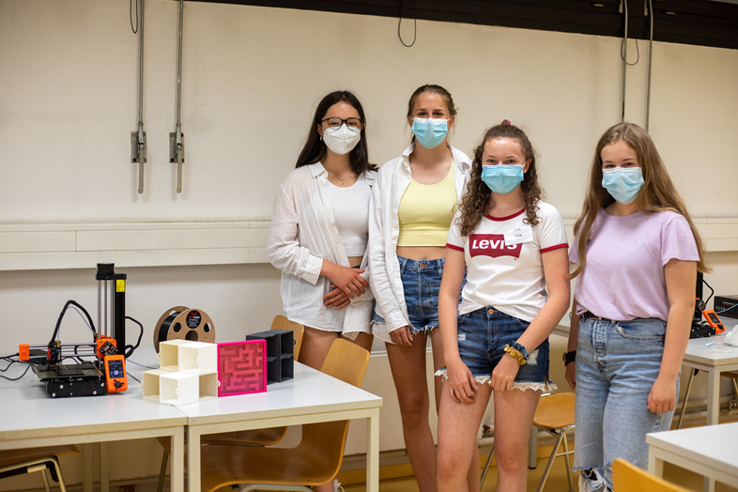
Summer School “Can you escape?” in Germany
Reaching Objective Nr.1
Notes:
For example, in Germany, a Summer School “Can You Escape?” took place. 24 school girls aged 13 to 17 years old spent 4 days took the opportunitiy to see behind the technologies. They designed, programmed and printed out their own 3D Escape Boxes.
Escape Box is usually an actual room where,solving different kind of tasks in a group and finding further clues you get to the solution, sometimes a key, and getphisically out of the room. Our colleagues here at the university of education came to with the idea, to build smaller boxes: a wooden box to that contains different doors and drewers that are locked and each contains a small mathematical task that has to be solved in order to get the next door open and eventually, a small treat. Working their way through the box, girls got an idea of the possibilities for development of an escape room.
Then,With the help of personally assigned mentors, other girls, more experienced ones, The girls learned the basics of 3D printing, including the importance of sustainability, started by programming and printing small items. In the last day they could then work on their own self designed escape boxes, choosing all details themselves. This gave the girls a huge feeling of success and empowerment as they said later in the evaluation round. The felt like they can trust their own abilities and have a potential to be successful in STEM.

Slide 10
Interest girls in STEM/ICT subjects through Summer Schools in 11 European countries
from the Lab “You can reach… the stars”
things to take with you
from the Lab “Escape Room”
Notes:
So we provided a wide range of topics and learning methods really. And the feedback from girls is outstanding. They wee really taken along on the STEM and ict trip and were inspired by what they are capable of in these fields
By evaluating learning units and impact on girls, by the end of this year we will provide organizational guidelines with detailed instructions on how to organize such summer schools. These will be available for everyone to use. After the next round of summer schools this summer, we will again evaluate the improved summer schools and optimize the guidelines yet another time.
So on the one side the girls are empowered through the meaningful activites to get closer to STEM/ICT. On the other hand

Slide 11
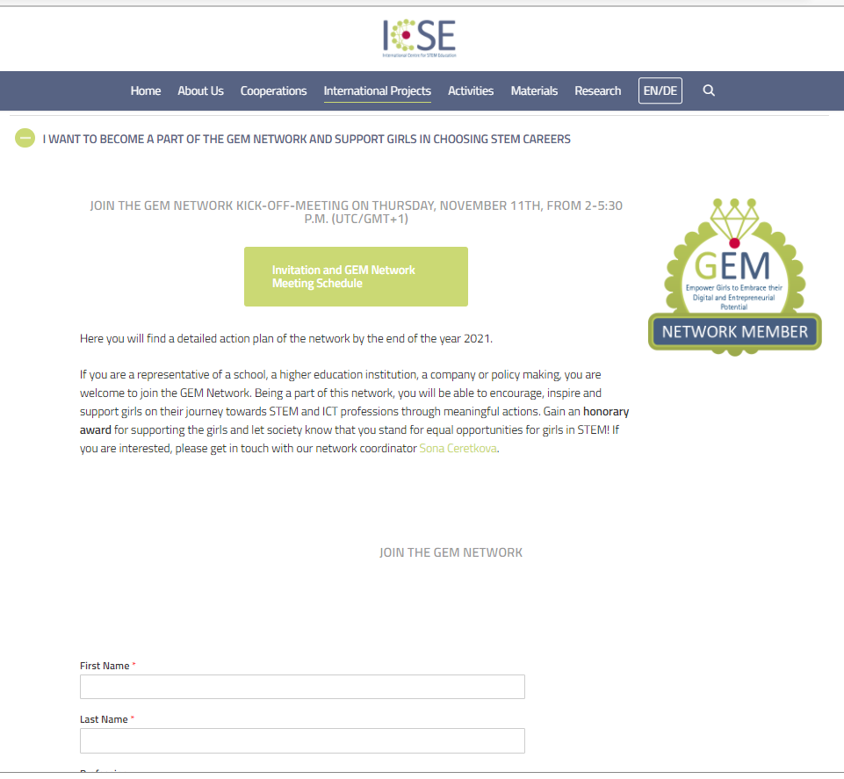
Establish societal basis which has the capacity to support girls to tap their STEM, digital and entrepreneurial potential
Notes:
we want to build a society that support the girls in choosing STEM and ICT carriers. And therefore a lot of stakeholders have to get informed about the possibilities, making a girl in a STEM job something very ordinary and normal. At the moment a lot of initiatives are taking place already all around Europe and we would like to connect the different levels of them and ensure an information exchange.
A crucial role is played by (1) families/friends/close human environment as they provide emotional stimulus such as encouragement,
Another group would be (2) business/industry representatives – as future employers,
(3) policy makers and media as a channel to mainstream und multiply existing issues, best practices, educational concepts, related events and so on, and
(4) educational stakeholders such as teachers, higher education institutions and informal learning providers. They have close contact to girls and can find ways to individually support and encourage them.
You the participants of this meeting are building the beginning of a network that will expand more and more in the future, combining measures and information exchange in Europe to Actually work against upcoming shortage of skills and loss of technological capacity in Europe by joining the network as you sign up to its mailinglist. You also see a link in the chat now, in case you have not done it yet.

Slide 12
Within the network we can
Sharing information on
  awareness rising events, STEM/ICT summer schools for girls, presentations on the topics, successful learning plans, structures, best-practices for successful STEM learning environments etc.
  Spreading or providing
  concise information texts on relevant topics (shortcomings of STEM/digital education, drop-out rates of girls, roles and barriers of girls, severe upcoming shortage of digital skills, loss of innovation capacity for Europe, etc.) for us to publish.
  relevant up-to-date research results, papers etc.
  GEM guidelines for summer camps
  Engaging in initiatives to overcome stereotypes
Supporting information events for girls all over Europe to present various education and training options
Notes:
Making a change starts with very simple methods, just an exchange of information and sensitizing the mentioned target groups brings a lot of impact, but of course also getting active yourself and organizing, for example, events of various kinds.
Whenever you come across an article, news story, a study and so on, feel free to share it with the network,
You can just write an email to your contact list of schools and higher education institutions or non profit organisations to invite them to organize similar summer school as organized within this GEM project last summer, add the mail the guidelines that I mentioned before.

Slide 13
Within the network we can
organizing open days at STEM/ICT companies and school visits
organising together awareness rising events, summer schools
organize informative events and workshops such as parental evenings at schools, student sessions - meetings with policy-makers (regional/national but also European level)
Linking and capitalizing on complementary initiatives
  exchange experiences, mutual expertise benefit, etc.
…
Notes:
You can engage and inform the network about initiatives to overcome stereotypes,
events you organize. You can search for partners to organize different events
And so on.

Slide 14
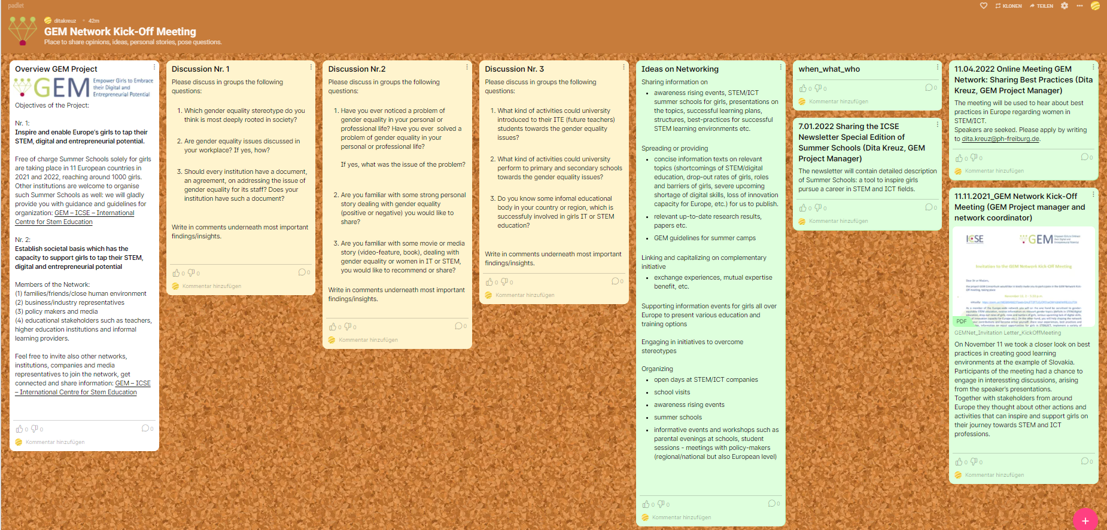
Further steps
Notes:
Shortly you will hear several inspiring speakers. At the end of each presentation a plenary discussion will start: please feel free to pose any questions about the matter of subject. After that, if there is enough time left, we would like to divide you into small groups to discuss some questions we have prepared. If there is not enough time after each speaker, we will do that in the end.
In chat you see a link to the working space after the discussion: padlet.
In the first column you see a summary of the project. On the very right side you see the ideas on networking possibilities, in blue.
And in between, there you see our discussion blocks.
As soon as you are divided into groups, please introduce yourselves shorty to one another and: firstly, each group please make a comment underneath the discussion block about the outcomes of the discussion.
Secondly, please think how do these questions or the topic in general resonate in your own country, region or institution: how these problems are addressed around you? What kind of best practices can you inform others about? Can you share some information on these topics? Maybe there is an event taking place nearby. We would love to hear about it. So please, if you can think of anything, write a comment under the block “Ideas of Networking”. This comment should contain the same kind of information as in the exemplary ents that you can already find there.
So, please write the name of the action (like sharing an article on gender equality in STEM in Spain or the name of the awareness rising event.
When: so you write the date, place (online or an actual place) and who is the contributor – is it you yourself, your or another institution and so on.
Maybe you know someone who would like to speak about these topics, so you can invite a speaker and we will organize a similar meeting as today, it does not necessarily have to be for several hours, it can be jut one speaker sharing his point of view. And we can invite all network mailing list to log in and hear it. Just in case there will not be enough time between the speaker presentations, you will have time for that at the end of the todays meeting.
After the last speaker and questions we will also summarize the discussions and look into future.

Slide 15
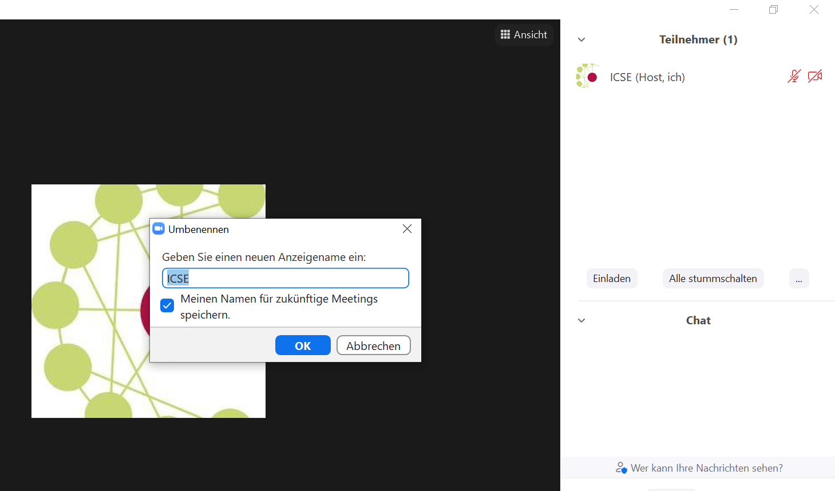
Please rename yourself and include: name, institution, country
Notes:
Also, please name yourselves by including your institution and country, so that it is easier for us to divide you into groups.

Slide 16
Thank you!
Notes:
Thank you very much for your attention. I wish you pleasant listening to the lecturers and have exciting discussions.

Slide 17
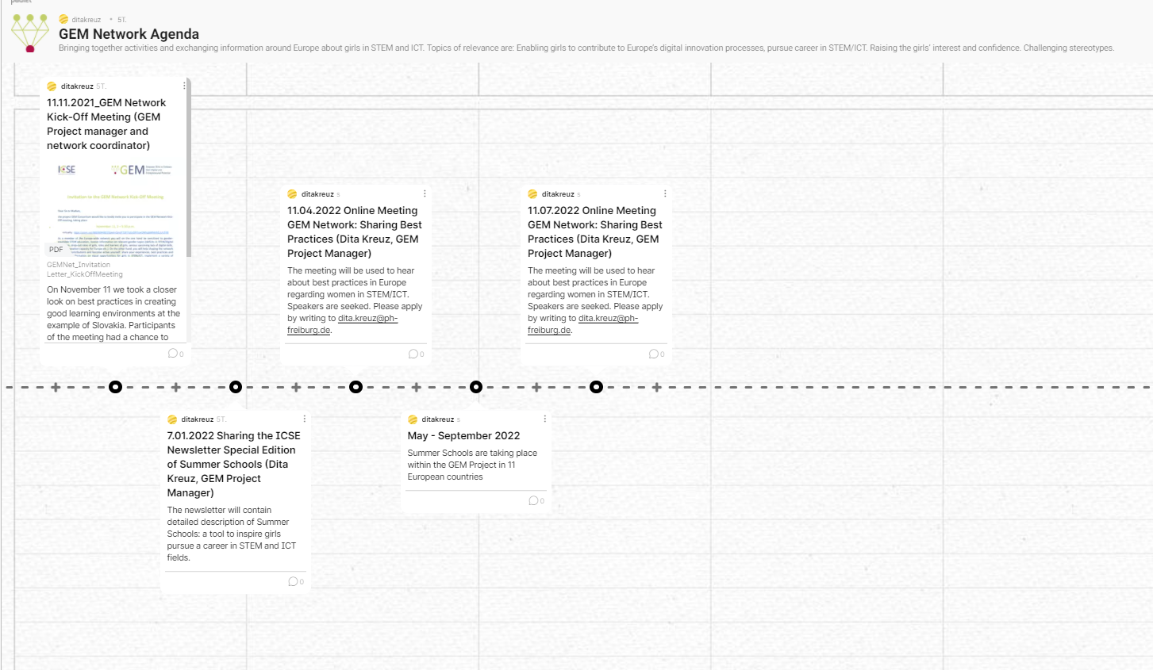
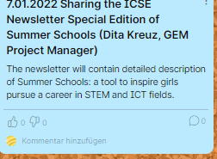
Notes:
The blue sticky notes will be transferred to this padlet an will create a timeline of the activities.

