Slide 1
Intercultural Mathematics Learning Outside of School
Imrich Jakab
Soňa Čeretková
Constantine the Philosopher University in Nitra

Slide 2
Introduction
Intercultural Mathematics Learning outside of School
| 2
Learning mathematics „outside of school“
What does it mean?
What is your experience?
Is the playground the topic rich enough for looking for mathematics or making mathematics outside of school?
Constantine the Philosopher University in Nitra

Slide 3
Activity 1.1 Discussion 1
Intercultural Mathematics Learning outside of School
| 3
Plenary discussion
Why are children’s playgrounds important?
How the playground of your childhood looked like?
(Poster of the plygorund of my childhood – optional.)
Constantine the Philosopher University in Nitra

Slide 4
Activity 1.1 Movie
Intercultural Mathematics Learning outside of School
| 4
Group work
Watch the movie carefully
Movie is online available at: https://www.youtube.com/watch?v=vTYPLY1dYYk&amp;t=
Constantine the Philosopher University in Nitra

Slide 5
Activity 1.1 Discussion 2
Intercultural Mathematics Learning outside of School
| 5
Answer the question
Which of common multicultural features and differences is possible to follow between European playgrounds and those in the South Africa, seen in the movie?
Constantine the Philosopher University in Nitra

Slide 6
Intercultural Mathematics Learning outside of School
| 6
Activity 1.2
Goals of the program ARCHITECTS
Detail mapping of selected recreation facility external area
Propose a new functional use of the area from the perspective of children
Experience the methodology for outdoor activity for pupils from 3rd to 9th grade (8 – 15 years old children).
Constantine the Philosopher University in Nitra

Slide 7
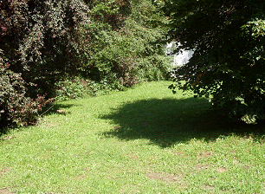
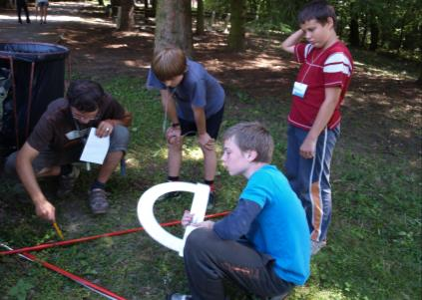
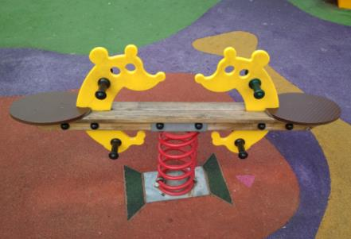
Intercultural Mathematics Learning outside of School
| 7
Methodology
1. Tasks and discussion
Main idea: „Let’s create our common space, little peace of our common World, full of game and joy.“
Discussion: Imagination of the ideal playground
Constantine the Philosopher University in Nitra

Slide 8
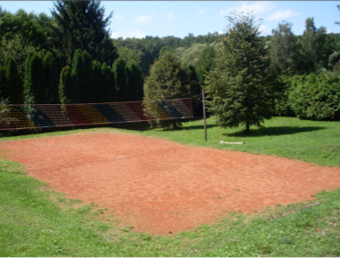
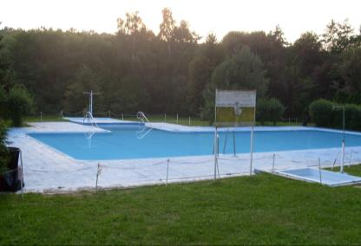
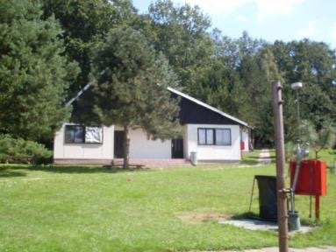
Intercultural Mathematics Learning outside of School
| 8
Methodology
2. Selection and recognition of external area
Evaluation the current state:
purpose of individual objects and surfaces
character of the landscape surroundings
assessment of facilities
presence or absence of facilities and services
Constantine the Philosopher University in Nitra

Slide 9
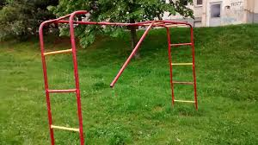
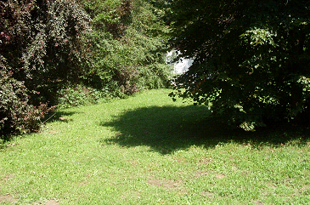
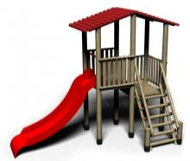
Intercultural Mathematics Learning outside of School
| 9
Methodology
3. Select areas for new functional use and define priorities
replacement or reparation of existing equipment's
enrichment of existing playground with new elements
design a new playground
Constantine the Philosopher University in Nitra

Slide 10
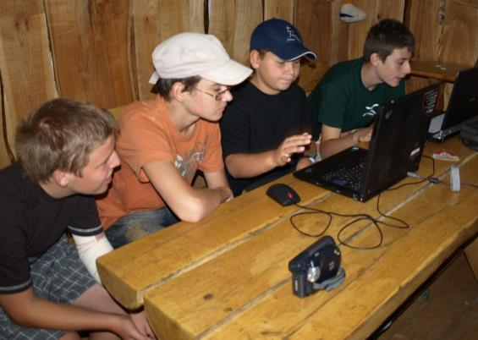
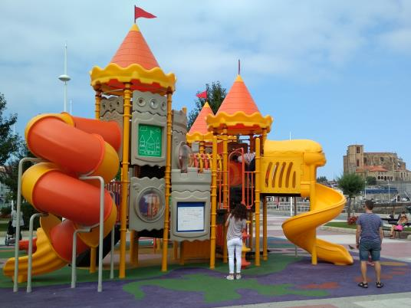
Intercultural Mathematics Learning outside of School
| 10
Methodology
4. Creating criteria for proposals
Examples given by teams of pupils:
use, safety, cost, durability, aesthetic appearance ...
Constantine the Philosopher University in Nitra

Slide 11
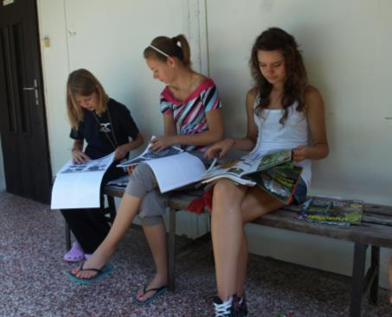
Intercultural Mathematics Learning outside of School
| 11
Methodology
5. Selection of particular elements from catalogues and internet
Individual work – selection of favorite elements
Presentation of individual choices
Team work on common proposal
Constantine the Philosopher University in Nitra

Slide 12
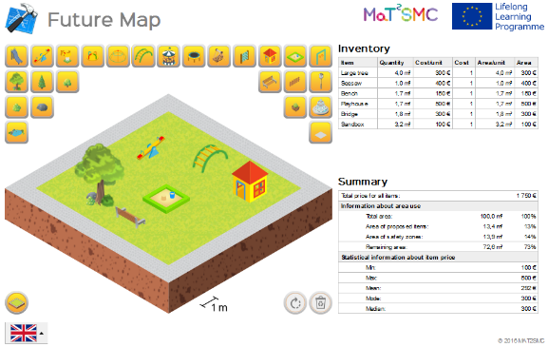
Intercultural Mathematics Learning outside of School
| 12
Methodology
6. Registration of proposals and setting of an overall budget for the purchase of selected elements
Constantine the Philosopher University in Nitra

Slide 13
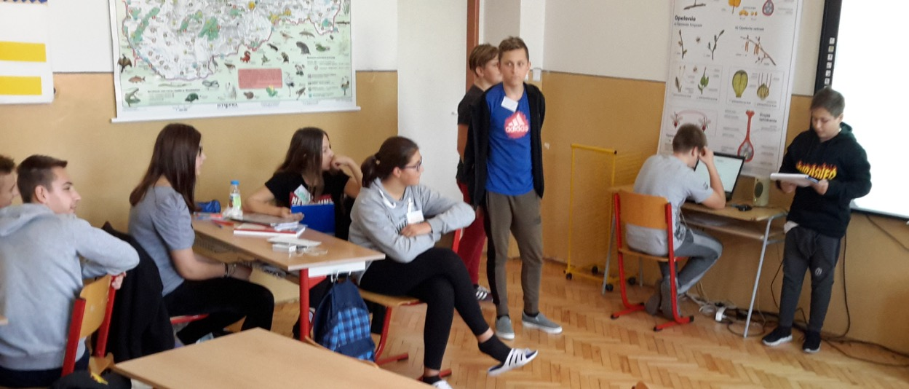
Intercultural Mathematics Learning outside of School
| 13
Methodology
7. Presentation and evaluation (self-evaluation) of proposals
Constantine the Philosopher University in Nitra

Slide 14
Activity 2.1 Pedagogical approaches applied
Intercultural Mathematics Learning outside of School
| 14
Group work
Create the conceptual map explaining the pedagogical approaches used in the education program Architects.
The basic common level of conceptual map is the title of education program Architects.
Based on this common starting point choose other levels which present educational approaches used in the program (e.g. work in groups, role playing, outdoor education, out of school education, IBL, ICT).
Constantine the Philosopher University in Nitra

Slide 15
Activity 2.2 Key competences development
Intercultural Mathematics Learning outside of School
| 15
Group work
Fill in the worksheet.
Define which concrete knowledge and skills are developed in the area of mathematics and science in each methodical step of the program Architects.
Fill in only columns Math and Science.
At the end each group presents its notes and remarks to each methodical step of the education program.
Constantine the Philosopher University in Nitra

Slide 16
Activity 3.1 Conductive diversity
Intercultural Mathematics Learning outside of School
| 16
Group work
Fill in the worksheet.
Focus on the last column - Intercultural dimension.
Try to describe how the intercultural approach would influence each methodical step of the education program.
Constantine the Philosopher University in Nitra

Slide 17
Further Discussion
Intercultural Mathematics Learning outside of School
| 17
How can a multicultural target group of children influence the process of planning and building a playground?
Which phases of the playground design and building will be the most affected?
How can an intercultural approach involving "Architects" from different cultures influences a playground design and building?
In which phase can intercultural approach be the most beneficial and why?
Constantine the Philosopher University in Nitra

Slide 18
Intercultural Mathematics Learning outside of School
| 18
This presentation is based on the work within the project Intercultural learning in mathematics and science initial teacher education (IncluSMe). Coordination: Prof. Dr. Katja Maaß, International Centre for STEM Education (ICSE) at the University of Education Freiburg, Germany. Partners: University of Nicosia, Cyprus; University of Hradec Králové, Czech Republic; University of Jaen, Spain; National and Kapodistrian University of Athens, Greece; Vilnius University, Lithuania; University of Malta, Malta; Utrecht University, Netherlands; Norwegian University of Science and Technology, Norway; Jönköping University, Sweden; Constantine the Philosopher University, Slovakia.
The project Intercultural learning in mathematics and science initial teacher education (IncluSMe) has received co-funding by the Erasmus+ programme of the European Union under grant no. 2016-1-DE01-KA203-002910. Neither the European Union/European Commission nor the project's national funding agency DAAD are responsible for the content or liable for any losses or damage resulting of the use of these resources.
IncluSMe project (grant no. 2016-1-DE01-KA203-002910) 2016-2019, lead contributions by Constantine the Philosopher University in Nitra, Slovakia.
CC-BY-NC-SA 4.0 license granted (find explicit terms of use at: https://creativecommons.org/licenses/by-nc-sa/4.0/deed.en)

