Slide 1
ASSESSMENT IN MATHEMATICS AND SCIENCE IN MULTICULTURAL CONTEXTS
Initial teacher education of prospective science and mathematics teachers

Slide 2
Aims
Define assessment and the purposes of assessment.
Explore the meaning of ‘fairness’ in assessment in mathematics and science.
Develop ‘culture-fair’ assessment strategies that take into account students’ diversity.

Slide 3
Structure of the module
Introduction
The purposes of assessment
Formative and Summative Assessment
Assessment & Educational Achievement
Fairness in Assessment
Assessment Strategies
Designing fairer Assessment tasks

Slide 4
1. Introduction: Assessment the bridge between teaching and learning…

Slide 5
1.1 Your personal experience
Think of a time you were assessed and it was a positive experience.
What made it positive?
Think of a time you were assessed and it was a negative experience.
What made it negative?

Slide 6
1.2: Reflection
What was the impact of each assessment experience?
Think of a phrase or sentence that best describes your experience.
In your groups choose your favourite phrase and
write it down.

Slide 7
1.3: Discuss...
Can we have learning without assessment?
Amy: I taught my dog to whistle.
Betty: Let’s hear it then.
Amy: He can’t whistle.
Betty: I thought you said that you taught
him to whistle.
Amy: I did he just didn’t learn it.

Slide 8
Assessment: the bridge between teaching and learning…
The teacher’s job is not to transmit knowledge, nor to facilitate learning. It is to engineer effective learning environments for the students. The key features of effective learning environments are that they create student engagement and allow teachers, learners, and their peers to ensure that learning is proceeding in the intended direction. The only way we can do this is through assessment. That is why assessment is indeed, the bridge between teaching and learning.
Dylan Wiliam (2013)

Slide 9
2. What are the purposes of assessment?

Slide 10
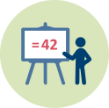
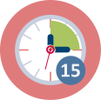
2.1: Case study
You have been presented with different scenarios.
In your group discuss what you think the purpose of assessment is in each of the scenarios.
Make a list of the various purposes of assessment.

Slide 11
The Purposes of Assessment
Screening and diagnosis to identify children’s individual strengths and weaknesses.
Feedback on student progress and the teacher’s success.
Record keeping of student achievement.
Certification to provide students with a qualification of level of competence.
Selection into further education or the world of work. (adapted from Gipps and Stobart, 1993).

Slide 12
The Purposes of assessment
Purposes are sometimes classified as:
Professional purposes
Administrative purposes

Slide 13
3. Formative and Summative Assessment

Slide 14
3.1 Introduction
Assessment as a cultural script…
…assessment practices are shaped by broader social and educational policies and structures such as awarding organisations whose practices are legitimised through government regulatory frameworks to develop assessment systems in line with government policies and directives…these project cultural beliefs that become embedded in our thinking about learners, learning and assessment and inscribed in our routines and behaviours as we engage with assessment activity…
(Elwood & Murphy, 2015)

Slide 15
Assessment practices
Psychometrics
Constructivism
Sociocultural

Slide 16
Psychometrics
Assessment is done to the individual to measure knowledge.
Constructivism
Knowledge is actively constructed by the learners.
Assessment is used to gain an understanding of an individual’s knowledge.
Sociocultural
Knowledge is constructed in a social and cultural context.
Assessment practices are not neutral and need to be re-defined.
Learning belongs to the individual and is co-constructed.
Learning and assessment are neutral.
Focus on the individual who has specific attributes.
Learning is not individual but takes place through interactions.

Slide 17
Assessment Practices
Summative
Psychometrics
Constructivism
Formative
Sociocultural

Slide 18
Formative and Summative Assessment
Assessments in and of themselves are not summative or formative.
What distinguishes an assessment as either summative or formative is HOW and WHEN you use the data i.e. the consequence.

Slide 19
Formative and Summative Assessment
Formative Assessment
Formal and informal processes teachers and students use to gather evidence for the purpose of improving learning.
Summative Assessment
Assessment information used to provide evidence of student achievement for the purpose of making a judgement about student competence or program effectiveness.
(Chappuis, Stiggins, Chappuis & Arter, 2012).

Slide 20
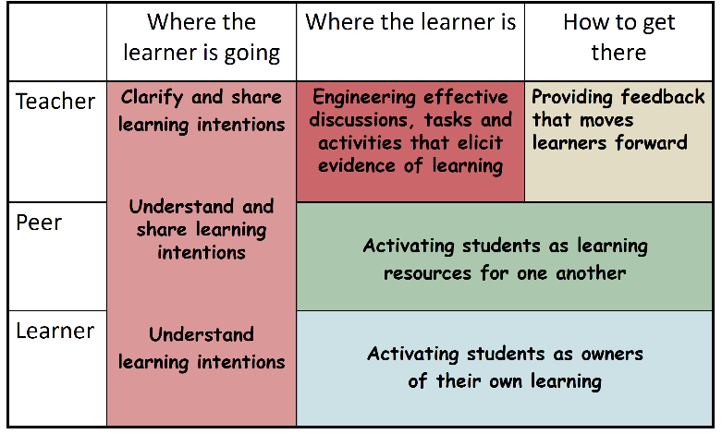
Key features of Formative Assessment (Wiliam, 2011)

Slide 21
Formative and Summative Assessment
Formative Assessment
Summative assessment
Formative assessment is when the cook tastes the soup!
Summative assessment is when the customer tastes the soup!

Slide 22
3.2: Case study
Read the vignettes you have on each of the cards.
In your group discuss when you think that the teacher was assessing the student (1) formatively and (2) summatively.

Slide 23
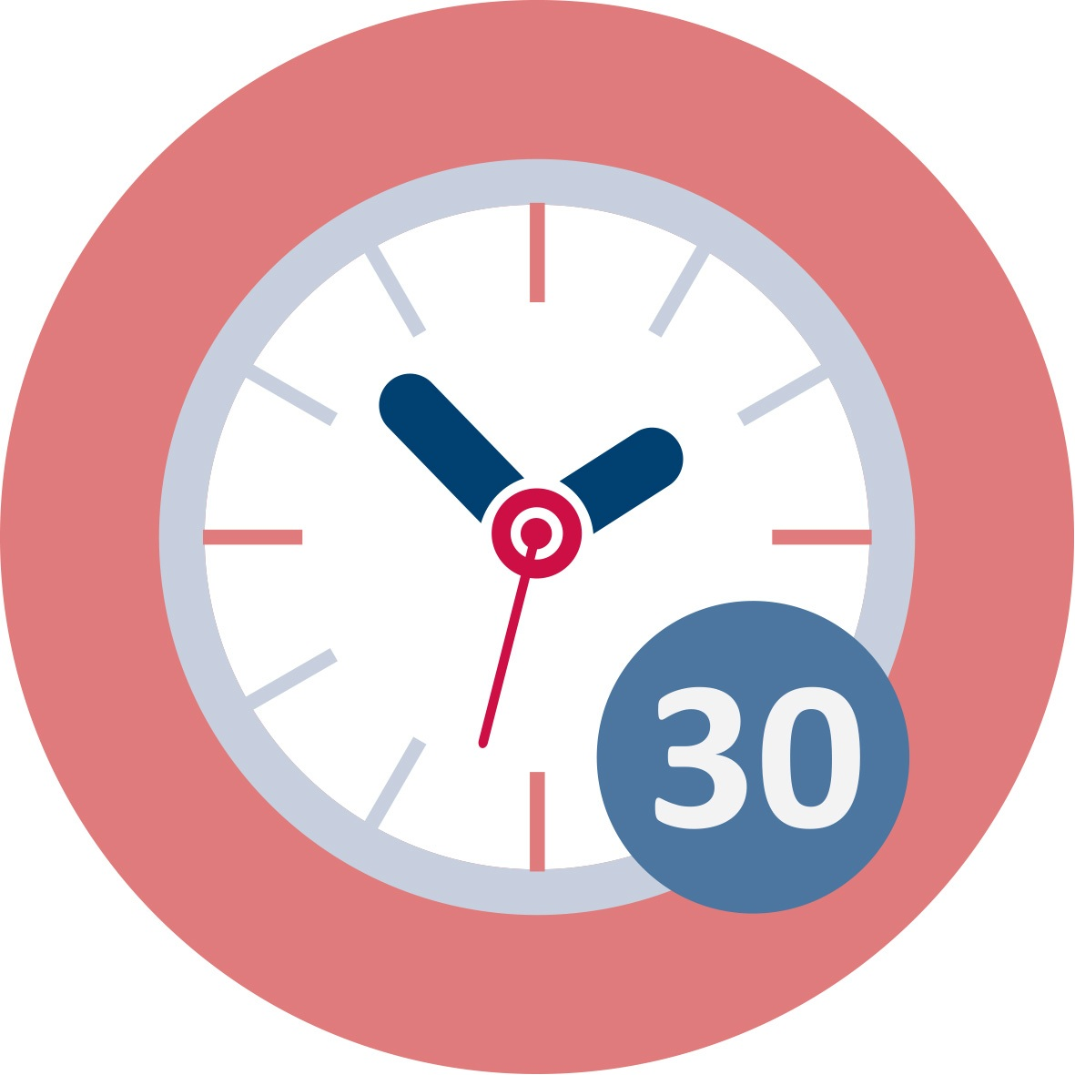
3.3: High stakes examinations
Summative assessment is often associated with examinations. Examination results are often very important for students, parents, teachers and school administrators.

Slide 24
When do examinations become high stakes?
They provide students with the necessary qualifications for entry into further education or the world of work (Elwood, 2012).
They have a significant impact on students’ life chances and opportunities (Elwood, Hopfenbeck & Baird, 2017).
They take over learning, teaching and curriculum and doing well in examinations becomes the main goal of schooling (Elwood, 2012).

Slide 25
If we acknowledge these high stakes…
We need to recognise that the effects of examinations may be magnified for those who enter the process already labouring under a disadvantage (Gardner, Holmes & Leitch, 2009).

Slide 26
Look at the following statements and discuss in groups…
Although examinations create a certain amount of stress they remain the fairest form of assessment…although we give a lot of importance to course work we feel that students work harder for examinations…
(Head of School)

Slide 27
Those of you who agree with this statement go to the right side of the room and discuss:
how have colleagues or know teachers or parents who think this way…
why do you think it is this way …
why do you think that examinations are considered to be more fair than course work for example?

Slide 28
Those of you who disagree with this statement go to the left side of the room and discuss:
how many have colleagues or know teachers or parents who do not agree with this …
why do you think …
why do you think that examinations are considered to be more fair than course work for example?

Slide 29
As a whole group discuss the reasons why you agree or disagree with the statement.
As a whole group discuss how the different ways of assessment are related to different ways of learning and theories of learning.

Slide 30
Now look at this…
From these results my whole life and career depended. Is it right to give all this importance to a few questions gathered together to form an examination ! I don’t think so… I got a good grade and I was satisfied but what if this wasn’t so? What if I had not passed? Would I have remained the same person?
(Female student aged 16).

Slide 31
3.4 Case Study
Luke is an 18 year old student who has just sat for his Advanced Level examinations in Malta.
These examinations are considered to be high stakes because they will determine whether he can continue his studies at University.
Read what Luke has to say about examinations…

Slide 32
Have you ever felt like this as a student?
Move to the right side of the room if you think that examinations should not be so high stakes.
Move to the left side of the room if you think that examinations are the fairer form of assessment?
As a whole group discuss the impact of high stakes examinations on students.

Slide 33
Examinations are considered to be fair because…
They are considered to be neutral and value-free.
They are perceived as being able to assess basic abilities.
They judge ability based on merit.
Since they are administered to large groups they can establish standards (Stobart, 2005).

Slide 34
Examination Boards try to make examinations fair by…
Developing tests that are psychometricallly reliable, valid, neutral and objective.
The focus is on the technical aspects of the writing and marking of the tests (Elwood, 2013).

Slide 35
These assumptions are constantly being challenged…
Such technicality does not factor in the social consequences of assessment.
Examinations, marks and grades lead to comparison.
Examinations are designed for students who fit in a societal norm, can read and write and can understand what is expected of them by examiners (Gardner, Holmes, & Leitch, 2009).

Slide 36
A one-size-fits all assessment system is not in the best interest of the students (Elwood & Lundy, 2010).

Slide 37
4. Why do Assessment and Educational Achievement Matter ?

Slide 38
4.1 Why does assessment matter ?
For the individual as it provides certification of competence for entrance into higher education or the world of work.
For schools as it increases learning and student achievement.
For society, since it results in better educated citizens.
(Wiliam, 2011).

Slide 39
Formative evaluation improves student achievement…
A 2008 study by John Hattie entitled “Visible Learning” compared the effect sizes of many aspects that influence student achievement.
According to Hattie (2008) one of the most important effects related to student achievement is formative evaluation mainly in the form of feedback.

Slide 40
The Question…
If Formative Assessment has such an important effect on student achievement…
how can we ensure that our assessment practices have the same effect on all the students in our mathematics and science classrooms?

Slide 41
4.2: Role Play
In your groups:
Each group has a question from a science examination paper.
Work out the question. You have 5 minutes to work it out.
In your groups discuss the difficulties you encountered when answering the question.
Reflect on how this made you feel…

Slide 42
4.3 Homework
Read the paper…short notes are available…
Wiliam, D. (2006). Assessment for Learning: Why, what and how. Institute of Education, University of London.
See the link:
http://www.dylanwiliam.org/Dylan_Wiliams_website/Papers.html

Slide 43
5. Fairness in Assessment: Equality or Equity ?

Slide 44
Fairness…
As we saw in your experiences of assessment practices, assessment practices can have an important impact on the lives of students.
Therefore as teachers we need to ensure ‘fairer’ assessment practices.
But what does fairness mean… can fairness be achieved by treating everyone the same?

Slide 45
5.1: Game
Game: You each have a plastic cup. The aim of the game is for you to fill the buckets at the end of the room using your cups.
Reflect on the outcome of the game.
Who managed to win the game?
How can we relate this to fair assessment?

Slide 46
Equality or Equity…
Equality aims to ensure that everyone gets the same things in order to be able to achieve their full potential in assessment.
Equity means ensuring that everyone has access to the resources and opportunities that they need to achieve their full potential in education.

Slide 47
Equality or Equity…
Teachers try to develop ‘fairer’ assessment practices by trying to create an educational ‘level-playing field’.
They try to do this by developing assessment tools that are psychometrically reliable, valid, neutral and objective (McArthur, 2015).
In reality the educational playing field in relation to assessment can never be equal or level for all students (Murphy & Elwood, 1998).

Slide 48
5.2 Equality vs Equity
What is the picture showing?
All the children are given the same support (equality) but can they all reach the higher shelves?
Do you think that this is fair?
What is unjust about it?
How could you fix it to make it ‘fairer’?

Slide 49
Equality vs Equity

Slide 50
5.3: Discuss
How is this cartoon related to assessment?
Think of an assessment situation that describes inequity. Think about how you could make the assessment fairer. Share with your group. Choose one situation to share with whole group.

Slide 51
5.4: Discuss
Everybody is a genius. But if you judge a fish by its ability to climb a tree, it will live its whole life believing that it is stupid.
Albert Einstein.
Discuss in your groups the implications of this statement:

Slide 52
Equality or Equity…
If we are committed to helping each child regardless of gender, class and race to succeed in the multicultural classroom, we need to accept that an uneven playing field exists.
We need to acknowledge that learning and assessment are not neutral by they are embedded within the social and cultural experiences of our students (Elwood & Murphy, 2015).

Slide 53
6. Assessment Strategies

Slide 54
6.1 Re-examining our assessment practices
As teachers we must re-examine our assessment practices both in the classroom and on a national level.
We need to think about individual students because in our mathematics and science classrooms every student must learn, and our assessment must lead towards learning.

Slide 55
Framework to support ‘fairer’ assessment
As teachers many of the decisions we take about assessment are made to benefit the majority of our students, without paying attention to the different cultures of our students.
The first step towards ‘fairer’ assessment practices is to be able to recognise the differences, accept them and celebrate them.

Slide 56
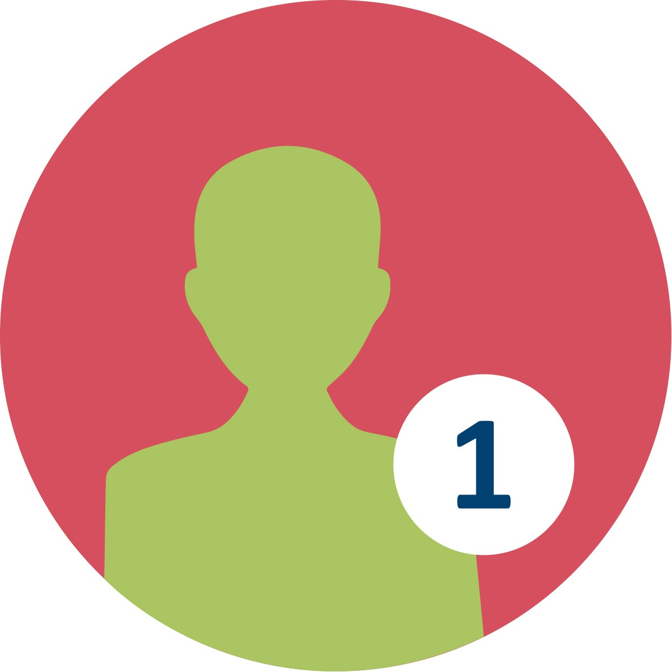
6.2: Groups I identify with
Can we define culture?
Let’s work on this short activity.

Slide 58
Place your name at the center circle.
Write other important aspects of who you are in each of the satellite circles (something that identifies you such as British, German, Maltese, athlete, teacher, scientist) or any other descriptor with which you identify.

Slide 59
Based on what you have written would you identify yourself with one or more specific groups?
Share the contents of the circles with the whole group.
How many different groups can be formed from all the participants? How many groups do you fit in?
How may this help us focus on similarities rather than differences between our students?

Slide 60
Culture can be defined as…
The explicit elements that makes people identifiable to a specific group(s) including behaviours, practices, customs, roles, attitudes, appearance, expressions of identity, language, housing region, heritage, race/ethnicity, rituals, religion… (Montenegro and Jankowski, 2017)

Slide 61
It can also mean…
The cognitive elements or ways that the lived experiences of a group of people affect their acquisition of knowledge, behaviour, cognition, communication, expression of knowledge, perceptions of self and others and so on.

Slide 62
6.3: Case study
Read an excerpt from the teacher’s (Ms. Maria) journal. In your group, discuss what differences you notice among the students. Is the teacher taking into account of these differences when assessing the students?

Slide 63
An equitable approach…
Valuing the classroom as a center of societal change, teachers change their methods to help students from diverse backgrounds to excel in the classroom and bring positive changes to their communities.
Banks & Banks (2004)

Slide 64
6.4: Models of responding to diversity
What does it mean to develop equitable practices in assessment?
How do you view students in your classroom?
Answer the questionnaire. See where you fit in.

Slide 65
Models of responding to diversity…
The assimilative model: In this model there is no appreciation of the previous knowledge of students from cultural backgrounds.
The recognition model: Here there is recognition and appreciation of the different knowledge and experiences students bring with them.
The interactive model: The knowledge of different groups influences the knowledge of the dominant group and enriches knowledge.
(Shohamy, 2000)

Slide 66
Culturally responsive assessment…
Is mindful of student differences and employs assessment methods appropriate for different student groups
The focus is on the students
The students are kept at the center
This requires their involvement at every step in the assessment process and builds upon their lived experience
(Montenegro and Jankowski, 2017).

Slide 67
Culturally responsive assessment practices…
Emphasising prior knowledge of different groups.
Building on cultural knowledge.
Developing a supportive relationship with students.
Recognising that students can belong to more than one group.
Including hands-on experiences.
Making use of code-switching.
Using a range of modes and tasks.
(Klenowski, 2009)

Slide 68
6.5: Homework
Read the paper…
Stobart, G. (2005). Fairness in multicultural assessment systems. Assessment in Education, 12(3), 275-287.
See the link:
https://cmap.helsinki.fi/rid=1G5ND3134-GLXTVW-1WM/fairness_multicultural_assessmentsystems.pdf

Slide 69
6.6: Read and Discuss
After reading Stobart’s paper and some definitions of cultural responsive assessment…
…Read the excerpt from the journal of Ms. Maria, a Maltese science teacher…
What practical suggestions does Ms. Maria give and do you think you would use them in your science/mathematics classes?

Slide 70
7. Designing Fairer Assessment Tasks

Slide 71
7.1 Steps towards Equity and ‘Fairer’ Assessment
Know every child
Ask each student to tell their story.
Share it with all the students in your class.
Ask students to bring with them an artefact from home that means something to them and describes their culture.
Build a story wall in each classroom.

Slide 72
Steps towards Equity and ‘Fairer’ Assessment
2. Develop a learning story for each student
Gather information about how each student learns.
See what are their strengths and their weaknesses.
Observe which assessment tasks are completed easily and which the students struggle with.

Slide 73
Steps towards Equity and ‘Fairer’ Assessment
3. Believe in every student
Believe that every student can succeed.
Make your science/mathematics classroom a safe place where students can be themselves.
Guide the students safely to their best potential.

Slide 74
Steps towards Equity and ‘Fairer’ Assessment
Use different assessment tasks
Develop assessment tasks that are different.
Develop tasks that assess different learning styles and knowledge.
Use oral, practical, problem-solving tasks.
Always give students feedback to help them progress from where they stand to where they could be.

Slide 75
Steps towards Equity and ‘Fairer’ Assessment
Use culture as a resource
Help students actively involve their cultural knowledge to access challenging content.
Value their different learning styles.
Develop assessment tasks that take the students’ individual and cultural identity into consideration.

Slide 76
Steps towards Equity and ‘Fairer’ Assessment
Build trust
Listen to your students.
Help them to trust you.
Understand their cultural background. Trust them back.

Slide 77
7.2: Get to know someone
Sit next to someone you do not know.
Ask them to tell you three things about themselves. Two are truths and one is an untruth.
Introduce your friend to the group.
What did you learn that you did not know before? As a whole group try and find out the true identity of each individual.
How did you conclude that a particular statement is untrue? Is it due to stereotypes?

Slide 78
7.3: Dealing with diversity
What types of assessments should I use to support diverse students?
Should content vary across assessments?
Should I assess some students using different assessment tasks?
Do my assessment tasks capture knowledge which some students might know but others do not?
Should I allow students to show what they know and can do in ways that they find easier?
Discuss. Share one of your answers.

Slide 79
7.4: Design a lesson plan including assessment tasks
Design a lesson plan for a topic of your choice and include assessment tasks.
How did you try and be ‘fair’ and ‘equitable’?
Discuss the challenges you faced in trying to develop ‘fairer’ assessment for science/ mathematics students.

Slide 80
This presentation is based on the work within the project Intercultural learning in mathematics and science initial teacher education (IncluSMe). Coordination: Prof. Dr. Katja Maaß, International Centre for STEM Education (ICSE) at the University of Education Freiburg, Germany. Partners: University of Nicosia, Cyprus; University of Hradec Králové, Czech Republic; University of Jaen, Spain; National and Kapodistrian University of Athens, Greece; Vilnius University, Lithuania; University of Malta, Malta; Utrecht University, Netherlands; Norwegian University of Science and Technology, Norway; Jönköping University, Sweden; Constantine the Philosopher University, Slovakia.
The project Intercultural learning in mathematics and science initial teacher education (IncluSMe) has received co-funding by the Erasmus+ programme of the European Union under grant no. 2016-1-DE01-KA203-002910. Neither the European Union/European Commission nor the project's national funding agency DAAD are responsible for the content or liable for any losses or damage resulting of the use of these resources.
IncluSMe project (grant no. 2016-1-DE01-KA203-002910) 2016-2019, lead contributions by Chetcuti, D., Farrugia, J. and Buhagiar, M. University of Malta, Malta.
CC-BY-NC-SA 4.0 license granted (find explicit terms of use at: https://creativecommons.org/licenses/by-nc-sa/4.0/deed.en)

