Slide 1
Introduction to culture and diversity
Initial teacher education of prospective mathematics and science teachers

Slide 2
Aims
Introduction into the topic
Getting to know important definitions
Reflecting about once owns beliefs
Connecting intercultural learning to science and maths
  by giving concrete examples
  by reflecting on important principles of intercultural science and mathematics education based on these examples
Giving an outlook on the other modules

Slide 3
Structure of the module
Introduction into the topic: 45 min
Theoretical background – definitions: 75 min
Connecting intercultural learning to mathematics and science education: 90 min + 120 min Homework
Outlook on the other modules: 5 min

Slide 4
1. Introduction

Slide 5
Why intercultural science and maths education?
Sevettin from Turkey to the biology teacher:
„Do you believe in evolution?“
Teacher: „I don‘t believe in it, it is proofed science“
Sevettin: „How can you know? You were not present!“
Teacher: ???
Mathematics teacher from Europe in a Maths lesson in Namibia:
„Anne goes to the Gym each day and spends an hour there….“
Freddy: „What is a Gym?“
Teacher: ???
Teacher to Khimbeni from Sudan, who has been learning English for one year in a special class for immigrants:
„Define a Rhombus“
Khimbeni: „What is a Rhombus?“
Teacher: ???

Slide 6


Activity 1.1: Why do we need intercultural competence?
You will see two films as an introduction.
Then, discuss in groups (based on your experiences) and write down your major results
What is culture?
Why do we need intercultural competence?
What should a person who has intercultural competence in a general sense feel and know? How should this person act?
Afterwards the groups will present their results followed by a plenary discussion

Slide 7
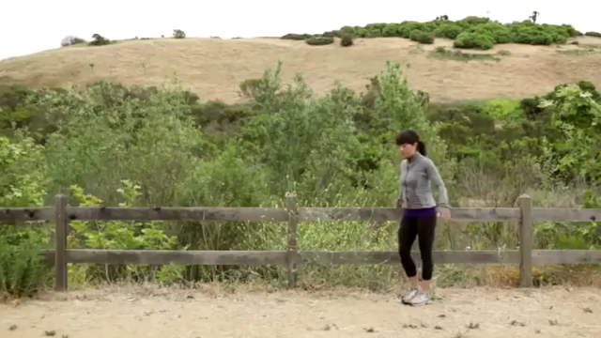
Why do we need intercultural competence?

Slide 8
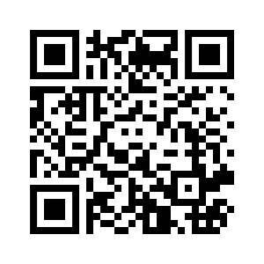
Why do we need intercultural competence?
https://www.youtube.com/watch?v=b80TzSIbK5Y&vl=de

Slide 9
2. THEORETICAL BACKGROUND
INTRODUCTION TO CULTURE AND DIVERSITY
Important concepts and definitions

Slide 10
Intercultural competence
Sensitivity towards and openess for cultural diversity
Awareness of one‘s own cultural situatedness and images of others
Sensitivity for influences of asymmetry of power as regards social class, gender, ethnicity
Sensitivity for collective experiences of groups as regards social class, gender ethnicity.
Sensitivity for the personal meaning a persons develops for experienced cultures, languages, religions and experiences of discrimination.
Auernheimer, G. (2016). Einführung in die interkulturelle Pädagogik (8. Auflage.) Wiesbaden: Springer VS, pp. e.g. 118.

Slide 11
Intercultural communication
Is influenced by different cultural structures, e.g. in respect to politeness and tabus (facial expression, gestures, eye contact, intonation, distance, communication structure (change of speaker, how to start a discussion)
Often asymmetry of power: One person knows better about communication habits in this specific culture and maybe the language and can frame the communication.
Is influenced by biographical and collective experiences of the group
Auernheimer, G. (2016). Einführung in die interkulturelle Pädagogik (8. Auflage.) Wiesbaden: Springer VS, pp. e.g. 110.

Slide 12
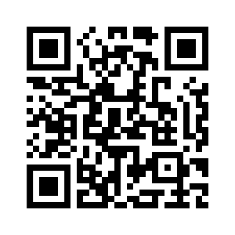
What is culture?
https://www.youtube.com/watch?v=jt2tikGSu98

Slide 13

Activity 2.1: What is culture?
Work in Groups:
Write down your own definition of culture and cultural identity.
How is cultural identity formed?
What are important aspects of your cultural identity?

Slide 14

Activity 2.2 : Culture and Cultural identity
Work in Groups:
Read the two definitions in the handout and summarize important aspects of culture and cultural identity.
Compare the summary with your own definition. What are the differences?
Afterwards we will briefly discuss your definitions.

Slide 15


Activity 2.3: Diversity
Human beings are different
Not only as regards their cultural background, but also as regards for example their age, their gender …
An important concept which takes these aspects into account is the concept of diversity.
Work in pairs. Read explanations on diversity in the handout.
Which aspects of diversity are particularly important for science and mathematics education and why?
Afterwards: Brief discussion

Slide 16
3. Connecting intercultural learning to science and mathematics education
INTRODUCTION TO CULTURE AND DIVERSITY

Slide 17
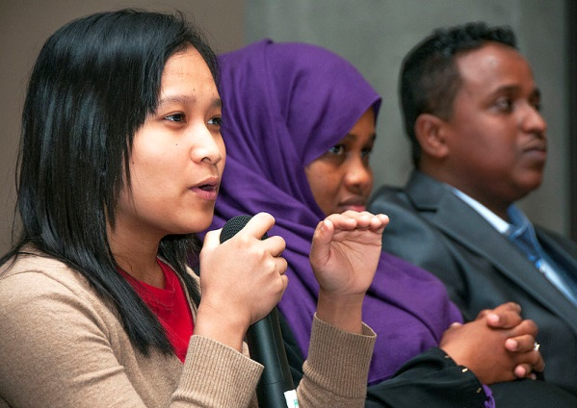

Activity 3.1: Science and mathematics in different cultures
To what extend does scientific knowledge depend on the the cultural context?
To what extend can indigenous peoples knowledge e.g. in Canada, Australia or the US contribute to science?
What are the contributions of Arabs to the development of mathematics and science?
Discuss in groups and write down the results of your discussion!
+
Picture taken from Wikimedia Commons: File:Diversity (10314223086).jpg

Slide 18

Activity 3.2 - Homework
Read the following texts and search for more information:
Medin, Douglas, Lee, Carol D. & Bang, Megan (2014): Point of View Affects How Science Is Done https://www.scientificamerican.com/article/point-of-view-affects-how-science-is-done/
Beg, Muhammad Abdul Jabbar: The Origins of Islamic Science. http://www.muslimheritage.com/article/origins-islamic-science (focus on the chapters 2.4 and 3.2)
Snively, Gloria & Corsiglia, John (2001). Discovering Indigenous Science: Implications for Science Education. Science Education, 85 (1), pp.6-34. (see below, Reading for activity 3.1 “Indigenous science”)
Search for „History of mathematics“ and „History of science“ in the internet.

Slide 19
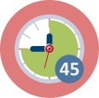
Activity 3.2 Homework
Task 1
Work in groups. Develop a slide presentations which provides answers to the following questions:
To what extend does scientific knowledge depend on the the cultural context?
To what extend can indigenous peoples knowledge e.g. in Canada, Australia or the US contribute to science?
What are the contributions of Arabs to the development of mathematics and science?
Task 2
Read the texts about intercultural pedagogy and multi-cultural education and combine this knowledge with your knowledge on science in different cultures.
What implications arise for a science and mathematics education?

Slide 20
Activity 3.2: Presentation of results in the next seminar
Presentations of the results of students homework in the following seminar and discussion

Slide 21
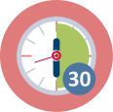
Activity 3.3: Examples of intercultural issues in science and maths education
Work in groups. Work through the examples 1 – 5 as outlined below the examples.
What conclusions do you draw for a science and mathematics education which (see definitions of intercultural pedagogy and multi-perspective education) …
  Supports all students in learning science and mathematics independently of the cultural background
  Promotes competence for intercultural understanding & intercultural dialogue
  Respects human dignity and recognizes (cultural) diversity & awareness for inequity
  Takes a multiperspective approach to science and mathematics?
Based on your discussion set up a list of important principles for intercultural science and mathematics education. We will discuss this afterwards.

Slide 22
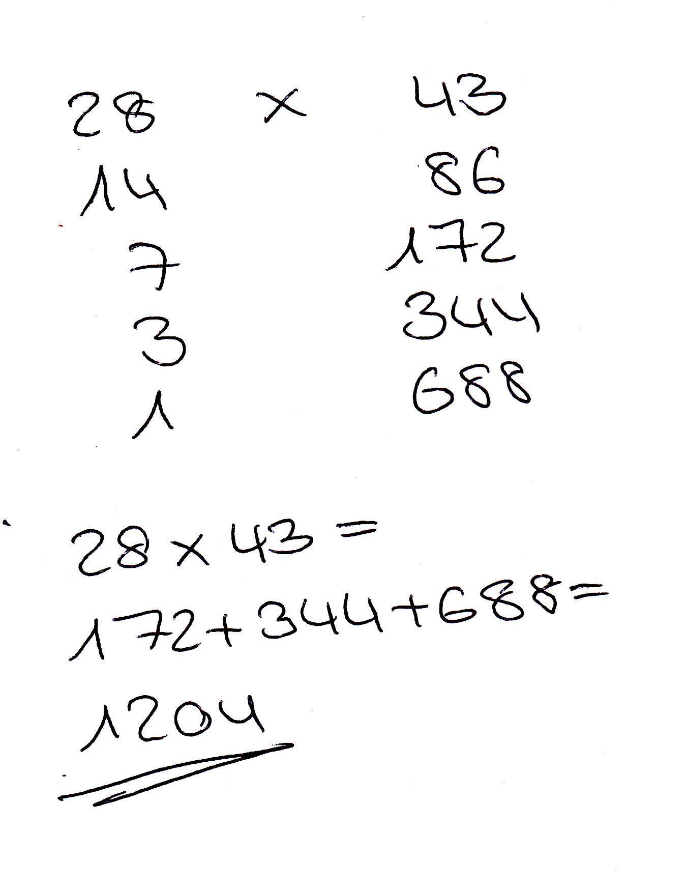
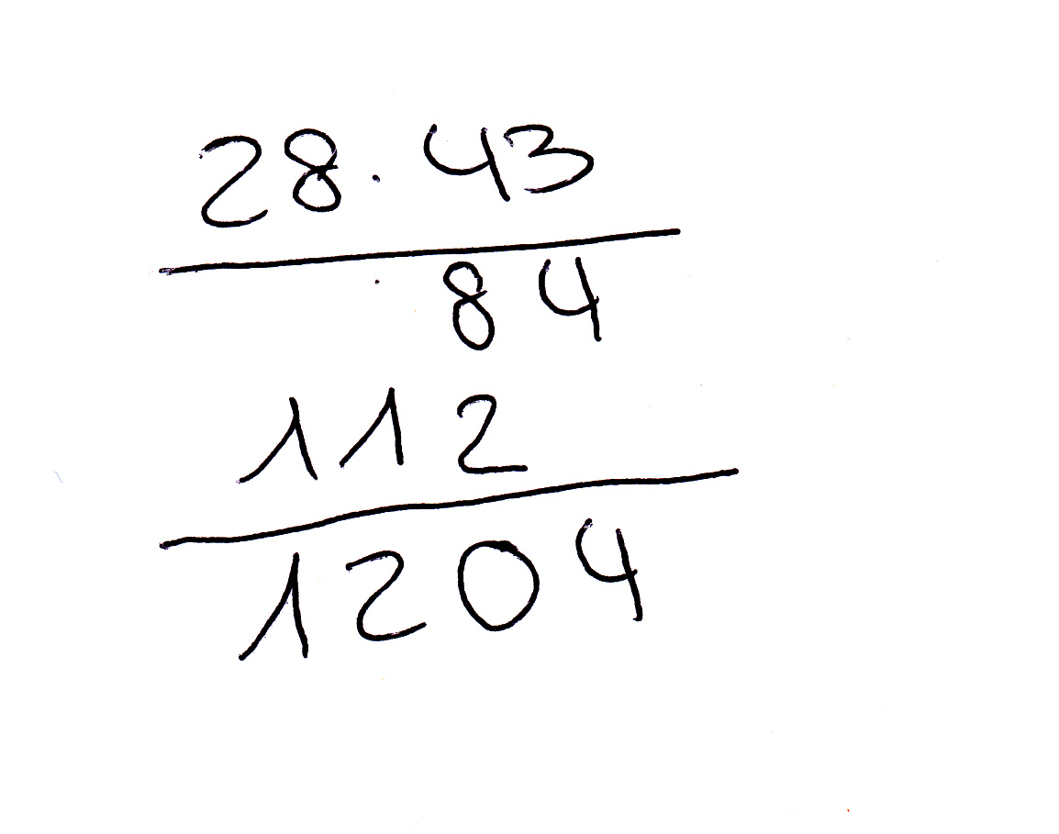
Examples of intercultural issues in science and maths education - Example 1
Compare the two multiplication algorithms and explain them.

Slide 23
Examples of intercultural issues in science and maths education – Example 2
Regarde ces trois objets.
Quel objet ne fait pas partie de deux autres?
Definis le characteristiques qui les deux ont ensemble et le troisieme n’a pas.
Selectionne un autre object et encore une fois donne des raison pourquoi il ne fait pas partie de deux autres.
Résous le problème en francais.
Reflection: How did you feel when trying to solve the problem in French?

Slide 24
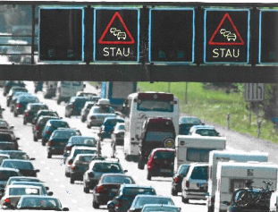
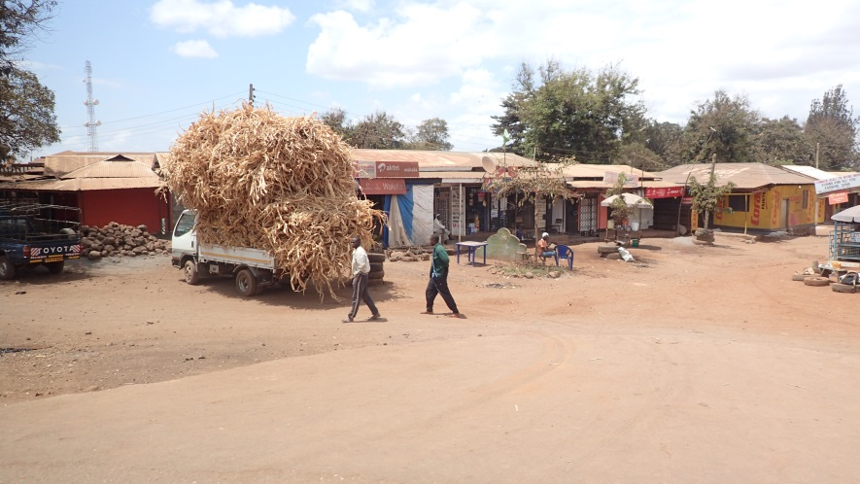
Examples of intercultural issues in science and maths education – Example 3
Anika wants to go on summer holiday with her parents. It is quite hot outside. Unfortunately, they have been stuck in a traffic jam for hours.
The radio informs Anika that the traffic jam has a length of 20 km.
Anika is thirsty, but at a certain point somebody from the red cross turns up and brings water for all the persons in the traffic jam.
For how many persons the red cross needs to provide water in a traffic jam of such a length?
What difficulties might a student from Tansania have with the task?

Slide 25
Examples of intercultural issues in science and maths education – Example 4
1 Osprey
Biology:
Why might this ecological pyramid be challenging for students from certain regions in Africa?
10 Northern Pike
100 Perch
1000 Bleak
10,000 Freshwater shrimp

Slide 26
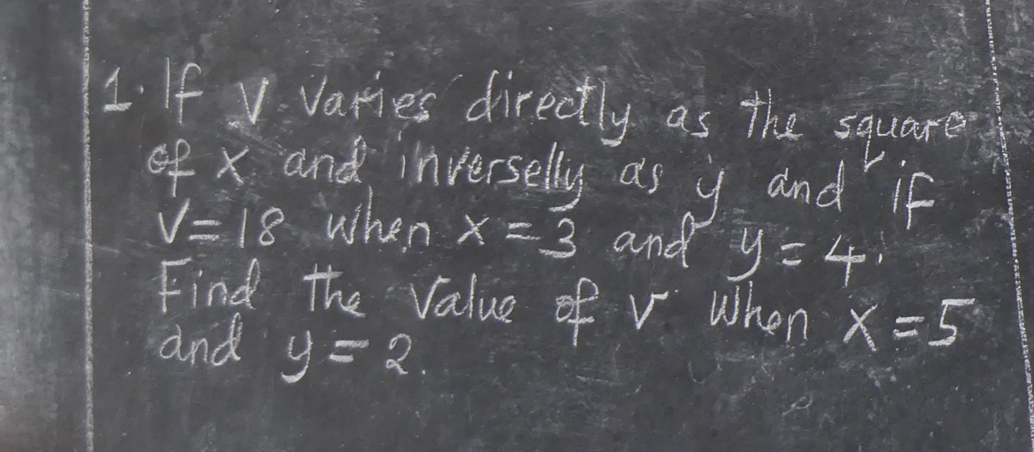
Examples of intercultural issues in science and maths education – Example 5
Mathematical task from Tanzania, class with students age 14.
Solve the task in your way.

Slide 27
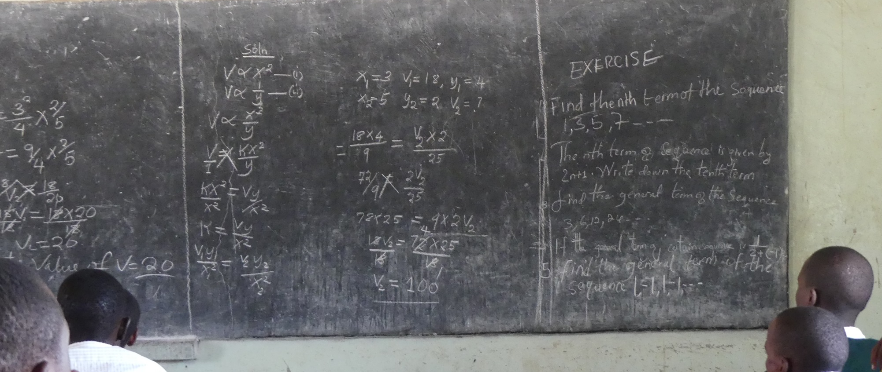
Examples of intercultural issues in science and maths education – Example 5
How did the class in Tanzania solve the task?

Slide 28
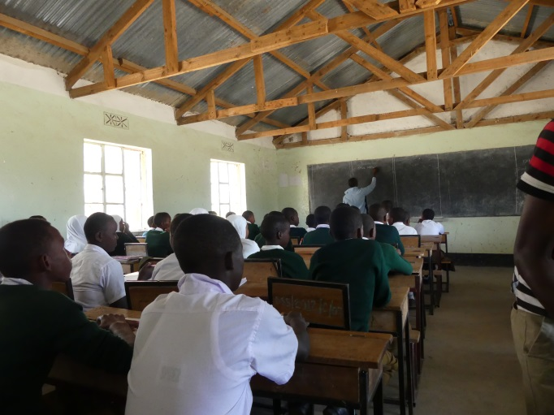
Activity 3.4 : Comparing curricula - Homework
Compare the mathematics curriculum for students in grade 1 and 2 in Tanzania with the curriculum in your country (or chose another country for comparison).
For the Tanzanian curriculum see here: https://www.futureschool.com/tanzania-curriculum/#552dfa3ac3582
Work in pairs.
What differences can you identify?
What consequences for your mathematics and science education arise?
30 min
+
10 min

Slide 29
4. OUTLOOK ON THE NEXT MODULES
Summary of prior discussions

Slide 30
Intercultural science and mathematics education means dealing with …
Different algorithms and reasoning students use (Module 3)
  Accepting different proceedings of students
  Using tasks which allow for different approaches (see examples 3 & 4)
  Using different algorithms as a learning opportunity for all by comparing them and asking students why they work
Language issues (Modules 8 & 9)
  Acknowledging the enormous difficulties students have when trying to learn mathematics and science in a foreign language
  Taking measures to support these students

Slide 31
Intercultural science and mathematics education means dealing with …
Different cultural backgrounds from students (Modules 2,4 & 5)
  Ensure that every body understands the context of the task (by using pictures, discussing the context etc.)
  Using the different contexts as a learning opportunity of all by discussing them.
  Taking into account students different understanding of science and its relation to religion and society by using a variety of contexts from different countries and discussing implications science has on society in different cultures.
  Acknowledging the impact different cultures have on the history of science and mathematics and not only present Western scientists.

Slide 32
Intercultural science and mathematics education means dealing with …
An enormous heterogeneity (Modules 6, 7, 10, 11 & 12)
  As curricular in the different countries are different and students might not have visited school for a long time, this means dealing with deficiencies and excellency of immigrant students:
  Using open tasks which allow for different solution strategies and different levels of dealing with the tasks (e.g. traffic jam task or „Odd one out“ (Task in French)
  Using methods which allow for individualised approaches of students (group work, think-pair-share, working in pairs etc.)
  Assessing students competencies and their learning to provide targeted and individualised support
  Include out-of-school learning activities to provide first-hand learning

Slide 33
Overview of Modules
  Introduction to culture and diversity for prospective mathematics and science teachers
  Culture-related contexts for mathematics and science
  Different cultures – different approaches to reasoning and algorithms in mathematics
  Socio-scientific issues (SSI)
  Different perspectives on current ecological problems
  Pedagogical approaches to mathematics and science teaching in diverse classrooms
  Dealing with deficiencies and excellency in the mathematics proficiency of immigrant pupils
  Relevance of language in mathematics education
  Relevance of language in science education
  Intercultural mathematics learning outside of school
  Intercultural science learning outside of school
  Assessment in mathematics and science in multicultural contexts
  Accompanying prospective teachers in making intercultural experiences

Slide 34
Dimensions of intercultural learning of a teacher
Personal dimension (Module 1 & 13)
  affecting values, attitudes and intercultural competences of prospective teachers;
Mathematics and Science SUBJECT dimension (Module 2 – 5)
  concerning (inter)cultural perspectives on the subjects themselves;
Mathematics and Science EDUCATION dimension (Module 6 – 12)
  which encompasses pedagogical approaches and practices for dealing with diversity in classrooms.

Slide 35
Links to the Films
https://www.youtube.com/watch?v=XUO59Emi3eo
https://www.youtube.com/watch?v=b80TzSIbK5Y
https://www.youtube.com/watch?v=jt2tikGSu98#t=280.559905

Slide 36

This presentation is based on the work within the project Intercultural learning in mathematics and science initial teacher education (IncluSMe). Coordination: Prof. Dr. Katja Maaß, International Centre for STEM Education (ICSE) at the University of Education Freiburg, Germany. Partners: University of Nicosia, Cyprus; University of Hradec Králové, Czech Republic; University of Jaen, Spain; National and Kapodistrian University of Athens, Greece; Vilnius University, Lithuania; University of Malta, Malta; Utrecht University, Netherlands; Norwegian University of Science and Technology, Norway; Jönköping University, Sweden; Constantine the Philosopher University, Slovakia.
The project Intercultural learning in mathematics and science initial teacher education (IncluSMe) has received co-funding by the Erasmus+ programme of the European Union under grant no. 2016-1-DE01-KA203-002910. Neither the European Union/European Commission nor the project's national funding agency DAAD are responsible for the content or liable for any losses or damage resulting of the use of these resources.
IncluSMe project (grant no. 2016-1-DE01-KA203-002910) 2016-2019, lead contributions by International Centre for STEM Education (ICSE) at the University of Education Freiburg, Germany.
CC-BY-NC-SA 4.0 license granted (find explicit terms of use at: https://creativecommons.org/licenses/by-nc-sa/4.0/deed.en)

