Slide 1
CULTURE-RELATED CONTEXTS FOR MATH AND SCIENCE
Initial teacher education of prospective mathematics and science teachers

Slide 2
Overview

Slide 3
Structure of the module
Three sessions of 60-90 minutes each
Introduction and background
Group introduction
Example and theoretical background on culture
Culture-related contexts
Studying examples
Theoretical background on culture-related contexts
Connecting to practice
Analysing textbooks
Design a lesson/activity with a context related to culture
(optional) Presentations and discussion of the lessons
Homework (optional) in between sessions

Slide 4
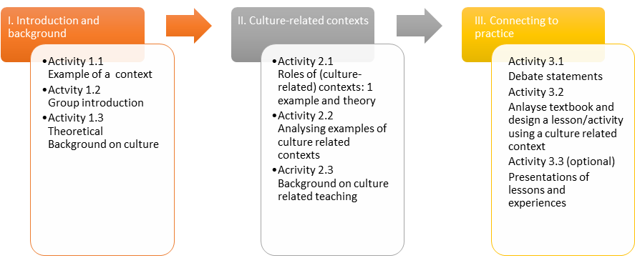

Slide 5
Aims
Introduction into the use of (culture-related) contexts for STEM
by studying concrete examples
by reflecting on theory
by discussing sources
Connection to your educational practices
by analysing textbooks
by talking to STEM colleagues and students
by designing (and trying out) a lesson/activity

Slide 6
I. Introduction
1.1 an example

Slide 7
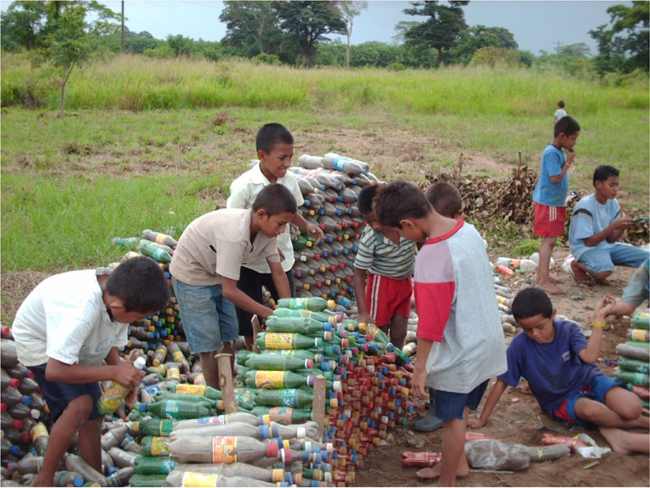
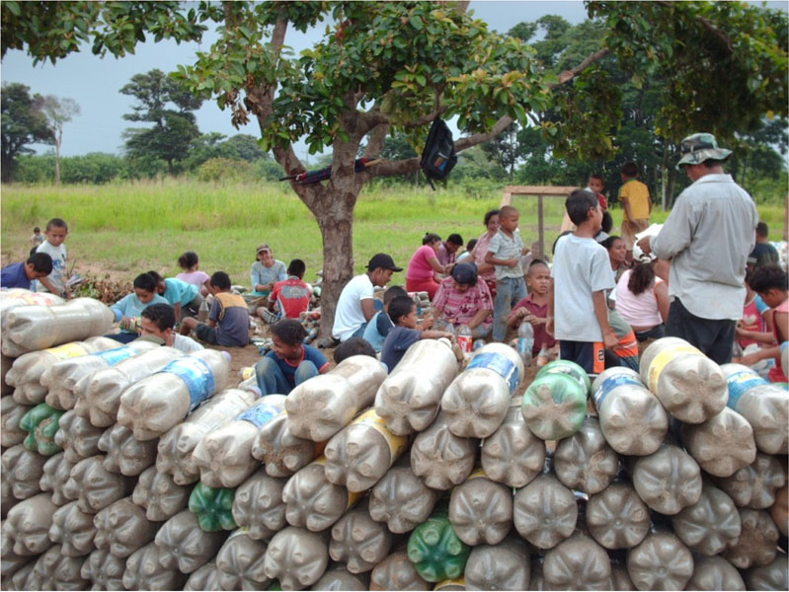
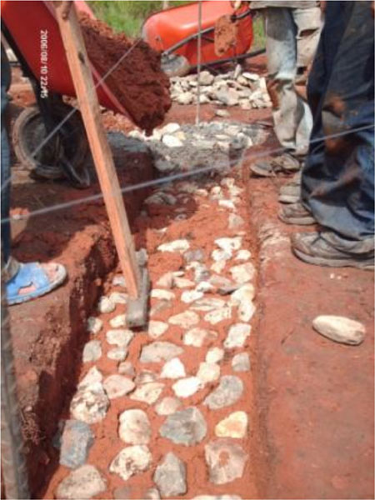
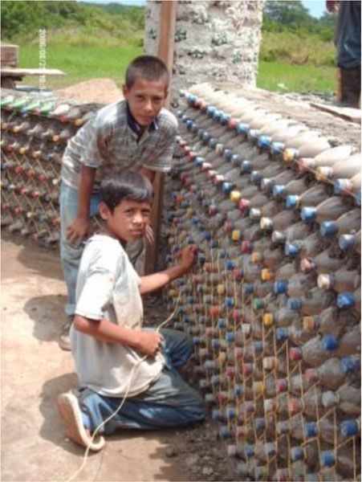
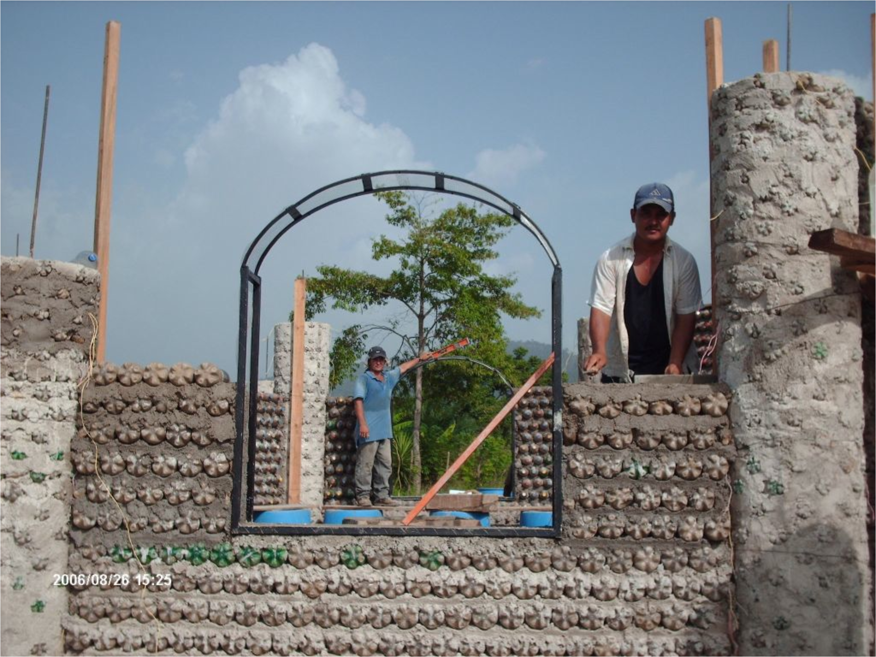
Activity 1.1 – see also worksheet 1
Source: https://www.primas.mathshell.org/pd/modules/1_Student_led_inquiry/html/index.htm

Slide 8
Activity 1.1 – see worksheet
Study the example and discuss the things you notice. Use these questions:
Do you see this as an example of a culture-related context? why?
Which topics, concepts or problems from mathematics or science relate to this context?
For whom (which students in your class) can this context be of interest: Why do you think so?

Slide 9
Activity 1.1 – wrapping up
Report outcomes from the discussion about the example building with bottles in Honduras‘
In what ways is it culture related?
Which STEM content can be related?
For whom (students) is this of interest?
What are your own experiences with the use of (culture-related) contexts in your teaching?

Slide 10
I. Introduction
1.2 Cultural subgroups

Slide 11
Activity 1.2 - Group introduction: cultural subgroups
“Divide this group into four groups that are culturally different.”
Write down (for each subgroup):
How you define your subgroup with respect to culture
Who are members of this group and why
Any limitations you experienced when forming the subgroup
Switch?

Slide 12
I. Introduction
1.3 Theoretical background on culture

Slide 13
Activity 1.3 – theoretical background
“What is culture according to you?”
Read text 1 on worksheet 1.3 and discuss the questions.
Would you answer this question differently after reading the text?
“What is culture according to you?”

Slide 14
II. Culture-related contexts
2.1 Roles of (culture-related) contexts

Slide 15
Remember activity 1.1?
Source: https://www.primas.mathshell.org/pd/modules/1_Student_led_inquiry/html/index.htm

Slide 16
Activity 2.1 – theoretical background on roles of contexts
Read text 2 on worksheet 2.1 and discuss the questions.

Slide 17
II. Culture-related contexts
2.2 Study examples of culture-related contexts

Slide 18
Activity 2.2 – Examples – see worksheets
Study 2-4 of the 8 examples on the worksheet and discuss them considering …..
Relation to STEM-subject, -content or – concepts
Possibilities for intercultural teaching/learning
Connection to the ALL students’ interests and backgrounds (personal cultures)
Practical issues to deal with when using each context
Also discuss:
Is the example meaningful to you? does it relate to your personal culture?

Slide 19
Poster-session
For one of the examples as a small group present your findings on a poster
Study all posters and note similarities and differences

Slide 20
Discussion – whole group
What did you learn:
“What was a real eye-opener for you during this session?”
Did this activity help you to become:
more aware of your own culture?
more respectful to the (personal) cultures of others?
more aware of cultural aspects related to mathematics and science?

Slide 21
Discussion – continued – preparing for activity 3.1
What would be the most important reason for you to use culture-related contexts? How does this reason relate to the theory (and your beliefs) about culture and contexts?
What in your opinion are the 3 most important characteristics of a good culture-related contexts for your teaching?

Slide 22
II. Culture-related contexts
2.3 Back to the theoretical background

Slide 23
Activity 2.3 – Back to the theoretical background
In a small group
Read 1 or 2 of the texts on worksheet 2.3.
Formulate a statement based on these texts that relates to contexts and/or culture (hand in on ppt slide at the end of the session).
Whole group debate (next session)
Present your statement in max 1. minute

Slide 24
Homework - optional
Find out at your school
how your STEM-colleagues think and feel about 'culture' and 'contexts' in their STEM-teaching
what the personal cultures of (some of your) students are.

Slide 25
III. Connecting to practice
3.1 Debate on statements

Slide 26
Activity 2.3 – Back to the theoretical background
Whole group debate
Present your statement in max 1. minute
Everybody takes position in favour of or against the statement
Some people are asked to clarify their position

Slide 27
III. Connecting to practice
3.2 Analyse textbooks and design a lesson/activity

Slide 28
Activity 3.2 – in small single-subject groups
Part A: Analyse textbooks – see worksheet
Does you textbook include (culture-related) contexts?
What is the role of these contexts?
Does your textbook present opportunities to relate to culture in general and your students (personla) culture(s)?

Slide 29
Activity 2.2 – in small single-subject groups
Part B – see worksheet
In your small group prepare a lesson or a teaching activity for your subject using a context and addressing culture in some way. For example by:
using one or more culture-related context(s)
connecting to your students (personal) cultures
making your students become aware of cultural aspects connected to mathematics and science.

Slide 30
Activity 2.2 – in small single-subject groups
Part B – Homework - see worksheet for details
Further prepare and design the teaching activity and plan how to use it in a lesson.
If possible: Try-out this activity with your students and ask them for feedback.
Fill in the lesson evaluation form (see worksheet).
For the next session. Prepare a 5 minute presentation

Slide 31
III. Connecting to practice
3.3 presenting your lesson

Slide 32
Activity 3.3 – Presenting the lesson
Focus on:
WHY you choose this specific context, also in relation to the content of the activity/lesson;
HOW you address cultural aspects and connect to their students (personal) culture(s) especially in a diverse classroom;
WHAT you learned from the try-out with students.

Slide 33
Evaluation and next steps
What conclusions do you draw about the use of culture-related contexts (or an intercultural approach to contexts) in science and mathematics education?
How will you use what you learned in this module in your teaching practice?

Slide 34
This presentation is based on the work within the project Intercultural learning in mathematics and science in initial teacher education (IncluSMe). Coordination: Prof. Dr. Katja Maaß, International Centre for STEM Education (ICSE) at the University of Education Freiburg, Germany. Partners: University of Nicosia, Cyprus; University of Hradec Králové, Czech Republic; University of Jaen, Spain; National and Kapodistrian University of Athens, Greece; Vilnius University, Lithuania; University of Malta, Malta; Utrecht University, Netherlands; Norwegian University of Science and Technology, Norway; Jönköping University, Sweden; Constantine the Philosopher University, Slovakia.
The project Intercultural learning in mathematics and science initial teacher education (IncluSMe) has received co-funding by the Erasmus+ programme of the European Union under grant no. 2016-1-DE01-KA203-002910. Neither the European Union/European Commission nor the project's national funding agency DAAD are responsible for the content or liable for any losses or damage resulting of the use of these resources.
IncluSMe project (grant no. 2016-1-DE01-KA203-002910) 2016-2019, lead contributions by Boerée-Kamphorst, C., Jonker, V., & Wijers, M. Utrecht University The Netherlands.
CC-BY-NC-SA 4.0 license granted (find explicit terms of use at: https://creativecommons.org/licenses/by-nc-sa/4.0/deed.en)

