Slide 1
SOCIO-SCIENTIFIC ISSUES
Initial teacher education of prospective mathematics and science teachers

Slide 2
Background activity: Knowing each other
Generating an appropriate atmosphere
Talk in pairs
Who I am (name, origin, age)
Two activities I enjoy doing alone are…
Two activities I enjoy doing with others are…
My favorite food is…
My favorite feast is…
I am good at…
A nice memory to share is…
In my near future I would like to…
Introduce your partner to the rest of the group

Slide 3
Task I: Experiencing SSI as reflective learners
1.1 Introduction
1.2 Immersion task
1.3 Reconsidering positions after inquiry
1.4 Active listening
1.5 Reflecting on learning

Slide 4
Module overview
Generating an atmosphere of respect and mutual appreciation:
Background activity: Knowing each other (20 min).
Task I
Teachers as learners
Task II
Teachers as designers
Task III
Teachers as reflective practitioners
Experiencing SSI as reflective learners
5 activities; 120 min
Designing SSI as teachers
5 activities; 120 min
Discussing and improving SSI as reflective practitioners
2 activities; 60 min
Introduction (10 min)
Engaging students (20 min)
Assessment (10 min)
Presenting and discussing (30 min)
Mapping controversy and preparing scaffolding (60 min)
Improving the design according to quality criteria and feedback (30 min)
Immersion (20 min)
Reconsidering position after inquiry (60 min)
Mapping curriculum (20 min)
Reflecting on what could be learn from this activity (10 min)
Encouraging action taking (10 min)
Promoting active listening and empathy (20 min)

Slide 5
I.1. Introduction
What is culture?
Beliefs, symbols, meanings, customs, and behaviours shared by a social group.
Not always equivalent to language boundaries or national borders.
A complex society exists of partial cultures that are not static but change over time and influence each other.
(OECD, 2010).

Slide 6
I.1. Introduction
Culture’s influence on learning
Impact on the interpretation of the world and the construction of meanings.
Impact on individuals’ values and dispositions towards a particular theme or topic.
Need to:
Identify different cultural meanings and perspectives
Promote an atmosphere of respect and acceptance of cultural differences.
SSI provides powerful scenarios for the constructive exploration of differences perspectives.

Slide 7
I.1. Introduction
What are Socio-Scientific Issues (SSI)
Socio-Scientific Issues are related to science and technology in nowadays societies and usually entail controversy due to the social, ethical and environmental implication of some scientific and technological advances.

Slide 8
1.1 Introduction
Why are SSI interesting?
They have the potential to:
Trigger students’ engagement with the topic and the need to express opinions, thus enhancing communication and learning.
Provide powerful opportunities to develop a better understanding of science and its applications and implications.

Slide 9
1.1 Introduction
Why are SSI interesting?
They have the potential to:
Bring a pedagogical approach based on argumentation and the consideration of diverse perspectives (scientific, social, ethical, moral, cultural, economical, environmental).
Promote argumentation skills and critical thinking.
Require a classroom atmosphere of democratic deliberation and respect, which is of special value in culturally diverse classrooms

Slide 10
1.2 Immersion
Write down your arguments:
Are you in favour of genetically modified food?
Would you support the creation of a nuclear power plant in your neighbourhood?
Are you in favour of genetic testing?
Would you ban coke sales to under-18s?
Position yourself along the line and negotiate with others:
Totally disagree-----------Disagree-----------Agree----------Totally agree
Identify the position of your argument and reflect.

Slide 11
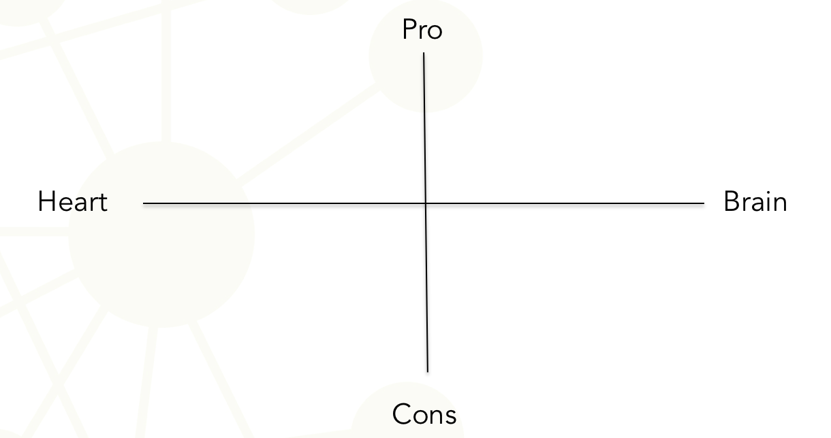
1.2 Immersion
Identify the position of your argument and reflect

Slide 12
1.3 Reconsidering previous position after inquiring
Getting a deeper understanding on the selected SSI
Search for different arguments: scientific, economical, environmental, ethical, health…
Critically analyse the reliability of information and potential bias
Evaluate implications at different levels: individual/social/global
In the light of the inquiry revise the arguments offered in the previous activities and classify them

Slide 13
I.3 Reconsidering previous position after inquiring
In the light of the inquiry revise the arguments offered in the previous activities and classify them as:
Superficial (with no evidence-based claims).
Subjective (drawing on personal funds of Knowledge: personal experiences or beliefs…).
Objective (based on academic/scientific evidence).
Authentic (combining subjective and objective evidence).

Slide 14
1.4 Active listening
Prepare arguments to support the position of the group you have been assigned to and present them to the opposite group in 3 min.
The opposite group will listen to you and represent your case even more strongly back, if possible.
Reverse the positions.
Discuss the differences between the two opposing group.s

Slide 15
1.5 Reflecting on what can be learnt
Could SSI be engaging and motivating to your students?
Could SSI encourage communication, discussion and the exchange of different perspectives in the classroom?
Could SSI scenarios allows understanding of interactions between science, technology, culture and society?

Slide 16
1.5 Reflecting on what can be learnt
Write down and discuss in small groups what you have learned through inquiring, reflecting and arguing in the previous activities in terms of:
Knowledge and information (about the foundation and implications of scientific and technological products…).
Skills (search for, critical selection and analysis of information, evaluation of the quality of evidence, argumentation, discussion…).
Values and dispositions (openness to take into account different perspectives, critical stance to evaluate evidence and fund…).

Slide 17
Task II: Designing SSI as teachers
2.1 Engaging students
2.2 Mapping the controversy and scaffolding
2.3 Encouraging action taking
2.4 Mapping curriculum
2.5 Assessment

Slide 18
2.1 Engaging students
Using media to introduce SSI in an engaging way:
Have a look at the media and think of recent news and events related to current socio-scientific issues.
Search for a topic which could be relevant for your future students. The topic or SSI will be perceived as relevant if it is well connected to your students’ needs and interests.
Use media (videos, news, advertisements…) to introduce the selected SSI in a catching way.

Slide 19
2.2 Mapping the controversy and scaffolding
Inquiry into the selected SSI and identify key aspect to learn about. Special emphasis should be placed on:
The identification of different types of arguments: scientific, social, ethical, economical, environmental…).
The evaluation of contrasting points of views considering benefits versus risks and implications at different levels (individually/locally/globally).
The critical examination of bias and reliability concerning the sources of information.
Advance possible students’ difficulties and prepare guiding questions.

Slide 20
2.3 Encouraging action taking
Think of potential ways to encourage students to take consequent actions after inquiring on a particular SSI.
Empower students to make a relevant contribution to their own lives/communities
Think about the action to be undertaken by your future students (a plan for improvement, a video clip/leaflet to disseminate key information, a letter to an organisation….).

Slide 21
2.4 Mapping curriculum
Reflect on what students’ could learn by working on the selected SSI.
Identify connections with the school curricula in terms of:
Content knowledge.
Competences and skills.
Values and dispositions.

Slide 22
2.5 Defining assessment criteria
Discuss how you would assess the learning outcomes defined in the previous activity and set consistent assessment criteria and processes.

Slide 23
Task III: Discussing and improving activities as reflective practitioners
3.1 Presenting your SSI-based educational intervention
3.2 Improving the design according to quality criteria

Slide 24
3.1 Presenting your SSI-based educational intervention
Present the classroom activities designed in Task 2 to the rest of the classroom in order to share and discuss them.

Slide 25
3.2 Improving the design according to quality criteria
Your small group will be provided with quality criteria to critically evaluate the design of SSI-based classroom activities (see table 1).
Use table 1 for self and peer evaluation and as basis for guiding the improvement of the designed classroom activities

Slide 26
Table 1: Quality criteria for the designed of SSI-base classroom activities

Slide 27
This presentation is based on the work within the project Intercultural learning in mathematics and science initial teacher education (IncluSMe). Coordination: Prof. Dr. Katja Maaß, International Centre for STEM Education (ICSE) at the University of Education Freiburg, Germany. Partners: University of Nicosia, Cyprus; University of Hradec Králové, Czech Republic; University of Jaen, Spain; National and Kapodistrian University of Athens, Greece; Vilnius University, Lithuania; University of Malta, Malta; Utrecht University, Netherlands; Norwegian University of Science and Technology, Norway; Jönköping University, Sweden; Constantine the Philosopher University, Slovakia.
The project Intercultural learning in mathematics and science initial teacher education (IncluSMe) has received co-funding by the Erasmus+ programme of the European Union under grant no. 2016-1-DE01-KA203-002910. Neither the European Union/European Commission nor the project's national funding agency DAAD are responsible for the content or liable for any losses or damage resulting of the use of these resources.
IncluSMe project (grant no. 2016-1-DE01-KA203-002910) 2016-2019, lead contributions by Romero-Ariza, M., Quesada, A. & Abril, A. M. University of Jaén, Jaén, Spain.
CC-BY-NC-SA 4.0 license granted (find explicit terms of use at:
https://creativecommons.org/licenses/by-nc-sa/4.0/deed.en)

