Slide 1
DIFFERENT PERSPECTIVES ON CURRENT ECOLOGICAL PROBLEMS
Initial teacher education of prospective mathematics and science teachers

Slide 2
The WATER
ONE CONCRETE EXAMPLE CONCERNING INTERCULTURAL ASPECTS OF ECOLOGICAL PROBLEMS

Slide 3
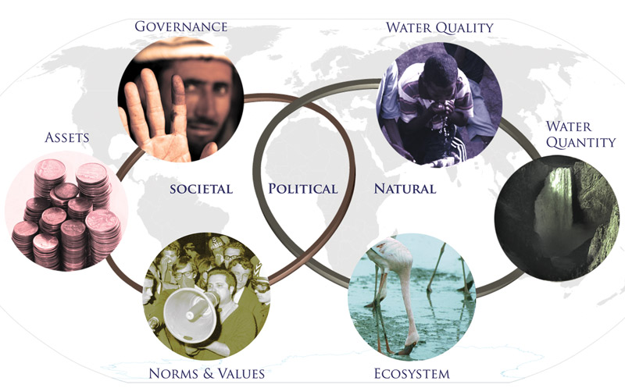
The Water in (inter)cultural perspectives on the mathematics and science subjects themselves
Spirituality – Rarity – Utility – Necessity - Insufficiency

Slide 4
Structure of the module
Three sessions (270 – 360 min + 90 min homework)
Introduction (90 min)
Two activities á 45 min
Immersion (60 – 90 min + 90 min homework)
Three activities á 30 min (+ 90 min homework)
Can be elected only two activities á 30 or 45 min (+ 90 min homework)
Application (120 – 180 min)
Three activities á 30 min (can be elected one activity)
One experimental activity 90 min

Slide 5
Types of Activities
Working with information sources
Brainstorming and brain writing activities
Story telling as support of intercultural communication
Experimental activities as evidence based (science) communication

Slide 6
Learning Outcomes
To create a safe classroom atmosphere supporting communication and argumentation.
To recognize one of the current ecological topic in different natural, social and cultural contexts.
To get familiar with teaching methods which have potential to connect ecological topics to intercultural learning.
To support of creative thinking without prejudice to different cultures.
To connect science and art in learning about global ecological problems.
To create ability to search relevant data from open access media.
To approach from complex point of view to problem solving.
To use science literacy for understanding of diversity.

Slide 7
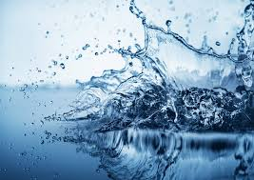
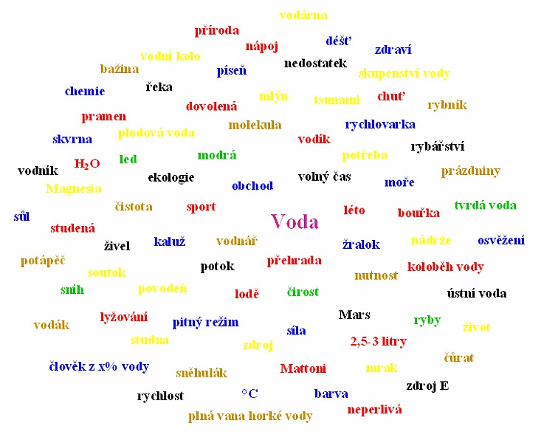
Structure of session I. – Introduction
Activity 1.1 Ambience evocation
„Warm up“ activity
„Free writing“ about different water phenomena
Activity 1.2 Mapping the field of interest
Brainstorming activity about phenomena „water“
Clustering and concept mapping

Slide 8
Structure of session II. – Immersion
Activity 2.1 Water as multi contexts phenomenon
Contexts related to water: natural-microscopic, natural-macroscopic, economic, political, cultural and mysterious
Application of „snow-ball“ method, using of „water-cards“

Slide 9
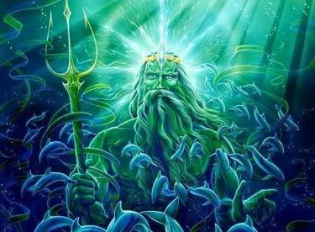
Structure of session II. – Immersion
Activity 2.2 Water in legends and myths
Water as “main element” of legends and myths
Connection with homework

Slide 10
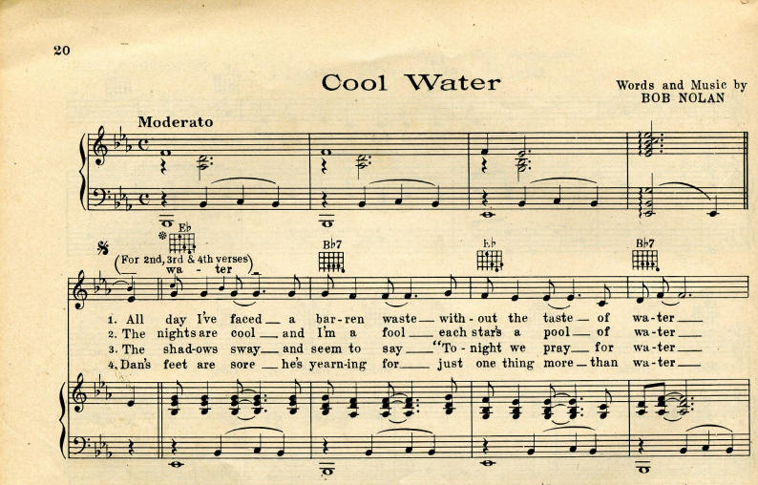
Structure of session II. – Immersion
Activity 2.3 “Singing water” or water in songs
Identification of natural (science elements) and social (cultural elements) and ecological (global ecological elements) contexts of the song (text and melody)

Slide 11
Structure of session III. – Application
Activity 3.1 Water in numbers
Analysing of different „numbers“ about water, „water footprints“
Activity 3.2 Water storage and transportation
water storage (water dams and tanks, water supply etc.) and water transportation (channels, pipelines, aqueducts, water mills etc.)
Activity 3.3 Drinking water in different contexts
cleaning water for drinking (mechanical, physical, chemical and biological ways)
drinking water in history and nowadays and in future

Slide 12
Structure of session III. – Application
Activity 3.4 Water in simple experiments
To propose, to realise and to interpret experiments with water
Water as not simple and extraordinary chemical compound (water surface, water density, water as solution, water paradoxes – density/temperature, coherency etc.)
Water as one of the ancient elements (water place on quadrants with fire, air and earth)
Water cleaning (separation methods like filtration, crystallization; making of sand filter etc.)
Water as power (experiments with turbines, water pumps, water conservation etc.)

Slide 13
Evaluation and next steps
What conclusions do you draw about the water like one example of environmental problems in culture-related or intercultural contexts (in science and mathematics education)?
How will you use what you learned in this module in your teaching practice?
Could you transfer your experience and knowledge to next examples of environmental problems (energy sources, diversity etc.)?

Slide 14
This presentation is based on the work within the project Intercultural learning in mathematics and science initial teacher education (IncluSMe). Coordination: Prof. Dr. Katja Maaß, International Centre for STEM Education (ICSE) at the University of Education Freiburg, Germany. Partners: University of Nicosia, Cyprus; University of Hradec Králové, Czech Republic; University of Jaen, Spain; National and Kapodistrian University of Athens, Greece; Vilnius University, Lithuania; University of Malta, Malta; Utrecht University, Netherlands; Norwegian University of Science and Technology, Norway; Jönköping University, Sweden; Constantine the Philosopher University, Slovakia.
The project Intercultural learning in mathematics and science initial teacher education (IncluSMe) has received co-funding by the Erasmus+ programme of the European Union under grant no. 2016-1-DE01-KA203-002910. Neither the European Union/European Commission nor the project's national funding agency DAAD are responsible for the content or liable for any losses or damage resulting of the use of these resources.
IncluSMe project (grant no. 2016-1-DE01-KA203-002910) 2016-2019, lead contributions by Bilek, M. & Machkova, V., University of Hradec Kralove, Hradec Kralove, Czech Republic.
CC-BY-NC-SA 4.0 license granted (find explicit terms of use at: https://creativecommons.org/licenses/by-nc-sa/4.0/deed.en)

