Slide 1
PEDAGOGICAL APPROACHES TO MATHEMATICS AND SCIENCE TEACHING IN MULTICULTURAL CLASSROOMS
Initial teacher education of prospective mathematics and science teachers

Slide 2
Aims
This module aims to support prospective teachers to:
  identify critical incidents related to teaching and learning in multilingual and multicultural contexts;
  interpret these incidents on the basis of research findings;
  design relevant teaching interventions;
  develop a reflective view on how teaching can affect the learning outcomes in diverse classrooms.

Slide 3
Structure of the module
I Introducing pedagogical approaches to mathematics and science teaching in multicultural classrooms (60mins + 30mins homework)
II Considering pedagogical approaches to mathematics and science teaching in multicultural classrooms through the lens of research and theory (70mins + 30mins homework)
III Designing mathematics and science teaching for multicultural and multilingual classrooms (70mins + 45mins homework)
IV Reflecting on and synthesizing ideas from the module (45mins +90mins homework)

Slide 4
I. INTRODUCING PEDAGOGICAL APPROACHES TO MATHEMATICS AND SCIENCE TEACHING IN MULTICULTURAL CLASSROOMS

Slide 5



Activity 1.1: Sharing prior teaching experiences in multicultural settings
Discuss in your group briefly on the meaning of the term “multicultural classroom”. Then try to answer the following questions:
    If you haven’t tried teaching in a multicultural classroom, what do you think the challenges are?
    If you have already taught in a multicultural classroom, what challenges have you experienced?
Share some of your experiences in the group and in the whole classroom.

Slide 6



Activity 1.2: Working with empirical data in multicultural settings (1)
We provide 3 episodes concerning mathematics and science teaching in multicultural settings.
Group work
  Discuss in the group what issues related to mathematics and science teaching in multicultural setting you identify in the three episodes.
  Identify what classroom practices are addressed in the three settings and justify their importance.
  Based on your group discussion prepare a short report on two teaching strategies that you would adopt in teaching mathematics and science in multicultural classrooms. Justify your choices and discuss about their potential and limitations. Share these ideas with the whole classroom..

Slide 7



Activity 1.3: Working with empirical data in multicultural settings (2)
Read an extract from the paper of Prediger, Clarkson and Bose (2016)
Consider the following issues and then prepare four slides to report your work in the whole class. Work in groups of three.
  By the way Amir and Ekim talk and write about the problem, what can you suggest about their initial understanding of the phrase “2/3 of all analphabets are women”?
  Identify the different teaching strategies applied by the teacher. Did they end up to be of any assistance to Amir and Ekim? (Excerpt 2)
  Amir and Ekim, even though they were born in Germany, their fluency in academic German was limited. On the contrary, both students were competent in their everyday, interpersonal communication. Can you visualize how the low academic proficiency in German might have affected the students’ participation in school mathematics?

Slide 8
II. CONSIDERING PEDAGOGICAL APPROCHES TO MATHEMATICS ABD SCIENCE TEACHING IN MULTICULTURAL CLASSROOMS THROUGH THE LENS OF RESEARCH AND THEORY

Slide 9
Activity 2.1: Reporting on the activity 1.3
Three groups present their slides from the homework and share their ideas with the other groups

Slide 10

Activity 2.2: Addressing theoretical issues concerning multicultural mathematics teaching
We provide a text on ‘Giving life to mathematical ideas’
Discuss the following issues in your group and then open the discussion to the whole class:
  Give one example following the model depicted in Fig. 2.2 concerning the different forms of representation of a mathematical idea.
  Name the issues that worry you as a prospective teacher of mathematics when looking at the cartoon in Fig. 2.3.
  Discuss about the transitions among the different forms of language depicted in table 1.
  Provide your own examples to demonstrate the difference among the everyday, the school and the mathematical forms of language.

Slide 11
Activity 2.3: Addressing theoretical issues concerning multicultural science teaching
Read an extract from Braaten and Sheth (2017) and produce a text with the main issues (in bullets) addressed in the text relevant to multicultural science teaching.

Slide 12


Activity 2.4: Readings from relevant research literature (Individual homework)
You are given a framework that describes what the teacher needs to take into account when teaching in multicultural and multilingual contexts (Fig. 2.3) and three extracts all taken from research papers.
Read the extracts and identify issues related to the framework concerning classroom practices in multicultural and multilingual contexts.
Write a short text (500 words) describing how you would take into account these issues while teaching in a multicultural and multilingual classroom and prepare two slides to communicate your ideas in the teacher education course.

Slide 13
III. DESIGNING MATHEMATICS AND SCIENCE TEACHING FOR MULTICULTURAL AND MULTILINGUAL CLASSROOMS

Slide 14

Activity 3.1: Reporting on the activity 2.4
  Present your slides from the homework in the class and share ideas with your peers.

Slide 15



Activity 3.2: Observing and analyzing video clips from multicultural and multilingual classrooms
Observe the following video and identify one critical incident related to culturally responsive teaching. On the basis of your prior readings interpret this incident and propose how you would handle the situation. Discuss in the classroom your ideas.
https://www.youtube.com/watch?v=nQCItldgzw0

Slide 16

Activity 3.3: Designing a culturally responsive mathematics teaching
You are given a text about how to design a culturally responsive lesson and examples of culturally responsive tasks (Smile, 1993).
Based on the text and the two suggested tasks work in groups of 2-3 to address: In which ways these tasks can facilitate mathematics learning in a class with students of different cultural and language background; Which classroom practices you could adopt in relation to (a) classroom interaction and communication and (b) the mathematics content at hand in the two tasks.

Slide 17
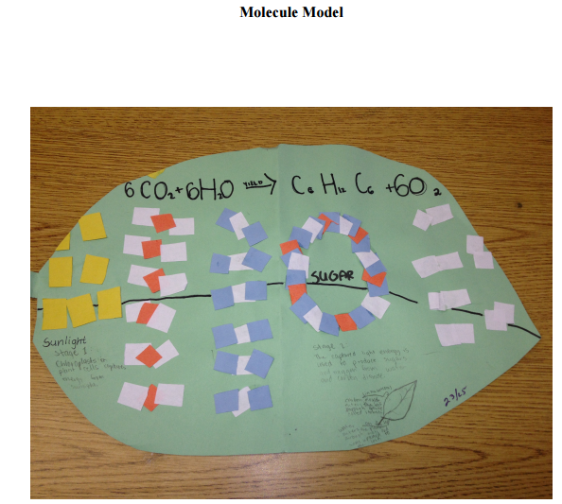
Activity 3.4: Designing a culturally responsive science lesson (Homework in groups)
Work in groups
  Read two teaching examples and think of possible uses of visual representations in teaching and learning in diverse classrooms.
  Specify a thematic unit and design your own scenario.
  Include details of the educational context and produce specific materials for classroom or out of classroom science learning.
  Produce one slide with the description of the educational context, one slide with the thematic unit and your rationale for your choice, two slides with the design of your scenario, and one at least activity/task for the students).

Slide 18
IV. REFLECTING ON AND SYNTHESIZING IDEAS FROM THE MODULE

Slide 19

Activity 4.1: Reflecting on lesson designs
Work in groups and whole class discussions
  Exchange your scenario with another group’s and evaluate each other’s work
  Prepare one slide with your reaction to the other group’s scenario. Justify your opinion. All scenarios and reactions are presented in the whole class (25mins).
  On the basis of the whole class discussion and the groups’ evaluation, reflect on your group’s scenario, propose changes and support them with arguments based on the knowledge you have developed throughout the module (1 slide).
  Whole class discussion will follow (20mins).

Slide 20

Activity 4.2: Preparing your final assignment of the module (Individual homework)
Identify an issue that you would like to examine related to culturally responsive teaching on the basis of your personal experience or a discussion with a teacher in a multicultural and multilingual mathematics or science classroom, or any other resource related to a realistic setting related to culturally responsive teaching (e.g. teaching refugee students in your country).
Read one of the extracts and produce a text (500 words) indicated ways to handle the identified issue.

Slide 21

This presentation is based on the work within the project Intercultural learning in mathematics and science initial teacher education (IncluSMe). Coordination: Prof. Dr. Katja Maaß, International Centre for STEM Education (ICSE) at the University of Education Freiburg, Germany. Partners: University of Nicosia, Cyprus; University of Hradec Králové, Czech Republic; University of Jaen, Spain; National and Kapodistrian University of Athens, Greece; Vilnius University, Lithuania; University of Malta, Malta; Utrecht University, Netherlands; Norwegian University of Science and Technology, Norway; Jönköping University, Sweden; Constantine the Philosopher University, Slovakia.
The project Intercultural learning in mathematics and science initial teacher education (IncluSMe) has received co-funding by the Erasmus+ programme of the European Union under grant no. 2016-1-DE01-KA203-002910. Neither the European Union/European Commission nor the project's national funding agency DAAD are responsible for the content or liable for any losses or damage resulting of the use of these resources.
IncluSMe project (grant no. 2016-1-DE01-KA203-002910) 2016-2019, lead contributions by Potari, D., Triantafillou, C., Psycharis, G. & Zachariades, T., National and Kapodistrian University of Athens, Athens, Greece, Sakonidis, C., Democritus University of Thrace, Alexandroupolis, Greece, Spiliotopoulou, V., School of Pedagogical and Technological Education, Patras, Greece, Triandafillidis, T. & Papailias, P., University of Thessaly, Volos, Greece.
CC-BY-NC-SA 4.0 license granted (find explicit terms of use at: https://creativecommons.org/licenses/by-nc-sa/4.0/deed.en)

