Slide 1
DEALING WITH DEFICIENCIES AND EXCELLENCY IN THE MATHEMATICS PROFICIENCY OF IMMIGRANT STUDENTS

Slide 2
Aims
Describe the connection between language, culture and teaching in mathematics;
Assess pupils’ pre-knowledge in mathematics in order to develop valid teaching strategies – and understand the importance and interdependence of diagnosis and the development of competences of the individual learner;
Explain how pupils’ previous experiences and cultural backgrounds can be used as a resource and a starting point in mathematics teaching;
Discern their own and the pupils’ understandings of fundamental concepts in mathematics and know how to address different understandings in class;
Understand the need of collaboration between teachers of different age groups as well as collaboration with language teachers – in order to get support in working with pupils whose maths/science or language proficiencies are very different from the average level in class.

Slide 3
Overview of the module
Part 1 - 150 min
Preparation – reading and reflection (out of class)
Introductive presentation – competence, culture and language & discussion 1: a visit to China (in class)
Discussion 2: two ”extreme cases” (in class)
Part 2 - 90 min
Presentation: Cultural experiences and mathematics (in class)
Discussion 1: Language and mathematical concepts (in class)
Discussion 2: Different methods (in class)
Part 3 – depending on the group size
Analysing and compiling diagnostic tests (in class)
Interview with local school (out of class)
Conducting and analysing test, present and discuss results (out of/in class)

Slide 4
I. INTRODUCTION TO DEALING WITH DEFICIENCES AND EXCELLENCY IN THE MATHEMATICS PROFICIENCY OF IMMIGRANT STUDENTS

Slide 5
1.1: Preparation – reading and reflecting
Read pp. 30–33 from Säfström (2013), and write down your reflections on the following questions:
What competencies have been valued in the mathematics classrooms you have observed or participated in?
What did constitute a successful student in these classrooms?
What kind of activities would a student need to participate in, in order to develop these competencies?

Slide 6
Mathematical competence
”…what counts as ‘competent’ gets constructed in particular classrooms, and can therefore look very different from setting to setting” — Gresalfi et al (2009, p. 50)
“Competence in som domain of personal, professional, or social life is ability to handle essential aspects of life in that domain.” — Säfström (2013, p. 32).

Slide 7
1.2: Classroom culture and mathematical competencies
https://www.youcubed.org/resources/a-visit-to-china/

Slide 8
1.2: Classroom culture and mathematical competencies
In what way is the Chinese lesson similar or different from mathematics lessons you have participated in?
What competencies do the Chinese students exercise, and in what way? How is that similar or different from the lessons you have experienced?
What kind of behaviour – which mathematical actions – does the teacher value in the Chinese lesson? How is that similar or different from the lessons you have experienced?
How do you think a student from the Chinese class would experience coming to a class in your local school? What advantages might the Chinese student have, and what potential problems? Conversely, how would a student from your local school manage in the Chinese class?
What role does language play in the exercising of different mathematical competencies?
What could the students at a local school learn from a Chinese student? What could the Chinese class learn from a student at the local school?

Slide 9
1.3: Classroom culture and language differences
CASE 1: Anna is a Swedish mathematics teacher, teaching a class consisting of students from various countries. During the matheamtics lessons, the students are placed in small groups with others who speak the same language. During problem solving sessions, the students discuss within their group in their native language, but when Anna introduces a new topic or leads whole class discussions, she speaks Swedish.
CASE 2: Bente is a Danish mathematics teacher, who also teaches a students from various countries. During the mathematics lessons, all students are required to speak exclusively in Danish. Students who share another language are spread out in the classroom to encourage them to speak Danish.

Slide 10
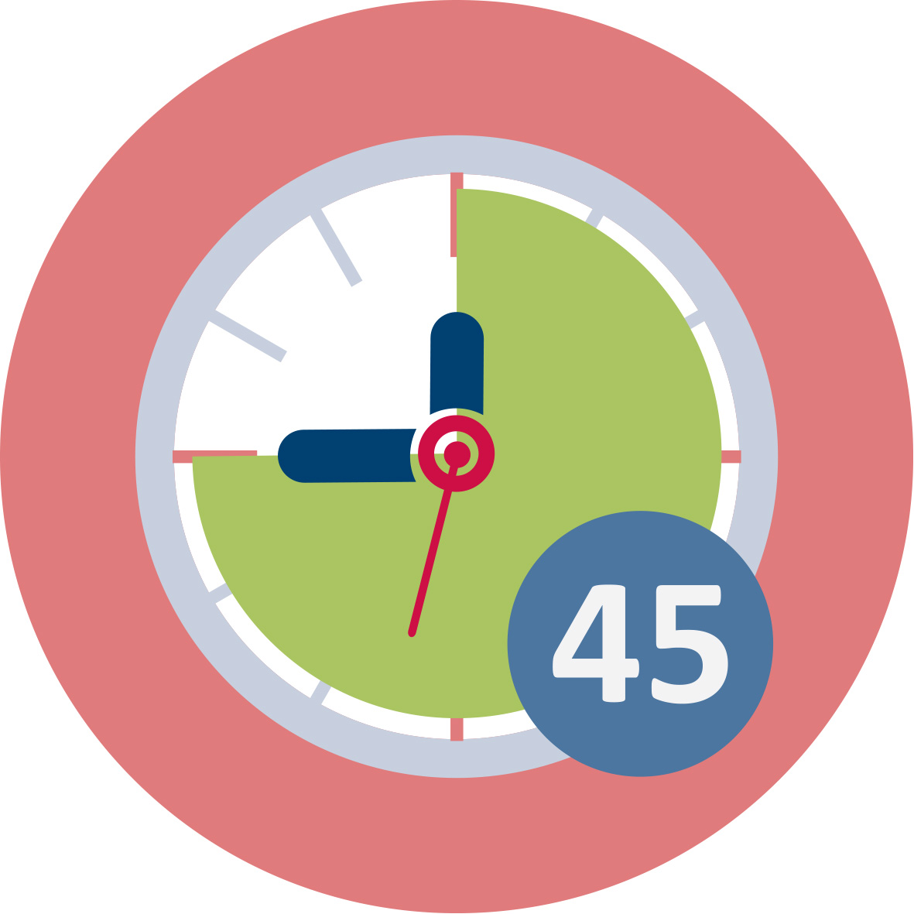
1.3: Classroom culture and language differences
What benefits and problems can you see in relation to Anna’s and Bente’s strategies?
How and when would you use these strategies? Why?
What strategies would you use if faced with teaching students who do not share any of your languages? How would you get access to those students’ mathematical competencies?

Slide 11
II. CULTURAL EXPERIENCE AND MATHEMATICAL COMPETENCE

Slide 12
2.1: Language and mathematical concepts
How is the understanding of mathematical concepts affected by everyday language used in related situations, and everyday use of the term associated with a concept?

Slide 13
2.1: Language and mathematical concepts
How, for example, do you think learning of the number system is affected by the number words? What patterns of the number system are visible in your language, and which are not?
 | English | French | German | Danish | Greek | Polish
1 | one | un | eins | en | eis | jeden
2 | two | deux | zwei | to | dyo | dwa
3 | three | trois | drei | tre | treis | trzy
10 | ten | dix | zehn | ti | deka | dziesiec
12 | twelve | douze | zwölf | tolv | dodeka | dwanascie
20 | twenty | vingt | zwanzig | tyve | ikosa | dwadziescia
60 | sixty | soixante | sechzig | tres | hexekonta | szescdziesiat
70 | seventy | soixante-dix | seibzig | halvfjerds | hebdomekonta | siedemdziesiat

Slide 14
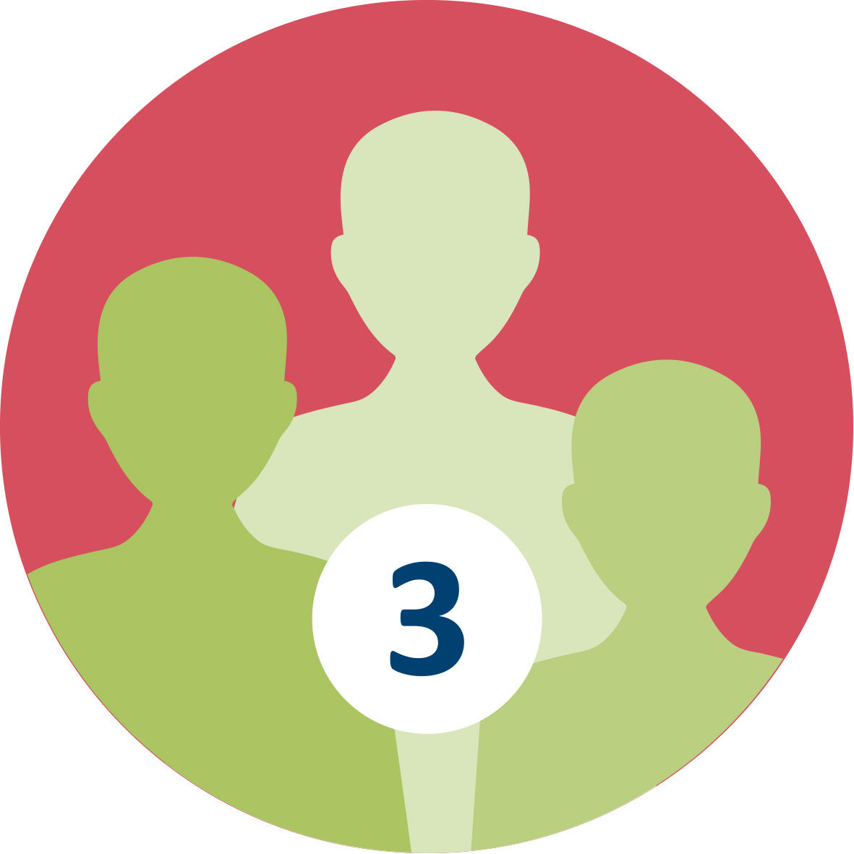
2.1: Language and mathematical concepts
Pick a mathematical concept relevant for your future mathematics teaching (e.g. the number sixty-two, volume, denominator, percentage, slope), and find out what it is called in different languages known in your group.
What else do these words mean in each language? In which everyday contexts are these words used? How may that shape the understanding of the mathematical concept?
What other terms or expressions are used in relation to the mathematical concept in each language? How may that shape the understanding of the mathematical concept?
How can your students and you as a teacher benefit from discussing these questions? What other questions could guide the discussion towards the development of conceptual understanding?

Slide 15
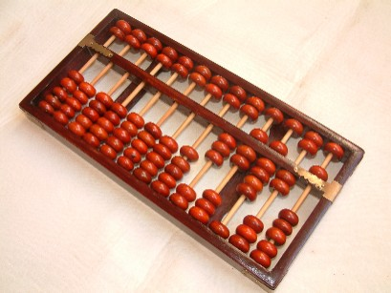
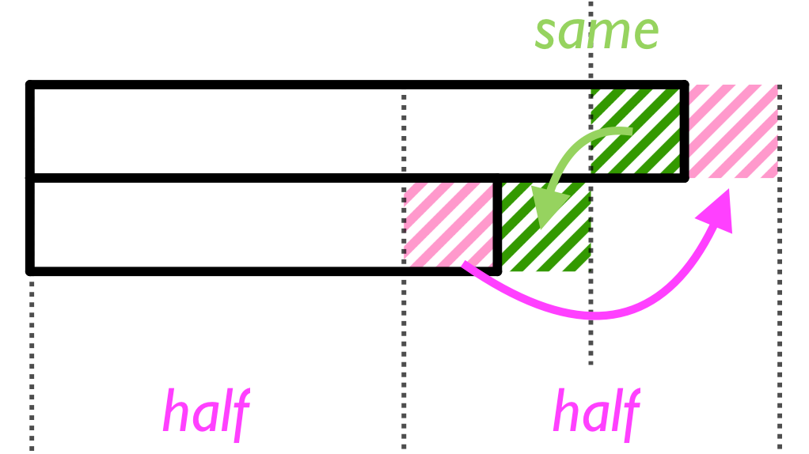
2.2: Cultural experiences and mathematical methods
Different methods and models carry different qualities and meanings of numbers and operations
…but there is also personal aspects of efficiency. Ask your students about the methods and models they are used to!

Slide 16
2.2: Cultural experiences and mathematical methods
MULTIPLICATION METHODS
https://www.youtube.com/playlist?list=PLRG4iHU5uhLCSlkX1N74K-vrr7ImSrDZj
DIVISION METHODS https://www.youtube.com/playlist?list=PLRG4iHU5uhLBs34Do2bkgKfxRddBJesn8

Slide 17
2.2: Cultural experiences and mathematical methods
Work out some examples with other numbers. Can you explain how the different methods work?
What merits and deficits do you see in the different methods? When is each method efficient, and when is it not?
What can students learn from discussing different methods? What aspects of the underlying concepts can become visible? What aspects of students’ knowledge can become visible for you as a teacher, by means of such discussions?

Slide 18
2.2: Cultural experiences and mathematical methods
How can you arrange a learning situation so that students are able to compare and evaluate different methods? What questions would you ask students in such a situation?
Assume you would lead a classroom discussion about multiplication or division methods. Pick three methods which you think could be used by three students in your class. In what order would you let the students present their methods, and why? What aspects would you highlight, and how would you compare and contrast the methods?
What are the benefits of including incorrect or mistaken methods? When would you let students who made mistakes present? How would you address the mistakes, in order for the student and the class to learn from them?

Slide 19
III. ASSESSING AND CHALLENGING ALL STUDENTS

Slide 20
3.1 Assessing mathematical competence
Creative and imitative reasoning
Creative mathematical reasoning is:
Novel
Flexible
Plausible
Mathematically founded

Slide 21
3.1 Assessing mathematical competence
Some tasks test only imitative reasoning:
At Lidl a large soda costs 15 kr. At the local store it costs 2 kr more. How much does it cost at the local store?
IMITATIVE REASONING: 15 + 2 = 17
In order to test creative reasoning, the task must require novelty, flexibility, plausibility and mathematical foundation:
At Lidl a large soda costs 15 kr. That is 2 kr less than at the local store. How much does it cost at the local store?
IMITATIVE REASONING: 15 – 2 = 13

Slide 22
3.1 Assessing mathematical competence
Numerous frameworks set out to delimit strands, or aspects, or constituents of mathematical competence, e.g. OECD/PISA, Adding it up, NCTM standards and the Mathematical Competency Research Framework.

Slide 23
3.1 Assessing mathematical competence
The OECD/PISA framework (OECD, 2017):
Communication
Representation
Devising strategies
Mathematisation
Reasoning and argument
Using symbolic, formal and technical language and operations
Using mathematical tools

Slide 24
3.1 Assessing mathematical competence
Adding it up Kilpatrick, Swafford & Findell, 2001)
Conceptual understanding
Procedural fluency
Adaptive reasoning
Strategic competence
Productive disposition

Slide 25
3.1 Assessing mathematical competence
The NCTM process standards (NCTM, 2018):
Problem solving
Reasoning and proof
Communication
Connections
Representations

Slide 26
3.1 Assessing mathematical competence
The Mathematical Competency Research Framework (Säfström, 2013):
Problem solving
Reasoning
Applying procedures
Representations
Connections
Communication

Slide 27
3.1 Assessing mathematical competence
What kind of task assesses:
problem solving skills?
reasoning and argumentation?
the use of mathematical representations?
forming and using mathematical connections?
mathematical communication?

Slide 28
3.1 Assessing mathematical competence
Compare and analyze at least two different diagnostic assessment materials.
Find out whether there are any diagnostic assessments adapted to your curriculum available. Such assessments may be provided by a national agency or developed by other organisations in your country. Choose a mathematical topic relevant for your futute students, and pick out the diagnostic assessments for this topic from two of the following sets of assessment materials:
Your own national/regional diagnostic materials
Australia: https://numeracyskills.com.au/assessment-resources
Germany: https://mathe-sicher-koennen.dzlm.de/node/336
New Zealand: https://nzmaths.co.nz/node/1599
Sweden: https://www.skolverket.se/bedomning/bedomning/bedomningsstod/matematik/diamant-1.196205

Slide 29
3.1 Assessing mathematical competence
Which mathematical competencies are tested by the diagnostic materials? Which are not tested?
To what extent does language skills affect the outcome of these tests? How can you as a teacher adapt the tasks for immigrant students, in order to assess their mathematical rather than their language competence?
Besides these tests, what do you as a teacher need to do in order to assess the mathematical competence of your students?
Compile your own diagnostic test for the topic by picking tasks from the analysed tests and constructing additional tasks. You will use this test in Activity 3.3.

Slide 30
3.2: Local resources for assessment and support
Find out what resources are available for assessing and supporting students at a local school.
Contact a local school and interview teachers and/or principals:
Are you using any standardised or local tests for assessing students’ mathematical knowledge? Are these tests available in different languages? How do you use these tests with students who do not speak the native language?
Are there language teachers or interpreters for the lanuages spoken by students at the school?
Do teachers in different grades collaborate to support and challenge students who lie significantly above or below the average level of their class? What other strategies does the school use to address these students’ needs for challenge and support?
Write down the answers, as well as your conclusions and reflections.

Slide 31
3.3: Using assessment in the development of teaching
Use the diagnostic test you compiled in Activity 3.1 in a class or a group of students at a local school.
Compile the results and describe the class or group as a whole. What is the overall level, and how large is the variation?
Pick out three students, whose results you want to analyse in depth.
What do these students know well? What deficiencies have you identified? What may be the cause of these deficiencies? To what extent may language skills have affected the outcome for these students?
What teaching strategies and student activities do you intend to use in order to address the students’ deficienciies?
Make use of relevant literature from the required reading of the course in order to answer these questions.

Slide 32
3.2: Local resources for assessment and support
Present your results from the interview:
Are you using any standardised or local tests for assessing students’ mathematical knowledge? Are these tests available in different languages? How do you use these tests with students who do not speak the native language?
Are there language teachers or interpreters for the languages spoken by students at the school?
Do teachers in different grades collaborate to support and challenge students who lie significantly above or below the average level of their class? What other strategies does the school use to address these students’ needs for challenge and support?

Slide 33
3.2: Local resources for assessment and support
Based on the different results from the interviews, discuss the following questions:
What is the overall picture of resources available at local schools? What language support is available for immigrant students? What support is there for students significantly below or above the average level of the class? How do these aspects affect your role as a teacher?
How large are the differences between schools? As an immigrant student, to what extent will the school impact your education? As a student significantly below or above the average level of the class, to what extent will the school impact your education?

Slide 34
3.3: Using assessment in the development of teaching
Present the results from the diagnostic tests – on group level and for the three selected students:
What did you learn from the results? What is the overall level of the class, and how large is the variation?
To what extent may the language skills of the pupils have affected their outcomes on the tests?
What do the three selected students know well? What deficiencies have you identified? What may be the cause of these deficiencies?
What teaching strategies and student activities do you intend to use in order to address the students’ deficiencies? Why did you choose these strategies?
Make use of relevant literature from the required reading of the course in order to answer these questions.

Slide 35
3.3: Using assessment in the development of teaching
Based on the collected results of the tests, discuss the following:
How large is the variation between schools? Have you changed any conclusions you made, based on the bigger picture?
Are there any themes or commonalities in the deficiencies you found? Is there a pattern in the difficulties students face?
Are there any themes or commonalities in the teaching strategies and student activities do you intend to use in order to address the students’ deficiencies?
What new ideas and strategies have come up, that you will take with you into your future classroom?
Make use of relevant literature from the required reading of the course in order to answer these questions.

Slide 36
This presentation is based on the work within the project Intercultural learning in mathematics and science initial teacher education (IncluSMe). Coordination: Prof. Dr. Katja Maaß, International Centre for STEM Education (ICSE) at the University of Education Freiburg, Germany. Partners: University of Nicosia, Cyprus; University of Hradec Králové, Czech Republic; University of Jaen, Spain; National and Kapodistrian University of Athens, Greece; Vilnius University, Lithuania; University of Malta, Malta; Utrecht University, Netherlands; Norwegian University of Science and Technology, Norway; Jönköping University, Sweden; Constantine the Philosopher University, Slovakia.
The project Intercultural learning in mathematics and science initial teacher education (IncluSMe) has received co-funding by the Erasmus+ programme of the European Union under grant no. 2016-1-DE01-KA203-002910. Neither the European Union/European Commission nor the project's national funding agency DAAD are responsible for the content or liable for any losses or damage resulting of the use of these resources.
IncluSMe project (grant no. 2016-1-DE01-KA203-002910) 2016-2019, lead contributions by Säfström, A. I., Nyman, R. and Boesen, J., School for Education and Communication, Jönköping University.
CC-BY-NC-SA 4.0 license granted (find explicit terms of use at: https://creativecommons.org/licenses/by-nc-sa/4.0/deed.en)

