Slide 1
The relevance of language for mathematics education
Initial teacher education of prospective mathematics teachers

Slide 2
Overview

Slide 3
Structure of the module
Three sections:
  I. Introduction into the topic – 2 activities (60 minutes)
  II. Background and tools – 3 activities (90 minutes)
  III. Connection to practice – 3 activities (120 minutes)
Homework optional between sessions

Slide 4
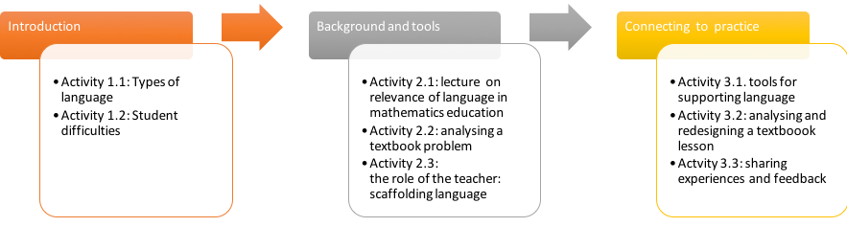
Overview

Slide 5
Overview
The distinction between 'everyday' language, general academic language and the specific language of mathematics;
Some background and characteristics of language-sensitive mathematics teaching;
The relevance of interaction, contexts and language-support for the learning of (the language of) mathematics;
Tools to analyse teaching materials and classroom interactions (scaffolding);
Tools and activities to support future teachers in designing language sensitive lessons and activities

Slide 6
Learning outcomes
Understand difficulties student face with language in mathematics (especially multilingual students);
Become aware of the role and relevance of language in mathematics education (everyday language, general school language and subject-specific language of mathematics);
Develop knowledge about the approach of language-sensitive mathematics teaching and its tools;
Analyze language in classroom materials and teaching practice;
Learn to value the role of various representations and visualizations as a bridge for understanding and developing linguistic skills in mathematics education:
Learn to know and use scaffolding strategies to support students in language-sensitive mathematics lessons;
Design classroom activities that support students' language proficiency as well as their mathematical understanding.

Slide 7


Introduction into the topic: The relevance of language for mathematics education
Activity 1.1
Types of language

Slide 8
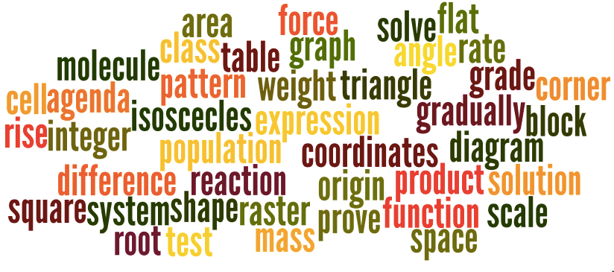
Study the wordcloud – it is on your worksheet as well

Slide 9
To do: also see worksheet
Individually select about 5 words that are typical for mathematics.
Share the words you selected and discuss the questions below:
  Which of these words are also part of our daily language? How is the meaning different in mathematics compared to daily life?
  What is a typical expressions (or sentence) using this word in daily language and what is a typical expression in mathematics.
  What problems do you expect your students may have regarding this ‘shift of’ meaning? Is this different for students who are native speakers in your language and for students who are not?
In the whole group share problems your small group identified.

Slide 10
Collected problems identified by small groups
Make a list of the collected problem

Slide 11

Introduction into the topic: The relevance of language for mathematics education
Activity 1.2
Student difficulties – an example

Slide 12
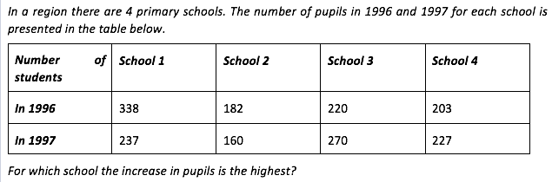
Part 1: A mathematical problem – see worksheet
Read and solve this problem individually.
Next discuss the following questions:
What problems do you expect students (grade 6 or 7) to have when solving this problem? Are some of these problems language related?
Explain why many pupils give ‘school 1’ as the answer.

Slide 13
Part 2: student work
Study the excerpt on the worksheet. It is a dialogue between a Student and a Teacher-researcher. The student has read the problem (about the schools) aloud, solved it and now explains what he did.
  Source: The excerpt is part of Dutch research (van den Boer, 2003) into the problems second generation immigrant students (in multicultural schools) encounter in mathematics education and the factors that cause these problems.

Slide 14
Discussion
Discuss the following questions about the excerpt in your small group.
  How do you value the students’ language abilities in general?
  What strategies does the student use to overcome language difficulties?
  What do you notice about the student –teacher/researcher interaction?
  Do you have similar experiences? What would you do in such a situation?
  How would you provide language support for this student?

Slide 15

Background: language and mathematics education
Activity 2.1
Lecture on the relevance of language in mathematics education

Slide 16
Topics in this lecture (separate ppt)
Why language is crucial for (mathematics) learning
The distinction between daily language, general academic language (school language) and subject specific academic language and difficulties students may have with each
Characteristics of the language of mathematics and the importance of subject-specific language objectives
How teachers stimulate students to speak and write (language production) for the learning of mathematics
Scaffolding language
Tools to support language development
Optional: discussion on statements, such as:
  All teachers are language-teachers
  Restricted talk becomes restricted learning (Barwell)

Slide 17
Homework
Read an article on language-sensitive mathematics education (see list with references)
Write a paragraph of about 300-500 words based on this article in which you make clear how you could make your own mathematics lessons more language-sensitive.

Slide 18
Background: language and mathematics education
Activity 2.2
Analysing a textbook problem

Slide 19
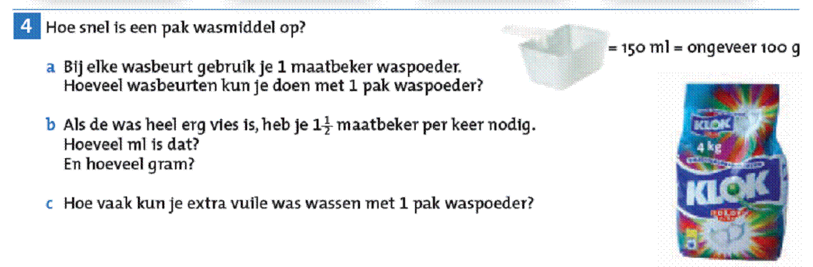
The washing-powder problem (see worksheet)
With every washing you use 1 measuring cup of washing-powder.
How many washings can you do with 1 pack of washing-powder?
If the clothing is very dirty you need 1 ½ cup per wash.
How many ml is that? And how many grams?
How often can you clean extra filthy laundry with 1 pack of washing-powder?

Slide 20
Types of language in the washing powder problem
General academic language: measuring cup, about/roughly
Mathematical language: 100 g., 150 ml., 4kg.
Everyday language: washing powder, pack, extra dirty.
Formulations: If the clothing is very dirty you need 1 ½ cup per washing.

Slide 21
Potential difficulties of students
The context:
  the pack of washing powder
  the measuring cup
They do not know:
  words: washing, laundry, per
  the measuring cup
  measurement units like g and ml
  that the formulation ‘very dirty’ is the same as ‘extra filthy laundry’.
They do not realise that they need the ‘4 kilo’ on the pack to answer the questions.

Slide 22
Background: language and mathematics education
Activity 2.3
The role of the teacher: scaffolding language

Slide 23
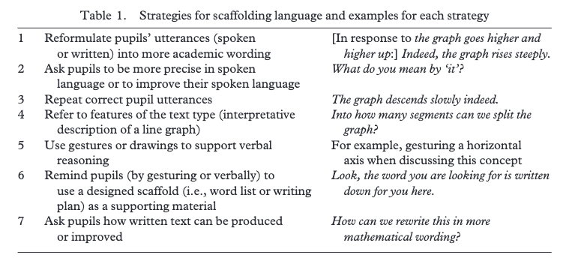
Seven scaffolding strategies

Slide 24
Task (see worksheet)
Individually: Read the two fragments of teacher-student interactions on the worksheet and ‘score’ the teachers utterances according to the scaffolding strategies from the table.
In pairs: Compare and discuss your ‘scoring’ of the scaffolding strategies.
Whole group: which of these strategies do you use?

Slide 25

Connecting to practice
Activity 3.1
Tools for supporting language

Slide 26
See worksheet for activity 3.1
In small groups study the eight tools and activities that support language proficiency in mathematics lessons.
Indicate how each tool contributes to the development of language proficiency and to the development of mathematical understanding. Try to generalize from the specific example to a more general use of the tool/activity
Formulate a subject-specific language goals can be addressed using each of these activities. Give examples.
Discuss your findings

Slide 27
Examples of mathematical language goals
List examples of goals from the group

Slide 28
Connecting to practice
Activity 3.2.
Analyzing and redesigning a textbook lesson

Slide 29
Part 1 – analysing a paragraph – see worksheet
What types of language are being used? What are typical mathematical words and expressions? What about general academic language and daily language?
Where do you expect problems to occur? Is this different for different types of students? Distinguish: native speakers and second language learners.
Is attention paid to the meaning of words/concepts/expression?
Are formulations clear? Are schemes, representations and visuals used, are they used in a clear way? If not: what problems do you foresee?
Do the activities provide opportunities for language production (speaking and writing)?

Slide 30
Discussion
Discuss your analysis with your peers.
What ways did you come up with to make the language more accessible to your students:
  what language goals did you formulate?
  How would you provide language support?
  What tools or activities can you use to make the lesson more language-sensitive?

Slide 31
Part 2 - (Re)designing a lesson
Formulate one or two content-related (mathematical) language goals for this lesson.
Design one or two activities providing ‘language support’ to the students in reaching these goals.
Justify your choices and decisions based on what you learned about language sensitive mathematics teaching
Prepare a 1-2 minutes pitch about your plans/design

Slide 32
Homework
Finish the design (goals, teaching activities, materials) and try the lesson in class (if possible)
Fill in the evaluation form on worksheet 3.3
Prepare to share/present your design and teaching experiences reflecting on:
  Your content-related mathematical language goals.
  The activities you had students do. Why these?
  Your role as a teacher.
  Your experiences: successes and challenges.

Slide 33
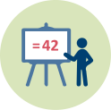
Connecting to practice
Activity 3.3.
Sharing experiences and feedback

Slide 34
Presentations
Briefly present your lesson-design and your experiences using it in class reflecting on:
  Your content-related mathematical language goals.
  The activities you had students do. Why these?
  Your role as a teacher.
  Your experiences: successes and challenges.

Slide 35

This presentation is based on the work within the project Intercultural learning in mathematics and science initial teacher education (IncluSMe). Coordination: Prof. Dr. Katja Maaß, International Centre for STEM Education (ICSE) at the University of Education Freiburg, Germany. Partners: University of Nicosia, Cyprus; University of Hradec Králové, Czech Republic; University of Jaen, Spain; National and Kapodistrian University of Athens, Greece; Vilnius University, Lithuania; University of Malta, Malta; Utrecht University, Netherlands; Norwegian University of Science and Technology, Norway; Jönköping University, Sweden; Constantine the Philosopher University, Slovakia.
The project Intercultural learning in mathematics and science initial teacher education (IncluSMe) has received co-funding by the Erasmus+ programme of the European Union under grant no. 2016-1-DE01-KA203-002910. Neither the European Union/European Commission nor the project's national funding agency DAAD are responsible for the content or liable for any losses or damage resulting of the use of these resources.
IncluSMe project (grant no. 2016-1-DE01-KA203-002910) 2016-2019, lead contributions by Boerée-Kamphorst, C., Jonker, V., & Wijers, M. Utrecht University The Netherlands.
CC-BY-NC-SA 4.0 license granted (find explicit terms of use at: https://creativecommons.org/licenses/by-nc-sa/4.0/deed.en)

