Slide 1
IO7: Aims of SSI and the curriculum
National and Kapodistrian University of Athens

Slide 2
IO7 Module aims
Module O7 focuses on
(1) the aspects of environmental SSIs that are related to the educational goals of schools (as intended in the curricula)
(2) how future teachers can embed them in curricula (as enacted in classroom practices).

Slide 3
Structure of the module
I. Introducing the Environmental Socio-Scientific Issues (EnvSSIs) and understanding their connection with mathematics and science curriculum.
1.1: Brainstorming about EnvSSIs.
1.2: Reflecting on EnvSSIs’ connections with mathematics & science education.
II. Exploiting research findings on connecting EnvSSIs to mathematics and science educational goals.
2.1: ΕnvSSI and education.
2.2: Readings on Teachers’ challenges.
2.3: Example of enacting EnvSSIs in classroom: The case of role-playing scenario.
2.4: Theoretical frameworks for analysing students’ arguments.
III. Experiencing how to enact EnvSSIs in mathematics & science classrooms.
3.1: Dealing with the Paper or Plastic Bag issue: Role-playing scenario.
3.2: Dealing with a specific Lake Drainage and re-creation issue: Multiplicity of the factors & “Uncertainty”.
IV. Implementing an EnvSSI-based mathematics and science lesson and connecting it to the national curriculum.
4.1: Lesson design.
4.2: Reflecting on the lesson designs.

Slide 4
I. Introducing the environmental socio-scientific issues (EnvSSIs) and understanding their connection with mathematics and science curriculum.

Slide 5
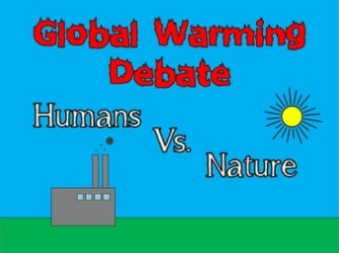
Activity 1.1: Brainstorming about EnvSSIs
Which are better for the environment, paper or plastic bags?
Is global warming caused by human activity or by natural cyclical phenomena?
Reflect on these questions. Share your opinions by arguing them.
Is there a unanimous answer/ a common output? Are you certain about your viewpoint?
What do you think you need to defend your claims & to convince opponents of your opinion?
How can science and mathematics help you in answering these issues?
Notes:
Images from kunplasticbag.com & teacherspayteachers.com

Slide 6
Activity 1.2: Reflecting on EnvSSIs’ connections with mathematics & science education
Provide examples of EnvSSIs.
What characteristics do you identify in such issues?
Do you think that it is important to teach such issues in the school? Why?
Are such controversies included in your mathematics & science national curriculum? If so, how?
Which role can EnvSSIs play in achieving expected learning outcomes of the mathematics and science curriculum?
What would be your concerns if you were asked to teach these issues?

Slide 7
II. Exploiting research findings on connecting EnvSSIs to mathematics and science educational goals

Slide 8
Activity 2.1: ΕnvSSIs and education (1/2)
The Socio Scientific Issue movement has drawn from a wide swath of interrelated scholarship, e.g.
epistemological maturation,
socio-moral discourse,
emotive reasoning,
character education,
nature of science and argumentation,
that uniquely positions it as a sociocultural progressive framework serving as a counterpoint (or a complement) to recent STEM initiatives as commonly conceived and practiced in academia (Zeidler et al, 2019).

Slide 9
ΕnvSSIs and education (2/2)
‘Environmental education typically emphasises private share environmentalism… i.e., what an individual can do to reduce negative effects on the environment. However, effective actions when dealing with environmental problems are collective…, therefore, students should be given opportunities to discuss the societal and global sphere and analyse environmental problems as public issues’ (Sternäng & Lundholm, 2012).
EnvSSIs are controversial issues that have a basis in science and mathematics and require people to engage in discussion and debate. In the decision-making processes, they require the use of evidence-based reasoning, as well as a degree of moral reasoning or the evaluation of ethical concerns.
Task: After reading the above extracts, discuss in groups how this type of issues could be related to the national curriculum.

Slide 10
Activity 2.2: Readings on Teachers’ challenges
Read the following extracts from research literature indicating challenges and dilemmas that teachers experience when integrating EnvSSIs into mathematics or science teaching
Teachers’ value-free beliefs. Many teachers believe that science and mathematics should be objective and value-free, (Bryce & Gray, 2004), and it is not the role of science and mathematics education to attempt to solve social, political issues. Also they feel insecure when trying to not promote their personal views about the issues involved (Gayford, 2002).
Teachers’ ill-preparedness in teaching EnvSSIs. Many teachers feel ill-prepared to select relevant socio-scientific topics and to teach them (Bryce & Gray, 2004) and to deal with the uncertainty of the students’ solutions and ideas (Evagorou, 2011).
Classroom management in leading debates. Many teachers express difficulties in leading debates or controversial discussions, judging the non-scientific aspects of the issues involved. Thus, they feel insecure in handling conflicting aims in terms of enhancing the students’ independence as learners (in a student-centred approach) while trying at the same time to control the learning outcomes (by acquiring basic science knowledge) (Aikenhead, 2006; Bosser et al., 2015).
Task: What issues do you recognize in mathematics and science curriculum objectives and their enactment in the classroom?

Slide 11
Activity 2.3: Example of enacting EnvSSIs in classroom: The case of role-playing scenario.
Task 1: The following table provides an analysis of enacting EnvSSIs in terms of the school subject, the resources used, the content knowledge and curriculum aims and the design of a role-playing scenario.
Try to make sense of this table through the examples provided in the table.
(Belova, Eilks, & Feierabend, 2015; Höttecke et al. 2010)
School subject | Resources | Curricular aims | Role-playing scenarios
Science | e.g., Magazine articles, YouTube videos, scientific presentations/reports, graphical data | e.g., greenhouse effect, climate change, recycling | e.g., a school decision not to offer meat dishes in the school restaurant
Mathematics |  | Modelling, problem solving, argumentation

Slide 12
Task 2: Read the role-playing scenario on “Green mobility” provided below.
Specify the school subject and the mathematical and scientific ideas involved.
Design your own role-playing scenario related to an EnvSSI from your choice and complete correspondingly the table provided above.
Green Mobility
As experts for Green Mobility you stand for alternative means of transportation like electric cars, alternative fuels such as biodiesel, and public transport with buses and trains. Your goal is the reduction of greenhouse gases and climate protection with the help of alternative means of transportation and the limitation of individual transport. Individual transport means that everyone uses his own car or motorcycle. Therefore a law on the increase of the minimum age for a driving license up to 21 years is a good idea to achieve goals, as it forces young people to use public transport and limits the overall traffic.

Slide 13
Activity 2.4: Theoretical frameworks for analysing students’ arguments
In the following, we will present two theoretical frameworks:
Toulmin’s framework
Belova et al.’s framework

Slide 14
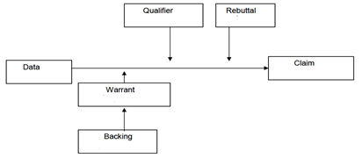
Toulmin’s framework
The construction of single arguments is based on Toulmin’s framework with the following elements: the claim, the data, the warrant, the backing, the qualifier and the rebuttal. The first four elements determine the soundness of the arguments while the last two their strength.
Claims are statements that advance the position being argued for.
Data are the foundation or supporting evidence on which the arguments is based.
Warrants are the logical connections (a general rule of inference) between data and claims that indicate how a claim is supported by the data.
Backing supports the validity/legitimacy of the warrants.
Qualifiers refer to the degree of strength and certainty in one’s argument while rebuttals consist of exceptions to the applicability of the warrant

Slide 15
Belova, et al.’s (2015) framework
Domain: Where do the arguments used by the students come from (science/everyday life/society/politics)?
Level of argument: How complex are the arguments?
Reference: Do the students make references to each others’ statements? Does a conversation arise?

Slide 16
Task: analyzing students' arguments
Below is a classroom task on the basis of Hydrogen fuel bus (Dawson & Carson, 2020)
“Between 2004 and 2007, Transperth trialled three EcoBuses in Perth which ran on hydrogen fuel cells as their fuel source. The benefit of using a hydrogen fuel cell is that the only waste emissions produced are water and heat. At the conclusion of the trial, the three buses had travelled 258,000 km and carried over 320,000 passengers. Three hundred tCO2eq (tonne of CO2 equivalent) were saved by not using regular diesel buses. Although the trial was deemed a success by Transperth, the WA government has decided not to proceed any further with the EcoBuses, claiming the cost to maintain each bus was too high a price to pay compared to a regular bus.
Do you think the WA government made the right decision?”

Slide 17
You find below an example of analysis of a student’s response according to Toulmin’s framework
CLAIM: Yes. “I think the WA government made the right decision (claim) as the buses would cost a lot of money and would put our state to bankrupt (data) meaning we will have to cut down on other expenses and Centrelink payments for those who are struggling (backing) just so we can have ecofriendly public transport. Also not many people use buses as many own cars (data) which means it is not really helping the environment. The difference it will make is not very big.”
Analyse the following student’s response utilizing both Toulmin’s and Belova et al.’s frameworks
CLAIM: No. “The reason for this is because as the statistics showed, 300tCO2eq were saved by using these types of buses, which indicate that a great amount of tCO2eq had been prevented from entering the atmosphere and causing further damage. Furthermore, it is also stated that the only waste emissions produced are water and heat; therefore, less harmful greenhouse gases are produced. If less greenhouse gases are produced, this means that the damage to the natural balance of producing greenhouse gases is slowed down(data),which means that by using this Ecobuses, it will be worth it for the long run as this will be beneficial for the environment. Therefore, the cost would not matter to the WA government because paying for the Ecobuses is like paying for a better future as less damage will be done to the environment.”

Slide 18
III. Experiencing how to enact EnvSSIs in mathematics and science classrooms

Slide 19
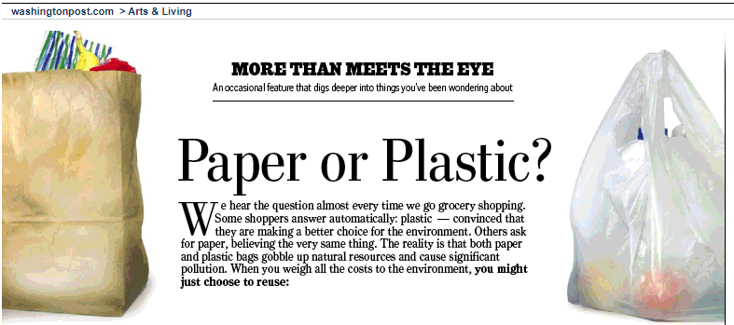
Activity 3.1: Dealing with the Paper or Plastic Bag issue: Role-playing scenario
1) Below, you can find an extract of the Washington Post Company newspaper (2007) that compares the paper and the plastic bag.

Slide 20
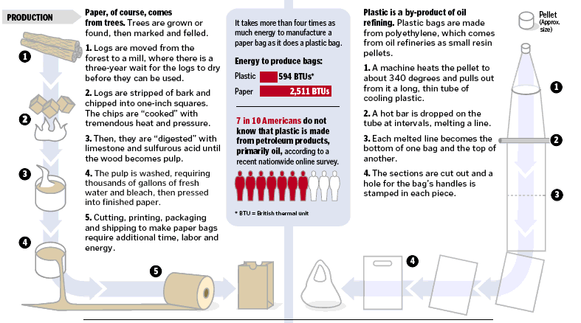

Slide 21
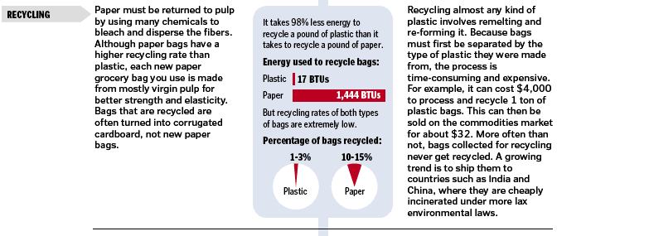

Slide 22
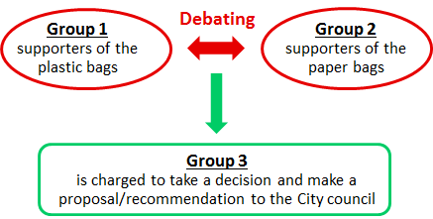
Task 1: Debating through a role-playing scenario.
Based on the issue: Are plastic bags or paper bags better for the environment? described in the above extract, form three groups and perform a role-playing scenario as following:
Group 1 and Group 2 will prepare an argumentation to support their views to form a debate in front of Group 3.
Group 3 will write a report to recommend to the city council of your city about the use of plastic or paper bags. Are the evidence-based arguments provided strong enough to persuade the city council?
Notes:
UNEP = UN Environment Programme.

Slide 23
To prepare this task (debate & recommendation), you can
search in your national curricula for tasks, information or resources about this issue,
use resources or data from your everyday life,
carry out your own internet research or/and use the references given below:
the Environment Agency’s report: “Life cycle assessment of supermarket carrier bags: a review of the bags available in 2006”.
the report “Life Cycle Assessment of Reusable and Single-use Plastic Bags in California”, J. Greene, 2011.
the NGO UNEP report “Single-use plastics, a roadmap for sustainability”, 2018.
Notes:
UNEP = UN Environment Programme.

Slide 24
Activity 3.2: Dealing with a specific lake Drainage and re-creation issue: Multiplicity of the factors & “Uncertainty”.
The story of Karla Lake in Thessaly, Greece
Karla lake is located in the central part of Greece. It had a rich biodiversity.
It was drained in the early 1960s and then re-flooded in recent years.
Below you can find
Some reasons that were advanced for the decision for drainage.
Some consequences that were observed after the drainage.
Some reasons for the decision for re-creation.

Slide 25
Reasons for the decision to drain:
The fluctuations in the water levels
The floods in the area
The need to create more farmland
The reduced catches
The need to reduce malaria epidemics
Environmental and social effects of the drainage:
Rapid fall of groundwater
Pollution in the closed gulf and appearance of phytoplankton
Appearance of deep cracks and destruction of buildings
Destruction of the fauna and flora of the area
Adverse changes in the microclimate of the region and increase of extreme weather phenomena
Inability to supply water for cities and villages
The decision for re-creation.
It was found that the effects on the ecosystem of the area were greater than the benefits offered by its drainage. Thus, the re-creation of the lake was decided.
Today, efforts are being made to carry out the recreation, which started in December 2010.

Slide 26
Task 1: Dealing with issues involved in lake drainage and recreation
Based on the resources provided below or other resources of your own,
Reflect on the advantages and disadvantages involved in two core decisions related to the drainage and restoration of Karla Lake.
Identify aspects of mathematics and science teaching that you recognize in lake drainage and recreation.
Discuss your ideas with your peers.

Slide 27
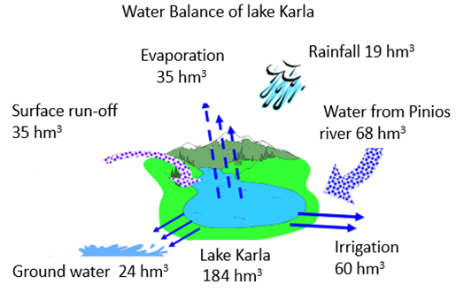
Resource 1 – Yearly water balance of Karla Lake
The figure below shows the yearly average values of some key functional characteristics of Karla Lake.
Source: Kagkalou, Υ.ΠΕ.ΘΕ. | Υδάτινοι Πόροι και Περιβάλλον Θεσσαλίας.
https://www.ypethe.gr/sites/default/files/basicpagefiles/2008_11_ypehode_stoiheia_ergoy_karlas.pdf

Slide 28
Resource 2 – Water Quality & Environmental Condition of Karla Lake
The table below compares some measurements made in 2017 at the Karla’s reservoir with respect to limits set in Directive 2006/44 / EC for the welfare of the fish Cyprinidae.
Parameters | Limits set in Directive 2006/44 / EC | Winter 2017 | Spring 2017 | Summer 2017 | Average
pH | 6-9 | 7,82 | 8,9 | 8,65 | 8,46
Total suspended solids (T.S.S.) | ≤ 25 mg/lt | 18 | 224 | 232 | 158
Biochemical oxygen demand (B.O.D5) | ≤ 6 mg/lt | 6,05 | 13 | 26 | 15,02
Nitrites (NO2⁻) | ≤ 0,03 mg/lt |  | 0,16 | 0,18 | 0,17
Ammonium (NH4⁺) | ≤ 0,2 mg/lt |  | 1,4 | 1,88 | 1,64
Source: Kagkalou, Υ.ΠΕ.ΘΕ. | Υδάτινοι Πόροι και Περιβάλλον Θεσσαλίας.
https://www.ypethe.gr/sites/default/files/basicpagefiles/2008_11_ypehode_stoiheia_ergoy_karlas.pdf

Slide 29
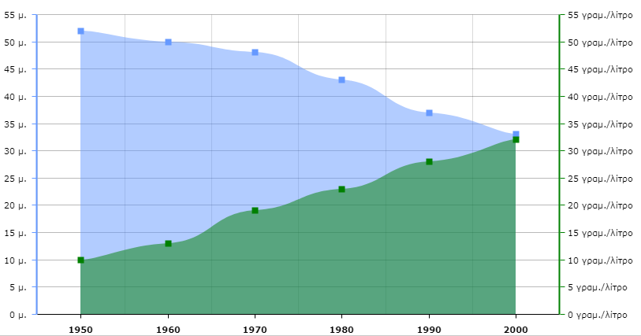
Resource 3 – An example of the salinity evolution of a lake
The graph below shows the relation between the water level and the salinity of a lake.
m
gr/l
Source: http://photodentro.edu.gr/lor/r/8521/10918 from the site Photodentro: a Greek National Aggregator of Educational Content developed by the Greek Ministry of Education.

Slide 30
Task 2: Discussing about “uncertainty”
Read the following extract from Barwell (2013)
Discuss in your group how the “uncertainty” involved in the Karla Lake issue could be dealt in a classroom lesson?
In post-normal science, values and facts cannot be separated, in part due to the problem of uncertainty. Climate models, for example, include uncertainty and any possible action to deal with climate change will have uncertain effects to a greater or lesser extent. Deciding which information to use, which voices to hear and which methods to try, depends as much on values as it does on scientific facts.

Slide 31
IV. Implementing an EnvSSI-based maths and sciences lessons and connecting it to the national curriculum.

Slide 32
Activity 4.1: Lesson design.
Task 1: Select an EnvSSI and reflect on this issue
Describe aspects of the issue (e.g., controversy, uncertainty, national or international topic, what are the social and scientific implications related to this issue)
Identify connections with the national curriculum, to what extent the issue is addressed in the school subjects.

Slide 33
Task 2 (Homework) : Design a mathematics or science lesson dealing with the EnvSSI that you have selected.
Take into account the following criteria used for assessing the lesson designs
Is the lesson clearly connected to the maths or science school curriculum:
To what extent is the lesson design connected with specific maths and science school curriculum objectives.
To what extent is the mathematical and/or scientific content knowledge of the EnvSSI addressed in the lesson.
To what extent are the uncertainty and the controversy of the issue dealt with in the lesson design:
Does the lesson design involve a debate?
Is there an evaluation of peer’s claims and arguments?
Does it involve a scenario (e.g. a role playing, writing a report…)
Is it required from pupils to make a conclusion?

Slide 34
Activity 4.2: Reflecting on the lesson designs
Present your lesson design.
Reflect on the following:
What type of mathematical or scientific knowledge is involved when teaching specific EnvSSIs?
What themes about connections of EnvSSIs and the curriculum are raised?
How is the uncertainty of the EnvSSI you have designed dealt with?
What difficulties have you encountered when designing the lesson (i.e. the choice of an EnvSSI, pre-requisite knowledge, connection with the curriculum, etc.)

Slide 35
References
Barwell, R. (2013). The mathematical formatting of climate change: critical mathematics education and post-normal science. Research in Mathematics Education, 15(1), 1-16.
Belova, N., Eilks, I., & Feierabend, T. (2015). The evaluation of role-playing in the context of teaching climate change. International Journal of Science and Mathematics Education, 13(1), 165-190.
Dawson, V., Carson, K. (2020). Introducing Argumentation About Climate Change Socioscientific Issues in a Disadvantaged School. Res Sci Educ 50, 863–88.
Höttecke, D., Hössle, C., Eilks, I., Menthe, J., Mrochen, M., Oelgeklaus, H., & Feierabend, T. (2010). Judgment and decision-making about socio-scientific issues: A fundament for a cross-faculty approach towards learning about climate change. In I. Eilks & B. Ralle (eds.), Contemporary science education (pp. 179-192), Aachen: Shaker.
Toulmin, S. E. (1969). The uses of argument. Cambridge, UK: Cambridge University Press.

