Slide 1
Analysing (Big) data
Module O4

Slide 2
1. Introduction
Environmental SSI and (big) data

Slide 3
Activity 1.1
Global Warming

Slide 4
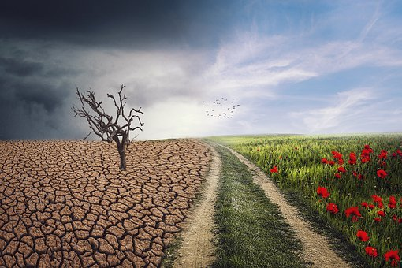
1.1 Climate change and global warming - background
‘Climate Action’ is one of the sustainable development goals of the UN. The EU adopted these goals and Eurostat (the European bureau of statistics) is monitoring progress towards the SDGs in an EU context.
Climate action is needed because our climate is changing and the global temperature is rising.
Notes:
Image from Pixabay: It is not necessary to quote the source

Slide 5
1.1 Climate change and global warming – part A
THINK: Answer the following question (individually)
In your opinion: is global warming ‘real’?
In your opinion: what is causing global warming?
On what sources do you base your opinions?
PAIR: Compare and discuss your answers with a peer.
Do you agree on 1 and 2?
Make a list of sources (you may add extra sources).
Notes:
Image from Pixabay: It is not necessary to quote the source

Slide 6
1.1 Climate change and global warming – part B
As a group: what can you conclude from the results of the poll?
Make a list of all sources mentioned for question 3.
In a small group, use the questions on worksheet 1.1B to……
Find out for one or two of these sources if and how the use of data is made visible in a table, graph(ic), diagram or reference.
Explore characteristics of these data.
Present (1 minute pitch) and discuss your findings in the whole class.
Notes:
This can be done

Slide 7
Activity 1.2
Exploring data and visualisation on global temperature change

Slide 8
Data talk
What do you notice?
What do you wonder?
What is going on in this data visualization?
Hawkins, Ed, 2018 visualisation update / Warming stripes for 1850-2018 using the WMO annual global temperature dataset.. Climate Lab Book (4 December 2018).
Archived from the original on 17 April 2019. "LICENSE / Creative Commons License / These blog pages & images are licensed under a Creative Commons Attribution-ShareAlike 4.0 International License."
Notes:
Discuss what this graphic shows, before telling your students this.
Next discuss the range (note: color scales range is about 0.1°C, so a total difference of about 2°C) and
ask student what story this graphic tells and what ‘feelings’ it evokes. How do the colors effect this

Slide 9
Questions to discuss
Warming stripes of the annual global temperatures from 1850-2018
What is the (temperature) range of the color scales?
What story does this graphic tell?
What feelings does it evoke for you?
Hawkins, Ed, 2018 visualisation update / Warming stripes for 1850-2018 using the WMO annual global temperature dataset.. Climate Lab Book (4 December 2018).
Archived from the original on 17 April 2019. "LICENSE / Creative Commons License / These blog pages & images are licensed under a Creative Commons Attribution-ShareAlike 4.0 International License."
Notes:
Discuss what this graphic shows, before telling your students this.
Next discuss the range (note: color scales range is about 0.1°C, so a total difference of about 2°C) and
ask student what story this graphic tells and what ‘feelings’ it evokes. How do the colors effect this

Slide 10
Whole group discussion on the results of worksheet 1.2
Share the results of worksheet 1.2 for all 3 websites and compare
the information on these sites
characteristics and source of the data set(s)
the way data is visualised
strong and weak points
What would be your own way to present global temperature change?
Notes:
Image from Pixabay: It is not necessary to quote the source

Slide 11
Graphs under discussion: worksheet 1.2
Look at the graph on the average annual global temperature from the part “When line graphs ought not include zero” on https://www.callingbullshit.org/tools/tools_misleading_axes.html
Discuss how the choice of scaling on the axes influences the ‘story’ .
What is your opinion about this way of representing the data?

Slide 12
Activity 1.3
National temperature change
compared to global temperature change

Slide 13
1.3 National temperature change
Explore the website of your national meteorological institute and in a small group answer the questions on worksheet 1.3 about the data collection, data analysis and data representations of your national weather data.
Present your summary and graphic of how your national temperature change relates to the global temperature change.

Slide 14
2. Background on big data
(Big) data as an SSI

Slide 15
Activity 2.1
What is big data?

Slide 16
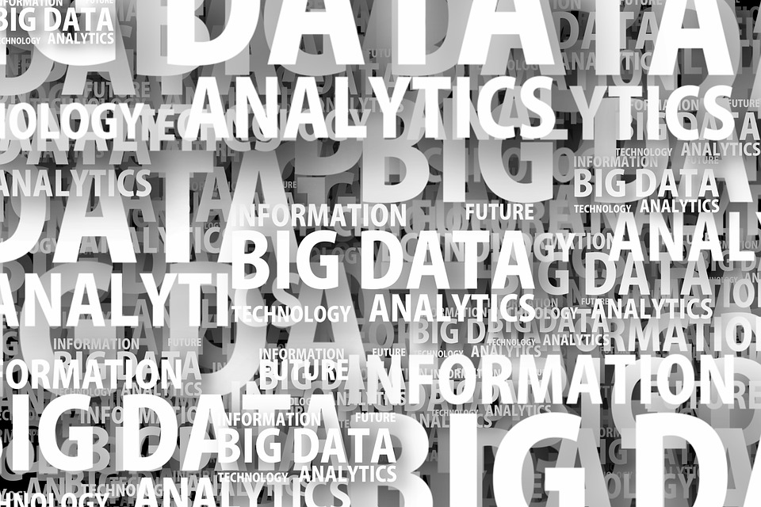
2.1 What is big data? Write one or two words
Source: pixabay
Source: pixabay
Notes:
pxi

Slide 17
2.1 What is Big data?
Explore one of these sources to find characteristics, definitions and examples (applications) of Big Data.
TED talk: Kenneth Cukier (2014)
https://www.ted.com/talks/kenneth_cukier_big_data_is_better_data?referrer=playlist-talks_for_when_you_realize_you#t-936693
Wikipedia on Big data
https://en.wikipedia.org/wiki/Big_data

Slide 18
2.1 What is big data?
What did you learn from the sources?
Do you experience Big Data in your own life? How?
How is big data being analysed? What is different from analysing ‘small’ data?

Slide 19
Activity 2.2
Big data as an SSI: dilemmas and other issues

Slide 20
2.2. Introduction
Statement Big data analytics and artificial intelligence (AI) increasingly replace human decision making.
Do you agree? If so, can you give examples?
If this is/becomes true: what issues may arise?
How is big data involved in this? What is the role of algorithms? What is meant by ‘algorithmic ethics’ ?

Slide 21
2.2 explore examples (in 4 small groups)
In a small group study one of the examples of issues and dilemma’s regarding the use of big data and algorithms. Use the worksheet(s).
A: Big data and algorithms in the Smart city (worksheet 2.2A)
B: Sampling bias: data gaps (worksheet 2.2B)
C: Algorithmic bias: Feedback loops (worksheet 2.2C)
D: Information bias (worksheet 2.2D)

Slide 22
2.2 Reflection (whole group)
Each group: What did you learn?
Further discussion:
How can we address big data as an SSI in (statistics) education?
What can you do as a teacher?

Slide 23
3. Analyzing and representing (big) data
The ecological footprint

Slide 24
Activity 3.2
SSI and data: (global) ecological footprint

Slide 25
3.2A Ecological footprint
The ecological footprint is a metric that compares the ecological resource demand of individuals, governments, and businesses against Earth's capacity for biological regeneration. Humans use as much ecological resources* as if we lived on 1.6 Earths.
*) can you name some examples?

Slide 26
3.2A How big is your ecological footprint?
How fair do you think is your personal (ecological) consumption compared with other people all around the world?
Take position on the imaginary line: fair – neutral – unfair.
What knowledge and feelings have you used to decide on your position?
What data would you need to be better able to determine your own position?

Slide 27
3.2A Your ecological footprint calculated (worksheet 3.2A)
Go to the footprint calculator at https://www.footprintcalculator.org/
Individually ‘calculate’ your ecological footprint (make notes of the data you enter)
In pairs: compare and discuss your personal footprints. What may have caused different outcomes?
Whole group: estimate the average footprint of your whole group (in the ‘number of earths’)

Slide 28
3.2B Comparing countries by analysing graphs and data
In pairs
Go to https://data.footprintnetwork.org and explore the footprint of the country assigned to you and do the tasks on worksheet 3.2 part B.

Slide 29
3.2B Comparing countries by analysing graphs and data
Whole group discussion
What are the similarities and differences between the trends in the countries explored by the pairs?
How fair is the consumption of each of these countries compared to the world? And compared to your own national footprint?
What can you tell about the data used on this website? Try to imagine the structure and size of the database underlying this website.

Slide 30
3.2B optional discussion on measures
what measures can be taken to reduce our footprint?
For examples see information/suggestions on the website https://www.overshootday.org/100-days-of-possibility/
or use other (national or local) sources.

Slide 31
Activity 3.3
Analysing a large data set

Slide 32
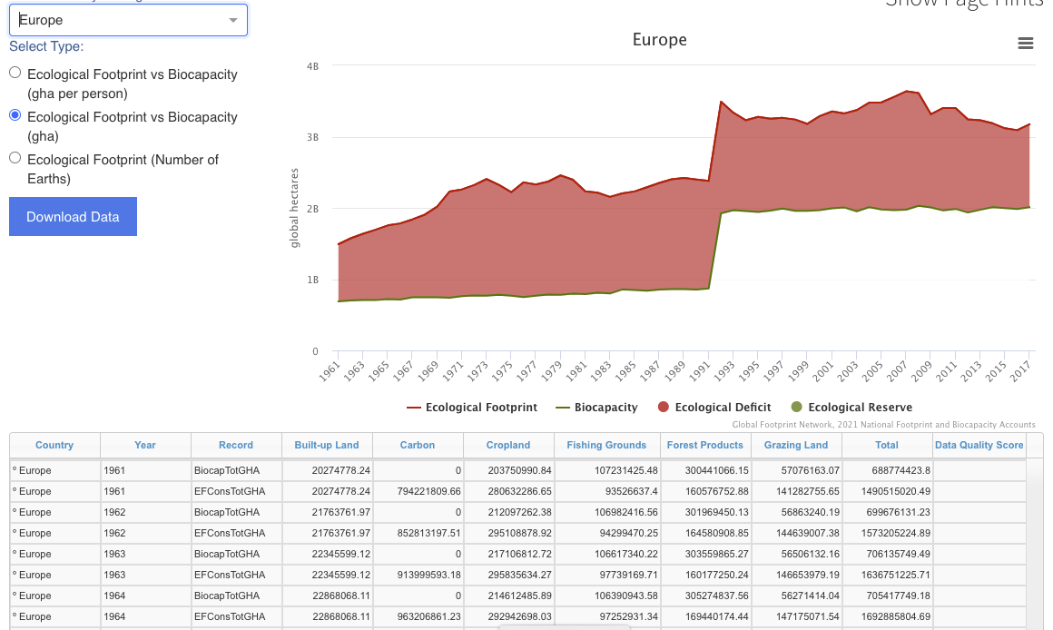
Here you see part of the
website of the
footprintnetwork with data from Europe.
Data from the world have been made available for you in an excel file.
Global Footprint Network National Footprint and Biocapacity Accounts, 2021 Edition Downloaded 20210902]from https://data.footprintnetwork.org.

Slide 33
3.3 Exploring and analysing footprint data (worksheet 3.3)
Download the excel file with footprint data
Explore the data-file using the questions on the worksheet and the codebook (see next slide)

Slide 34
Questions to explore the excel file
How many rows? How many columns? How many cells? What types of data?
Why are some numbers big and others small (even in the same column)?
What is meant by the headings of columns? What special columns are there? What is in them?
How is the data organised in the table?
HINT: use the codebook to further explore and understand

Slide 35
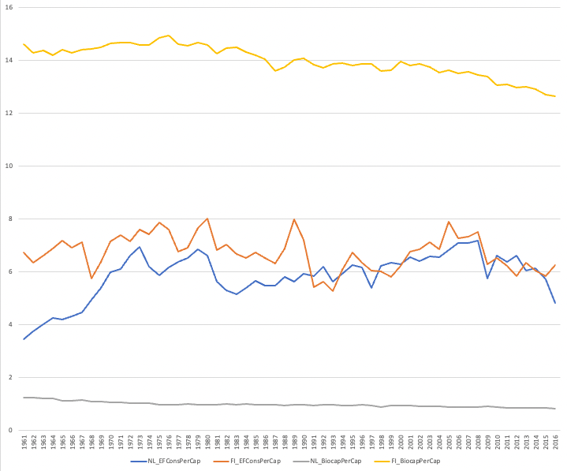
3.3 Selecting an d graphing the data
Use the worksheet and the Excelfile to make a combined line graph for 2 countries
Compare the results in the whole group and discuss your ways of working.

Slide 36
4. Teaching

Slide 37
Activity 4.1
Analysing and reviewing a lesson

Slide 38
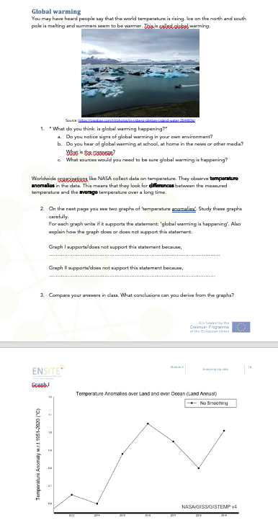
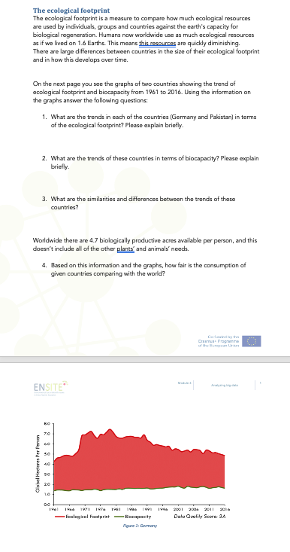
4.1 Reviewing a lesson
Select one of the 2 lessons
Individually: do the tasks
In pairs: share your work and discuss it (see worksheet 4.1)
Your opinion about the topic and the tasks
How this lesson fits the topics and goals of the secondary school curriculum
Improvements you would make
What you need to teach this lesson

Slide 39
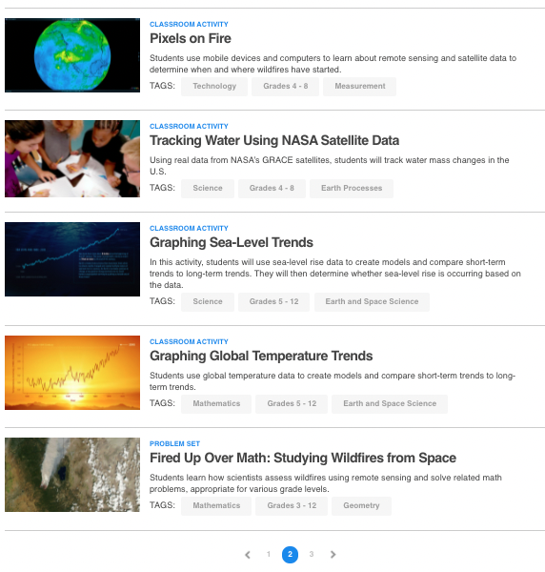
4.1 Optional follow-up activity
On the internet (for example on websites of NASA, EU and other sites) you can find data and educational materials on environmental SSI.
Choose teaching materials that fit your pupils and review these, using worksheet 4.1.
https://www.jpl.nasa.gov/edu/teach/tag/search/Climate+Change

Slide 40
Activity 4.2 optional
(Re)designing a lesson or a data talk activity

Slide 41
4.2 (re)designing a lesson or an data talk activity including an environmental SSI
Data talks are short 5-10 minute classroom discussions to help students develop data literacy.
https://www.youcubed.org/resource/data-talks/
Find a graphic and ask:
What do you notice?
What do you wonder?
What is going on in this data visualization?

Slide 42
4.2 Requirements, your design should include:
A lesson plan
A teachers guide: including some background on teaching goals, pre-requisite knowledge, content/context (environmental SSI), relations to the curriculum, pedagogical approach….
The teaching materials for the students/pupils.
Notes:
Soll das E

