Slide 1
DEcision-making based on confronting scientific positions
Decision-making based on confronting scientific positions on the example of food provision for the world

Slide 2
Decision-making based on confronting scientific positions
Science
Society
ENVIRO
SSI

Slide 3
Learning outcomes (I) “Decision-making in food market”
Different strategies for decision-making
Understanding of decision-making process, i.e. steps needed to be carried out, evaluation of conditions, results, and consequences
Examples of decision-making strategies connected with food-world
Reflection on specific characteristics of decision-making strategies and their relation to mathematics and science education
Beliefs on decision-making in relation to food market and their influence on human being
Examples of own decision-making cases from everyday life connected with food consumption

Slide 4
Learning outcomes (II) “Decision-making in food market”
Skills to compare different ways of dealing with decision making. i.e. acting in the sense of active and critical citizenship versus ignoring evidence and following “leaders” on examples from food-world
Reasons for including decision-making in science education
Experience in decision making in classroom teaching: an example with food topic for use on secondary level
Reflections on what students learn when dealing with such a task
Readiness to include decision-making in day-to-day teaching
First introduction into pedagogical concepts for dealing with topic decision making

Slide 5
Structure of the module
Three sessions
Introduction
„warm-up“ activities
Immersion
context activities
„role play“ activities
Application
activities with practical orientation
„experimental“ activities including

Slide 6
Types of Activities
Working with information sources
Brainstorming and brain writing activities
Story telling as support of communication
Role playing as support of communication
Practical (incl. experimental) activities as evidence based (science) communication

Slide 7
Structure of session I. – Introduction
Activity 1.1. Evocation
„Free writing“ about phenomena „decision making“ based on pictures about food
To add „Title“ and „Short description“ to elected picture
Activity 1.2 Mapping the field of interest
Brainstorming activity with central term “FOOD” or “FOOD CHOICE”
Clustering and concept mapping

Slide 8
Structure of session II. – Immersion
Activity 2.1. Decision making about food as multi context phenomenon
Contexts related to phenomenon: Sensory assessment, Content assessment, Tradition in use, Advertising influence, Following the leaders, Packaging, Branding, Costs limits, Own beliefs about…
Application of „snow-ball“ method, using of cards („food cards“)

Slide 9
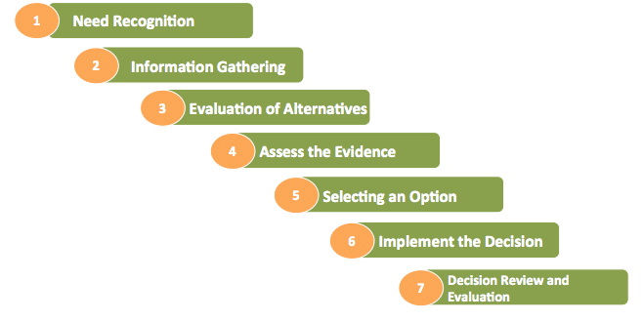
Structure of session II. – Immersion
Activity 2.2. My decision to buy a food
Theories behind of Buying Behavior
Generic Theory of Buying Behavior
the buyer will initiate research on products and pricing…
Cultural Theory of Buying Behavior
set of values and beliefs learned in the context of a community…
Environmental Theory of Buying Behavior
behavior based upon the situation…
Internal Theory of Buying Behavior
decision by kind of personality…
Creation and application of questionnaire or interview (research questions, items, sample, data elaboration, publishing)

Slide 10
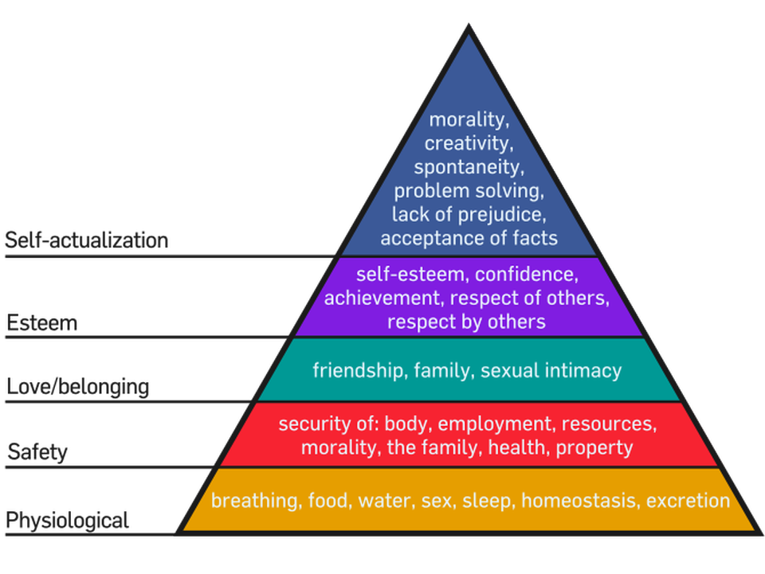
Structure of session II. – Immersion
Activity 2.3 Food market and food consumption in different countries (regions, cultural customs, religions…)
Identification of natural (science elements) and social (cultural elements) and ecological (global ecological elements) contexts of the food market and food consumption
Application of information sources analysis
Inscenations, dramatization
Exhibition of products, competition
Cultural context (f2f or on-line)

Slide 11
Structure of session III. – Application
Activity 3.1 Decision making about food in numbers
Analysing of different „numbers“ about decisions
Food consumption in different part of the world (e.g. per country, per capita, per age group; consumption in household, numbers of production, numbers of waste etc.)
Calculation of different footprints connected with different products and activities (connected with comparison food needs in different part of the world)
Calculation of food consumption in different areas and what we can do with these calculations (calculations connected with food production, transport, consumption and waste)

Slide 12
Structure of session III. – Application
Activity 3.2 Decision making for food storage and transportation
Storage (expiration, durability etc.) and transportation (distances, needs, „hidden bussiness“ etc.)
to prepare own product in form of
“mind map”
“flowchart”
“lab manual for model experiment”
and show and discuss it in classroom or in wider forum.

Slide 13
Structure of session III. – Application
Activity 3.3 Decision making about food in confrontation of different contexts
Preparation and consumption of food in history and in current situation and also in prognosis for the future in view of different cultures
Science context (contents, mechanical, physical, chemical and biological properties)
Social context (culture, history and nowadays and future, fair trade, solidarity etc.)
video “The Hidden Costs of Hamburgers”

Slide 14
Structure of session III. – Application
Activity 3.4. Decision making about food in simple science experiments
To propose, to realise and to interpret experiments with food
Food as multi component objects (chemical content, physical properties, biological activity, paradoxes, coherency etc.)
Food cleaning (filtration, crystallization, destilation, etc.)
Food conservation (chemicals, procedures, etc.)
Food as power of life (energy consuption, energy production, energy conservation etc.)

Slide 15
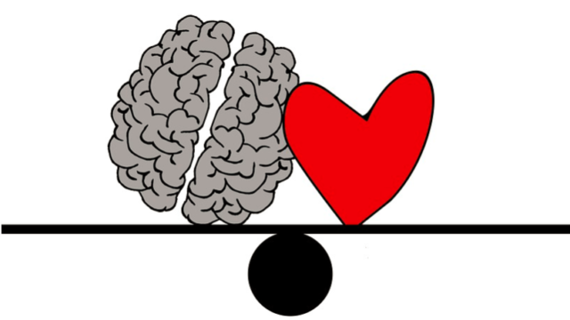
Decision-making based on confronting scientific positions
Science
Society
OR/AND???
THANK YOU FOR YOUR ATTENTION AND COOPERATION!

