Slide 1
IO 10 Lesson planning II
Focus to methods
Constantine the Philosopher University in Nitra

Slide 2
Module 10 Description
Reflection and critical analysis on specific designs on SSI lessons.
Examples of lessons designs on SSI where activities of creativity, critical thinking and reasoning are dominant.
Give future teachers a deeper understanding and stronger appreciation of the usefulness and effectiveness of STEM lessons which focus on the development of creativity, critical thinking and reasoning in relation to SSI.
Pedagogical concepts for dealing with SSI and provoking creativity, critical thinking and reasoning among students such as problem solving strategies in dealing with open-ended problems; inquiry-based learning; discussion on different solutions; making prognosis; giving arguments for solution assessment.
Constantine the Philosopher University in Nitra

Slide 3
Structure of Module 10 Activity 1
Reflection and critical analysis on specific designs on STEM lessons
Two examples: Aircraft fuel consumption and Flow of fluids: River
Common and different features of materials and methods
Citizenship: individual and society and science dimensions of the two lessons topics
How adapt two lessons to be more actual and motivated, including SSI principles
Redesigning the lesson
Discussing the redesigned lesson with schoolmates, lesson study principles
Constantine the Philosopher University in Nitra

Slide 4
Structure of Module 10 Activity 2
2. Examples of lessons designs on SSI where activities of creativity, critical thinking and reasoning are dominant
Example lesson: Mathematics outdoor trail with support of ICT device and portal, topic: Tree or Water
Linking SSI principles to key competences framework and outdoor education
Designing an outdoor MCM trail on topic Tree or Water
How to include environmental socio-scientific issues into outdoor teaching?
Example lesson: Carbon footprint
Designing a STEM lesson with carbon footprint topic and its reflection
Constantine the Philosopher University in Nitra

Slide 5
Structure of Module 10 Activity 3
3. Give future teachers a deeper understanding and stronger appreciation of the usefulness and effectiveness of STEM lessons which focus on the development of creativity, critical thinking and reasoning in relation to SSI.
Reflection of
what do ITE students learn about pedagogical concepts for dealing with SSI and provoking creativity, critical thinking and reasoning?
what do students (pupils) learn in relation to importance and usefulness of mathematics and science knowledge and competencies for being active citizen and keeping the environmental principles and sustainability in everyday life?
Constantine the Philosopher University in Nitra

Slide 6
1. Reflection and critical analysis on specific designs on SSI lessons
Two examples
Aircraft and River
Constantine the Philosopher University in Nitra

Slide 7
Structure of Module 10 Activity 1
Reflection and critical analysis on specific designs on STEM lessons
Two examples: Aircraft fuel consumption and Flow of fluids: River
Common and different features of materials and methods
Citizenship: individual and society and science dimensions of the two lessons topics
How the two lessons topics adapt to be more actual and motivated, including SSI principles
Redesigning the lesson(s)
Discussing the redesigned lesson with schoolmates, lesson study principles
Constantine the Philosopher University in Nitra

Slide 8
Activity 1.1: Two STEM lessons plans INTRODUCTION
Two lessons with focus to interdisciplinary approach and SSI principles analysis.
Study content, concepts and methods in plans of two lessons:
Fuel requirements for aircraft Aircraft
Flow of fluids River
Constantine the Philosopher University in Nitra
Notes:
Image from Pixabay: It is not necessary to quote the source

Slide 9
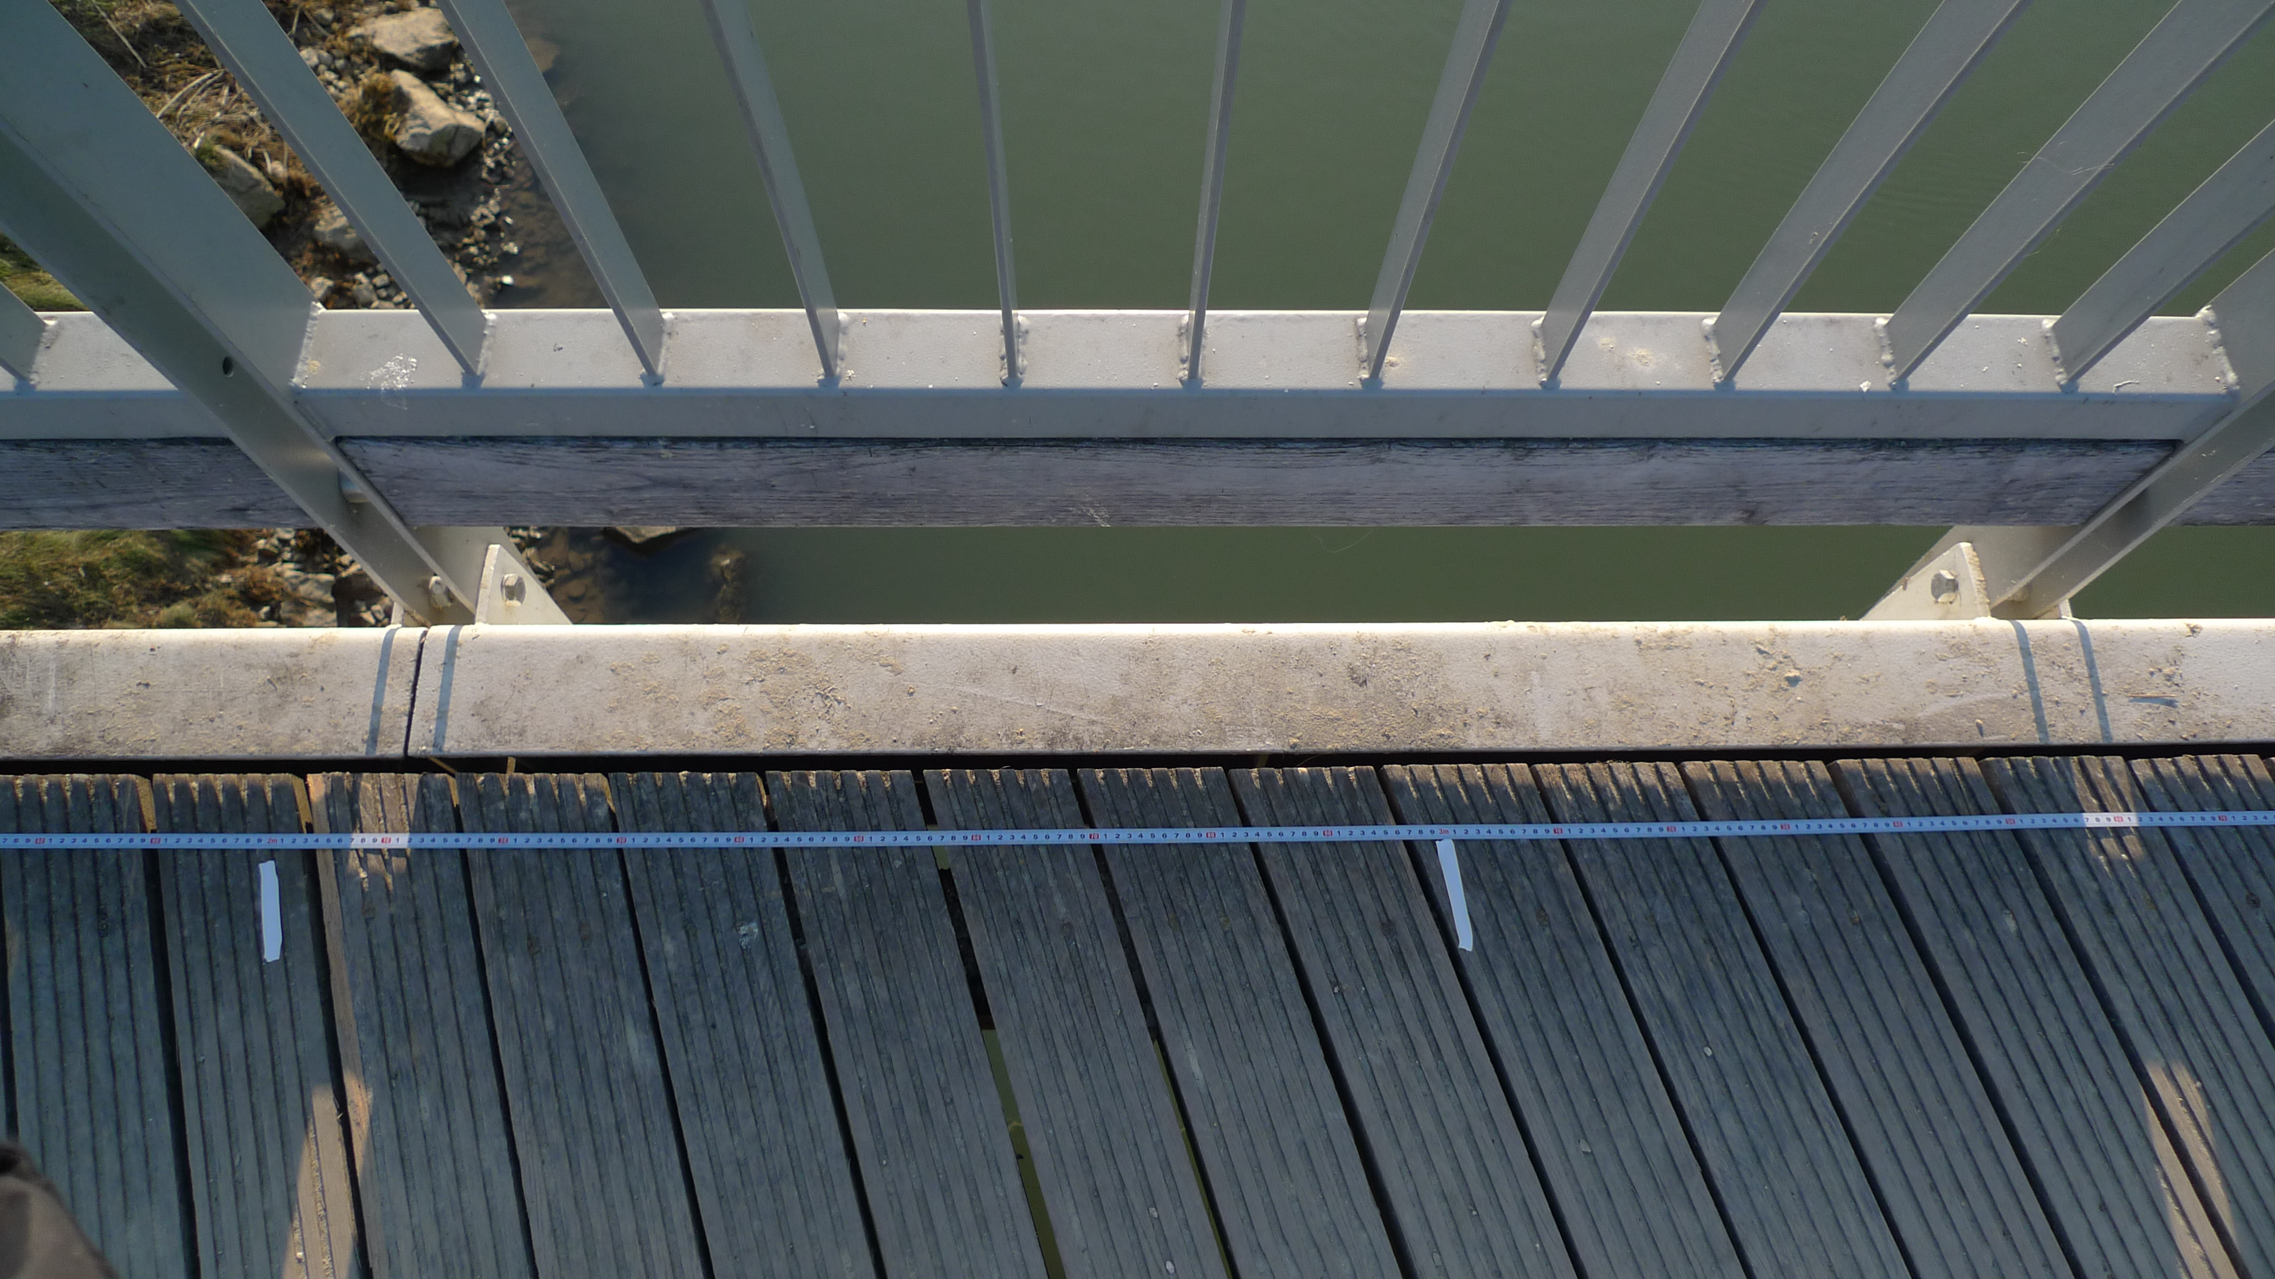
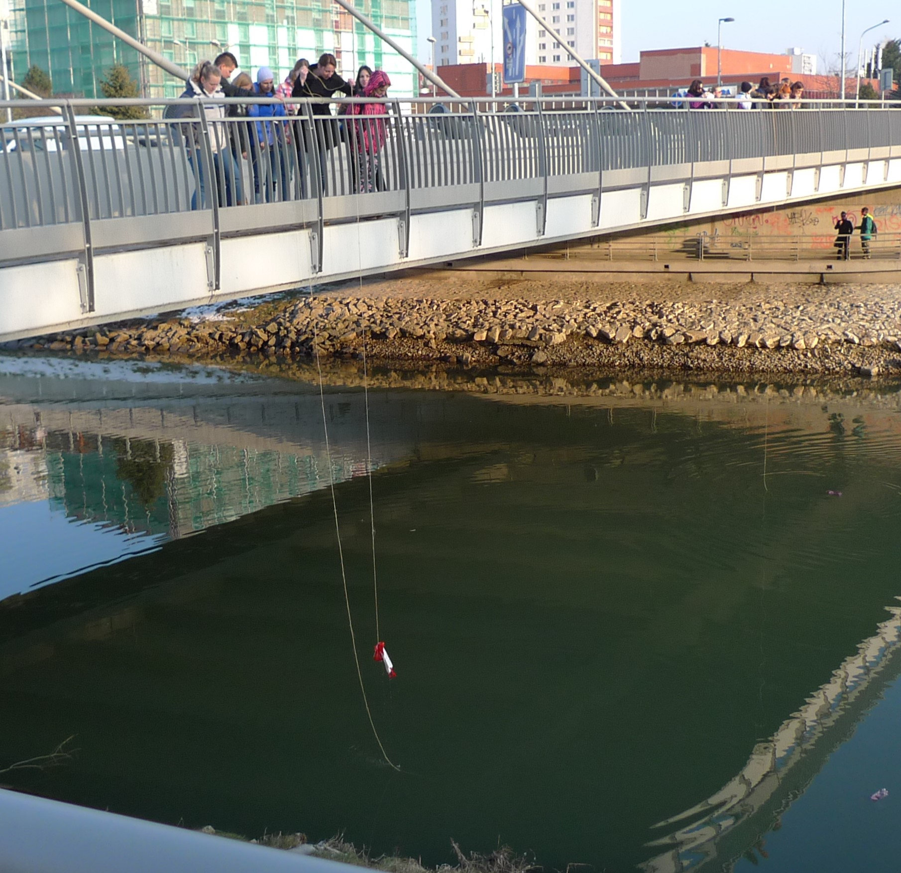
Activity 1.1: Two STEM lessons plans INTRODUCTION
Constantine the Philosopher University in Nitra

Slide 10
Activity 1.2: Two STEM lessons plans ANALYSIS
Inform your schoolmates about the lesson plan, content, concept and methods designed.
As a future mathematics teacher: Which lesson would you prefer? Why?
As a student: Which lesson would you prefer? Why?
Do you notice some socio-scientific dimension in the two lessons? Which?
Describe how strong is the lesson topic connected with
your personal life,
research, science.
Constantine the Philosopher University in Nitra

Slide 11
Activity 1.3: Two STEM lessons plans DISCUSSION
LESSON PLANNING II
In how far do such topics relate to STEM education? What do you think?
Do you think dealing with such topics is included in syllabus of mathematics? If so, how?
Constantine the Philosopher University in Nitra

Slide 12
Activity 1.3: Two STEM lessons plans DISCUSSION
LESSON PLANNING II
Which topics are normally dealt with in relation of transport or fluids (rivers, water) at school?
To what extend do these topics motivate students?
To what extend do these topics show students why mathematics is important for everyday life?
What is missing?
What would you add to the lessons?
Constantine the Philosopher University in Nitra

Slide 13
Activity 1.4: Two STEM lessons plans SSI TOPICS
SSI topics for discussion, open ended problems for IBL pedagogies
Aircraft: Massive aircraft transport over living area, fields and gardens, influences the environment in the area: noise, the quality of air, the quality of ground because of liquid pollution from plains. Some farmers blamed massive aircraft transport over town Nitra (Slovakia) of very bad quality of vegetable they plant on their fields (especially tomatoes).
What do you think about such problem?
Constantine the Philosopher University in Nitra

Slide 14
Activity 1.4: Two lessons plans SSI TOPICS
River: Building small hydropower systems on small rivers was very attractive business in Slovakia last years. Opponents, ecologists, argument: Small hydropower system is the ecological catastrophe!
What do you think about such problem?
Constantine the Philosopher University in Nitra

Slide 15
Activity 1.5: Two STEM lessons plans HOMEWORK
Individual homework
Choose one of the two lessons and adapt the lesson
to become more motivated for students (teenagers)
to show the importance of mathematics competencies for solving real life problems
to discuss the SSI principles during the lesson
Consider the OECD 21 century competences and Competences for lifelong learning
Constantine the Philosopher University in Nitra

Slide 16
OECD 2013 21th century competences
Analytic skills | Interpersonal skills | Ability to execute | Information processing | Capacity for change
Critical thinking | Communication | Initiative and self-direction | Information literacy | Creativity Innovation
Problem solving | Collaboration | Productivity | Media literacy | Adaptive learning Learning to learn
Decision making | Leadership and responsibilities |  | Digital citizenship | Flexibility
Research and inquiry |  |  | ICT operations and concepts
Constantine the Philosopher University in Nitra

Slide 17
Key Competence Framework of the EU
Literacy competence
Multilingual competence
Mathematical competence and competence in science, technology and engineering
Digital competence
Personal, social and learning to learn competence
Citizenship competence
Entrepreneurship competence
Cultural awareness and expression competence
COM (2019). Key competences for lifelong learning
Constantine the Philosopher University in Nitra

Slide 18
Activity 1.6: Redesigned STEM lessons plans HOMEWORKS PRESENTATION AND DISCUSSION
Discussing the redesigned lesson plan
Method: Lesson study principles
Sharing the redesigned lesson plan with the whole group
Constantine the Philosopher University in Nitra

Slide 19
Structure of Module 10 Activity 1
Reflection and critical analysis on specific designs on STEM lessons
Two examples: Aircraft fuel consumption and Flow of fluids: River
Common and different features of materials and methods
Citizenship: individual and society and science dimensions of the two lessons topics
How the two lessons adapt to be more actual and motivated, including SSI principles
Redesigning the lesson(s)
Discussing the redesigned lesson with schoolmates by using method: Lesson study principles
Constantine the Philosopher University in Nitra

Slide 20
Structure of Module 10 Activity 2
2. Examples of lessons designs on SSI where activities of creativity, critical thinking and reasoning are dominant
Example lesson: Mathematics outdoor trail with support of ICT device and portal, topic: Tree or Water
Linking SSI principles to key competences framework and outdoor education
Designing an outdoor MCM trail on topic Tree or Water
How to include environmental socio-scientific issues into outdoor teaching?
Example lesson: Carbon footprint
Designing a STEM lesson with carbon footprint topic and the lesson reflection
Constantine the Philosopher University in Nitra

Slide 21
2. Examples of lessons designs
Three examples
Tree, Water, Carbon Footprint
Constantine the Philosopher University in Nitra

Slide 22
Activity 2.1: Quiz, topic: TREE
Quiz prepared by ITE educator.
The topic of the quiz: TREE evokes many SSI topics with focus to importance of trees and their characteristics or parameters for life of:
individuals,
society,
science.
Constantine the Philosopher University in Nitra

Slide 23
Activity 2.1: Quiz, topic: TREE
Socrative student login
Room name: MATEMATIKA8761
Constantine the Philosopher University in Nitra

Slide 24
Activity 2.1: Quiz, topic: TREE
Quiz results discussion
SSI topics for indoor and/or outdoor lessons
Constantine the Philosopher University in Nitra

Slide 25
Quiz results discussion: Mind map TREE
Constantine the Philosopher University in Nitra

Slide 26
Quiz results discussion: TREE PROJECT
Project and mathematical trail
Trees around us
Compose, solve and publish at least five mathematical tasks about trees on your school yard (or other selected area such is: park, botanical garden, …).
Draft tasks:
Is there some fruit tree on your school yard? If yes, what kind of fruit is it?
Which tree is the oldest one?
Which tree is the highest one?
Which tree has the thickest trunk?
What is the longest direct distance between two tress of the same species?
Additional tasks
Make a real map of trees, localization of every tree (GPS) and photo.
Is there some tree dangerous? Why?
Choose your favorite tree and describe it in details.
Constantine the Philosopher University in Nitra

Slide 27
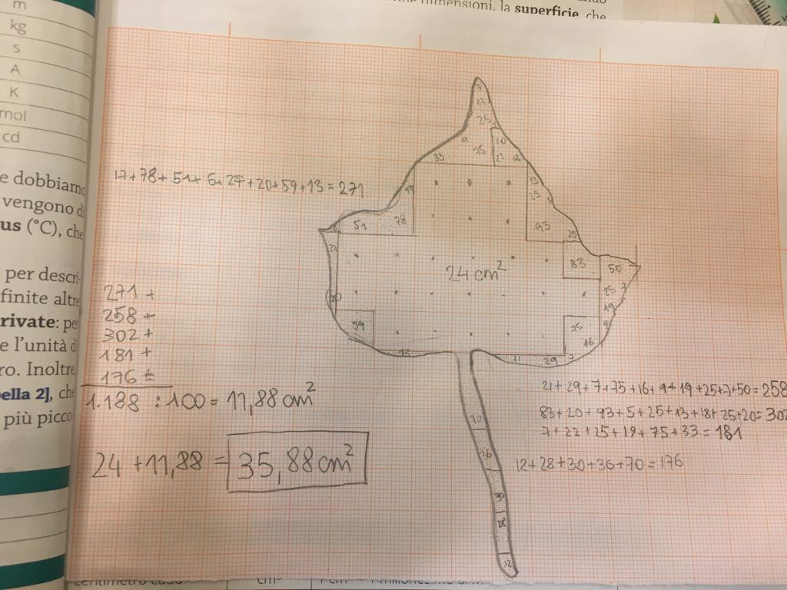
Quiz results discussion: TREE MATHEMATICS
Do you like these pictures?
Choose the favorite tree with leaves and count the area of one leaf.
Can you estimate how many leaves are on one single tree? What methods would you use to calculate the number of leaves on the tree?
Can you estimate the area of the tree (with leaves) crown?
Constantine the Philosopher University in Nitra

Slide 28
Quiz results discussion: STEM and IBL lessons
Constantine the Philosopher University in Nitra

Slide 29
Activity 2.2: Outdoor lesson introduction
Introduction to principles of outdoor lesson using MathCityMap (MCM) application
MathCityMap (MCM) portal short introduction
Generic tasks database presentation
MCM application downloading
Constantine the Philosopher University in Nitra

Slide 30
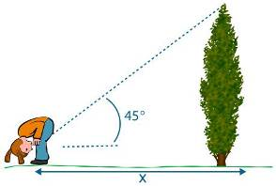
Activity 2.2: Outdoor lesson introduction
MCM Generic tasks
Constantine the Philosopher University in Nitra

Slide 31
Activity 2.3: Outdoor lesson experience
Homework
outdoor trail (MCM), in groups
or
[MCM@home] trail, individual
Constantine the Philosopher University in Nitra

Slide 32
Activity 2.3: Outdoor lesson experience
Homework experience
feedback
summary
Discussion about SSI principles in outdoor trail and tasks
Constantine the Philosopher University in Nitra

Slide 33
Activity 2.4: Create outdoor lesson
Design outdoor tasks and trail
Discuss the SSI principles of the trail
Which objects to choose and which parameters calculate?
Trees
Fountains
Drinking water sources
Wild water reservoirs
...
Constantine the Philosopher University in Nitra

Slide 34
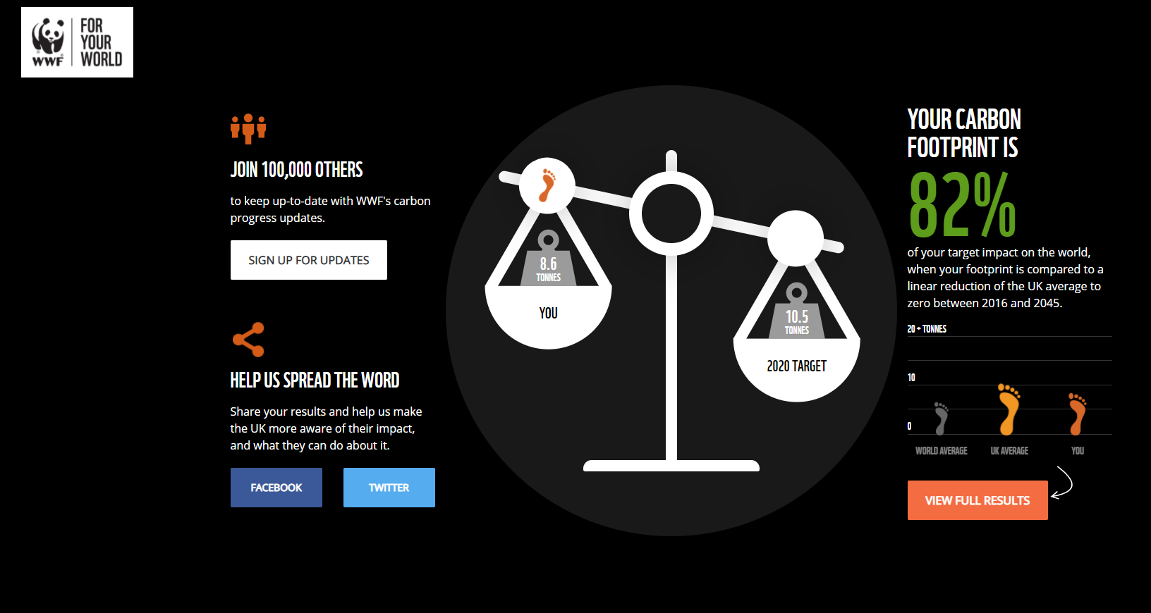
Activity 2.5: Example lesson: Carbon footprint
https://footprint.wwf.org.uk/#/
Constantine the Philosopher University in Nitra

Slide 35
Activity 2.5: Example lesson: Carbon footprint
https://footprintcalculator.henkel.com/en
Constantine the Philosopher University in Nitra

Slide 36
Activity 2.6: Carbon footprint LESSON DESIGN
Designing a STEM lesson with carbon footprint topic
Comparing the footprint calculators
Discussion about key principles of sustainable environment
Role of
Individuals
Families
Society ...
Reflection of the designed lesson.
Constantine the Philosopher University in Nitra

Slide 37
Structure of Module 10 Activity 2
2. Examples of lessons designs on SSI where activities of creativity, critical thinking and reasoning are dominant
Example lesson: Mathematics outdoor trail with support of ICT device and portal, topic: Tree or Water
Linking SSI principles to key competences framework and outdoor education
Designing an outdoor MCM trail on topic Tree or Water
How to include environmental socio-scientific issues into outdoor teaching?
Example lesson: Carbon footprint
Designing a STEM lesson with carbon footprint topic and the lesson reflection
Constantine the Philosopher University in Nitra

Slide 38
3. Usefulness and effectiveness of mathematics lessons in relation to SSI
Cafe sharing method
Essay
Assessment
Granularity
Constantine the Philosopher University in Nitra

Slide 39
Structure of Module 10 Activity 3
3. Usefulness and effectiveness of mathematics lessons in relation to SSI
Give future teachers a deeper understanding and stronger appreciation of the usefulness and effectiveness of STEM lessons which focus on the development of creativity, critical thinking and reasoning in relation to SSI.
Pedagogical concepts and active methods reflection: What do ITE students learn about pedagogical concepts for dealing with SSI and provoking creativity, critical thinking and reasoning?
Importance and usefulness of key competencies: What do students (pupils) learn in relation to importance and usefulness of mathematics and science knowledge and competencies for being active citizen and keeping the environmental principles and sustainability in everyday life?
Constantine the Philosopher University in Nitra

Slide 40
Activity 3.1: ITE students reflection to lesson 1
What do ITE students have learnt about pedagogical concepts for dealing with SSI and provoking creativity, critical thinking and reasoning?
Cafe sharing method
Designed lessons: feedback and pedagogical concepts analysis
pedagogical methods mapping
principles of creativity, critical thinking and reasoning specifying
SSI approach specification
Constantine the Philosopher University in Nitra

Slide 41
Activity 3.2: Importance and usefulness of key competencies
What do students (pupils) learn in relation to importance and usefulness of mathematics and science knowledge and competencies for being active citizen and keeping the environmental principles and sustainability in everyday life?
Essay
Give the personal feedback with the Module 10 theoretical experience
Give the authentic feedback based on Module 10 lessons with pupils during practice
Constantine the Philosopher University in Nitra

Slide 42
Assessment Colloquium
Student teacher
One own designed (redesigned) lesson presentation
Essay summary presentation
Formative assessment by lecturer or by schoolmate(s) or by colloquium board
Constantine the Philosopher University in Nitra

Slide 43
Summary Module 10
Students workload
1 lesson redesigned
3 lessons designed
2 lessons accomplished
1 quiz
1 essay
Four – five 90 minutes sessions
IBL pedagogies
Outdoor (out of school) teaching
ICT and digital technologies
Small groups
Cafe sharing method
Lesson Study method
Role playing method
Plenary presentation
Constantine the Philosopher University in Nitra

