Slide 1
The nature of enviromental socio-scientific issues
How do they look like and why are they relevant for STEM teaching

Slide 2
Structure of session
What are environmental socio-scientific issues?
  Two introductinal examples
  Definition of environmental SSI
  How to deal with enviromental SSI?
How do environmental socio-scientific issues connect to mathematics and science education?
  Reflection on the aims of mathematics and science education
  Linking SSI to key competence framework
  What does citizenship education mean for maths and science?
  Reflecting on possibilities and limitations of maths and science
How to include environmental socio-scientific issues into teaching?
  Example tasks for secondary level – what do students learn?
  Designing a lesson

Slide 3

1. What are environmental socio-scientific issues?

Slide 4
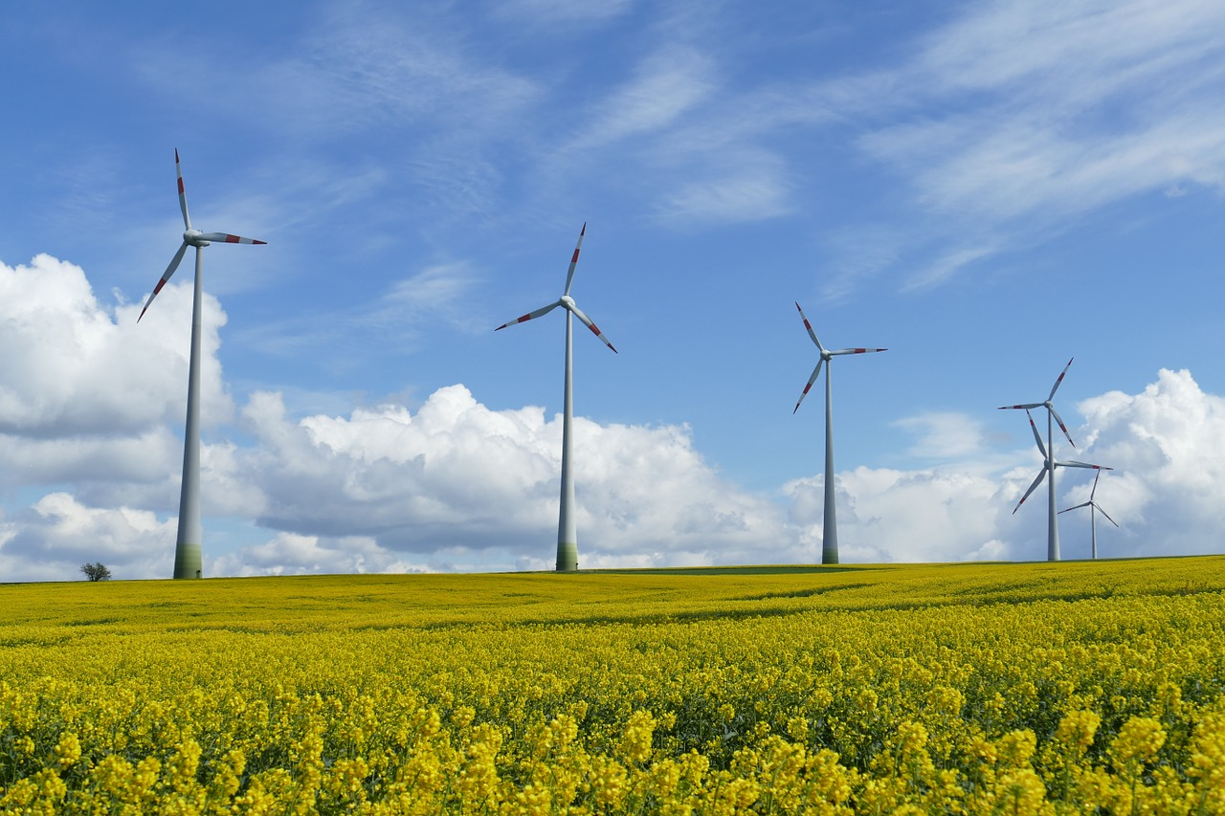
Example 1: Should wind power plants be set up everywhere?
Wind turbines are generally considered a clean energy source. Nevertheless, the construction of wind turbines, especially near residential areas, divides our society.
Notes:
Image from Pixabay: It is not necessary to quote the source
Note for the lecturer

Slide 5
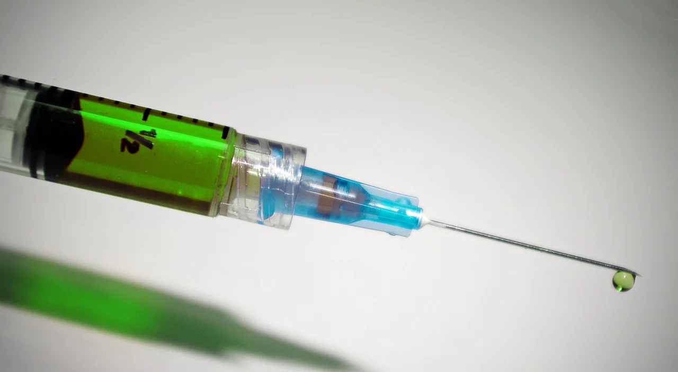
Example 2: Should the SARS-Covid-2 vaccination be obligatory?
For many diseases, vaccinations provide effective protection, but always carry certain risks of vaccine reactions. Whether vaccinations should be used or not is therefore always a weighing of the risks and often leads to differing opinions both in society and among experts.
Notes:
Image from Pixabay: It is not necessary to quote the source

Slide 6


Activity 1.1:a) “Should wind power plants be set up everywhere”
The goal of this task is to show how different opinions evolve and strengthen.
Would you accept a wind power plant near your house?
  What are the advantages/disadvantages of installing wind power plants?
Put yourself in the role of a politician/expert. How would you argue…
  … if you would like to promote the installation of a wind power plant close to your village
  … if you oppose installing wind power plants in your village
Do a research.
  Find list of (seemingly) scientific based arguments favoring respectively opposing the use of wind power plants.
  Elaborate on the connection between the main question and scientific facts.
  What other aspects influence the decision on setting up wind power plants?
Notes:
Image from Pixabay: It is not necessary to quote the source

Slide 7


Activity 1.1b): Should the SARS-Covid-2 vaccination be obligatory?
The goal of this task is to show how different opinions evolve and strengthen.
Are you for or against SARS-Covid-2 vaccination?
  How do proponents argue?
  How do opponents of vaccination argue?
Put yourself in the role of an expert/politician. How would you argue…
  … if you would like to promote a vaccine mandate for SARS-Covid-2
  … if you oppose installing a vaccine mandate for measles
Do a research.
  Find list of (seemingly) scientific based arguments favoring respectively opposing the use of vaccines.
  Elaborate on the connection between the main question and scientific facts.
  What other aspects influence the decision on vaccination?
Notes:
Image from Pixabay: It is not necessary to quote the source

Slide 8
Activity 1.2: Should wind power plants be set up everywhere?/Should vaccination be mandatory -> choose your example
In how far is it important to reflect on such questions?
Which topics are normally dealt with in relation with these examples at school?
To what extend do these topics prepare students in dealing with such questions.
What questions or facts do you miss?
Conclude: Would you use this example in class? If yes, what should students learn from?

Slide 9


Activity 1.3 Comparing the two examples with „traditional“ tasks
To what extend are such tasks different to „traditional“ tasks you know from your time in school?
What are their features and what are their challanges when using them in class?
Traditional task
Read about active and passive immunization. What are the differences?

Slide 10
Socio-scientific Issues (SSI)
Such problems as the wind power question and the vaccination question are examples of Socio-scientific Issues (SSI‘s).
SSIs have a basis in science and require people to engage in dialogue, discussion, and debate.
They are mainly controversial in nature.
They require forming opinions and making decisions including moral, ethical or social reasoning issues.

Slide 11
Socio-Scientific Issues (SSI)
Intransparent or incomplete information situation:
Mostly, people have to deal with these issues through incomplete information because of conflicting or incomplete scientific evidence and incomplete reporting
Lack of objectivity
Often these issues involve a cost-benefit analysis in which risk interacts with ethical reasoning

Slide 12
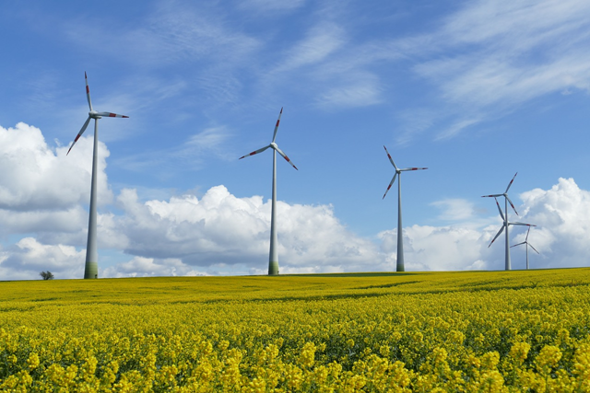


Activity 1.4: How to proceed when dealing with SSI?
Should wind power plants be set up everywhere?
Should the SARS-Covid-2 vaccination be obligatory?
How do we have to proceed when dealing with a socio-scientific issue in class? What has to be taken care of specifically?
Set up a list of steps that need to be taken.

Slide 13
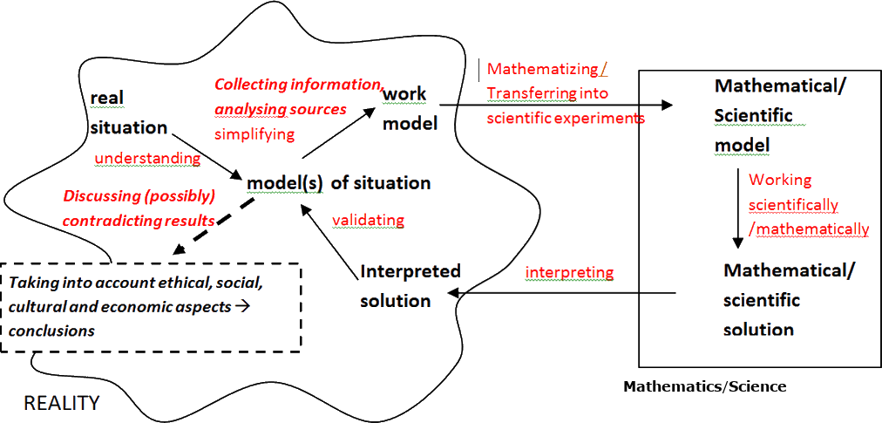
Dealing with Socio-Scientific issues
From Maass, Doorman, Jonker, Wijers (2019).

Slide 14
Explanation of the cycle
When modelling real-world problems often a cycle is used to describe the proceeding
Based on Blum and Leiss (2007), we conceptualize the following steps of the modelling process: (1) understanding the instruction and the real situation (situation model); (2) making assumptions and simplifying the situation model (real model); (3) mathematizing the real model (construction of a mathematical model); (4) working within the mathematical model (mathematical solution); (5) interpreting the solution; (6) validating the interpreted solution. The modelling process may be illustrated by the following scheme.
An idealized scheme of the modelling process based on Blum & Leiss (2007)
Blum, W., & Leiss, D. (2007). How do students and teachers deal with modelling problems? In: C. Haines, W. Blum, P. Galbraith & S. Khan (Eds), Mathematical modelling (ICTMA 12): Education, engineering and economics (pp. 222–231). Chichester, UK: Horwood.

Slide 15
Explanation of the extended modelling cycle
When dealing with SSIs, the steps as outlined in the modelling process (see prior slide) need to be extended to fully take into account the specific features of SSIs. These extensions could include: search for information and (risk) analysis of sources of information, discourse about (possibly) contradicting scientific results and ethical, social, cultural reasoning (Zeidler and Nicols 2009). Particularly the difference between scientific results and conclusions has to be made clear (Ratcliff and Grace 2003). A possible resulting modelling process is shown on the slide before.
Maass, K., Doorman, M., Jonker, V. & Wijers, M. (2019). Promoting active citizenship in mathematics teaching. ZDM Mathematics Education, 51(6), 991-1003. DOI 10.1007/s11858-019-01048-6.

Slide 16
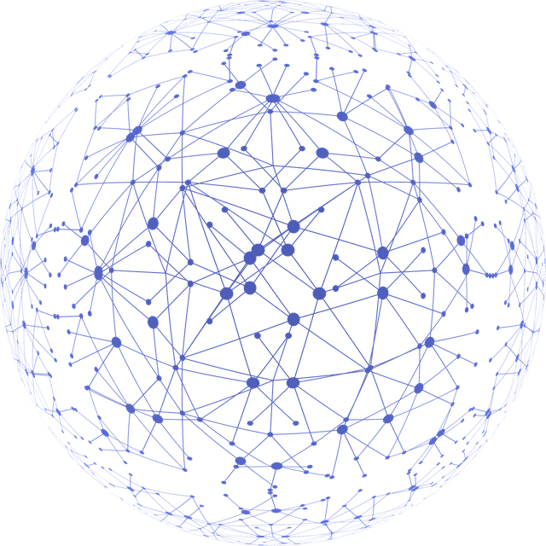
2. How do environmental SSI connect to mathematics and science education?

Slide 17


Activity 2.1: What are the aims of mathematics and science education?
What are the objectives of mathematics & science education from your perspective?
What do students learn when dealing with tasks like example 1 and example 2?

Slide 18
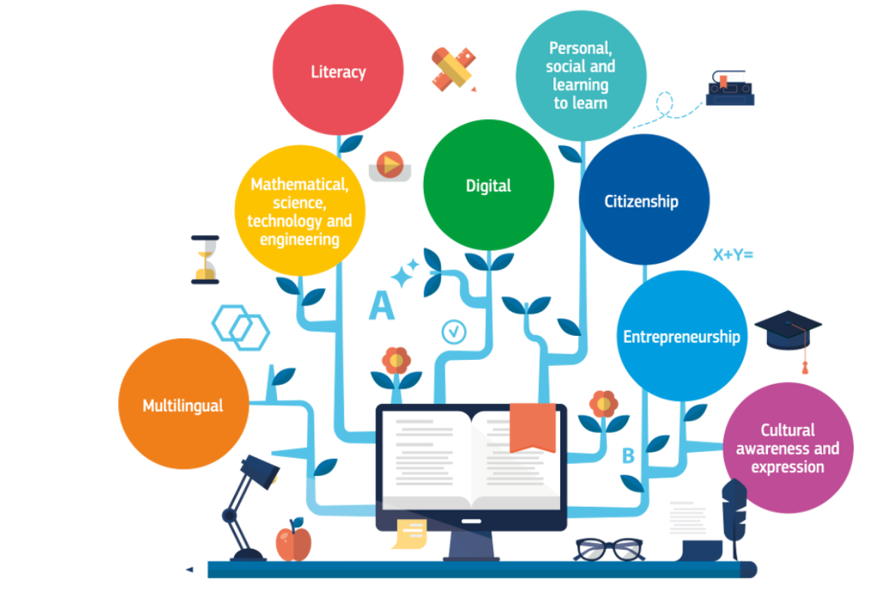
Key Competence Framework of the EU
Literacy competence
Multilingual competence
Mathematical competence and competence in science, technology and engineering
Digital competence
Personal, social and learning to learn competence
Citizenship competence
Entrepreneurship competence
Cultural awareness and expression competence
COM (2019). Key competences for lifelong learning

Slide 19
Mathematical competence
Mathematical competence is the ability to develop and apply mathematical thinking and insight in order to solve a range of problems in everyday situations.
Mathematical competence involves the ability and willingness to use mathematical modes of thought and presentation (formulas, models, constructs, graphs, charts).
(COM, 2019)

Slide 20
Mathematical competence: Knowledge, skills and attitudes
Skills:
An individual should have the skills
  to apply basic mathematical principles and processes in everyday contexts at home and work (e.g. financial skills),
  and to follow and assess chains of arguments.
An individual should be able
  to reason mathematically, understand mathematical proof and communicate in mathematical language,
  to use appropriate aids including statistical data and graphs and understand the mathematical aspects of digitalization.

Slide 21
Competence in Science: Knowledge, Skills and Attitudes
Competence in science refers to…
The ability and willingness to explain the natural world by making use of
  knowledge and methodology
  observation and experimentation.
The ability to identify questions and to draw evidence-based conclusions.
The understanding of the changes caused by human activity and responsibility as an individual citizen.

Slide 22
Competence in Science: Knowledge, Skills and Attitudes
Skills include
the understanding of science as a process for the investigation through specific methodologies, including observations and controlled experiments,
the ability to use logical and rational thought to verify a hypothesis and the readiness to discard one’s own convictions when they contradict new experimental findings.
the ability to use and handle technological tools and machines as well as scientific data to achieve a goal or to reach an evidence-based decision or conclusion.
the ability to recognize the essential features of scientific inquiry
the ability to communicate the conclusions and reasoning that led to them.
Source: (COM, 2019)

Slide 23
Citizenship Competence
Citizenship competence is the ability
to act as responsible citizens and to
to fully participate in civic and social life, based on understanding of social, economic, legal and political concepts and structures, as well as global developments and sustainability.

Slide 24
Citizenship Competence
Skills for citizenship competence relate to the ability to engage effectively with others in common or public interest, including the sustainable development of society.
This involves critical thinking and integrated problem solving skills, as well as skills to develop arguments and constructive participation in community activities, as well as in decision-making at all levels, from local and national to the European and International level.
This also involves the ability to access, have a critical understanding of, and interact with both traditional and new forms of media and understand the role and functions of media in democratic societies.

Slide 25


Activity 2.2: What does citizenship education mean in relation to science and mathematics education?
What could citizenship education in relation to science and mathematics mean?
Is something like citizenship competence included in the syllabus? If so: Where and how?

Slide 26

Activity 2.3: What are possibilities and limitations of maths and science?
What can mathematics and science offer to find solutions to global challenges?
What can mathematics and science not offer to solve global challenges?

Slide 27
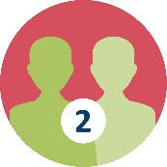
Activity 2.3: What are possibilities and limitations of science?
Myths
Hypotheses become theories which in turn become laws.
Scientific laws and other such ideas are absolute.
A hypothesis is an educated guess.
A general and universal scientific method exists.
Evidence accumulated carefully will result in sure knowledge.
Science and its methods provide absolute proof.
Science is procedural more than creative.
Consider the following list of myths about mathematics and science.
How do they reflect reality?
If you consider them to be wrong, correct them.
We will later discuss your ideas jointly.

Slide 28
Solution
Myth | Corrections
Hypotheses become theories which in tum become laws. | Laws are generalizations or pattems. Theories are explanations of those generalizations .
Scientific laws and Other such ideas are absolute. | Scientific laws have limitations and can be subject to revision.
A hypothesis is an educated guess. | Hypothesis could mean (i) a generalizing hypothesis (which might become a law); (ii) an explanatory hypothesis (which might become a theory); (iii) a prediction.
A general and universal scientific method exists. | No research method is applied universally. Scientists approach and solve problems With imagination, creativity, prior knowledge and perseverance.
Evidence accumulated carefully will result in sure knowledge. | lt is impossible to make all possible observations and to secure facts for all time.
Science and its methods provide absolute proof. | Accumulated evidence can provide support for a law or theory but never prcwe them to be true.
Science is procedural more than creative Correction. | lt is the creativity of individual scientists which allows them to go beyond the evidence and develop laws and theories.

Slide 29
Objective: Fighting against myth about science
Consider the following list of myths about science. How do they reflect reality? We will later jointly discuss your thoughts.
Myths
Science and its methods can answer all questions.
Scientists are particularly objective.
Experiments are the principal route to scientific knowledge.
Scientific conclusions are reviewed for accuracy.
Acceptance of new scientific knowledge is straightforward.
Scientific models represent reality.
Science is a solitary pursuit.
Science and technology are identical.

Slide 30
Solution
Myths | Reality
Science and its methods can answer all questions. | Science cannot answer moral, ethical, social, aesthetic questions.
Scientists are particularly objective. | Scientists are no different in their objectivity than Other professionals. They do try to be careful in analysis of evidence.
Experiments are the principal route to scientific knowledge. | Scientific knowledge is gained in many ways including observation, analysis, speculation, library investigation and experimentation.
Scientific conclusions are reviewed for accuracy. | The number of findings from one laboratory checked by others is small .
Acceptance of new scientific knowledge is straightforward. | If an idea is a significant breakthrough or change, its acceptance is by no means quick or easy.
Scientific models represent reality. | Scientific models are created to describe aspects of the natural world and are useful in giving predictions and explanations .
Science is a solitary pursuit. | Scientists work in teams.
Science and technology are identical. | Pure science is the pursuit of knowledge for its own sake. Technology, or applied science, is exploitation of science.

Slide 31

Maths and Science education
Should maths and science education give students insight into possibilities and limitations of maths and science and clarify myths?
If so, how?
If not, why?
How can dealing with environmental SSI contribute to this?

Slide 32
3. How to include environmental SSI into teaching?

Slide 33
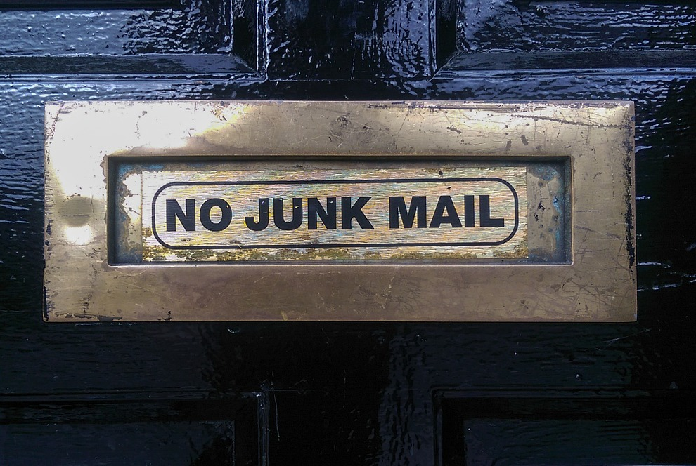
Activity 3.1: What do students learn when dealing with SSI?
This is an exemplary task for students, solve the
exercise yourself.
Everywhere in Europe people try to avoid junk mail in their mailbox by using “NO JUNK MAIL” stickers. However, often people do not use such stickers on throw any advertisement directly in the trashcan. This produces unnecessary waste of paper. In Amsterdam it is now forbidden to put junk mail in the mailbox as long as it is not explicitly allowed with a special sticker. The city reported, since then the paper waste decreased significantly.
How would such a ruling affect your city? Discuss how much paper waste could be avoided and which other effects (i.e. economical) may play a role?
Notes:
Image from Pixabay: It is not necessary to quote the source. In Amsterdam werrden dadurch 6000 Bäume und 34kg Papiermüll pro Haushalt gespart.
https://www.geo.de/natur/nachhaltigkeit/22480-rtkl-amsterdam-kein-werbe-muell-mehr-im-briefkasten-so-machen-es-unsere

Slide 34
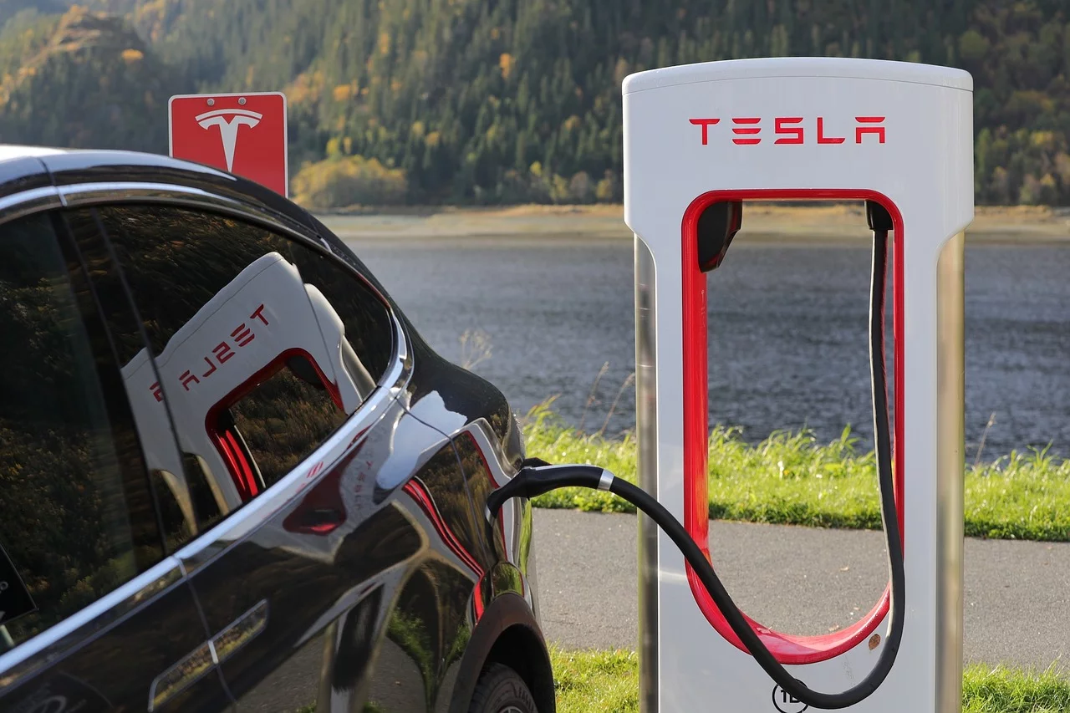
Activity 3.1: What do students learn when dealing with SSI?
This is an exemplary task for students, solve the
exercise yourself.
While discussions about climate change are heating up and divide our country, electric cars become more and more popular throughout our society.
Critics of electric cars often argue that the need for rare earth elements in batteries makes their life cycle assessment (LCA) worse than the LCA of Diesel cars.
Do you think an electric car is the better option? Start with a list of pros and cons for electric and diesel cars. Do research on this topic and argue carefully in the end.
Notes:
Image from Pixabay: It is not necessary to quote the source.
Hint: The discussion about the usabillity of electric cars is highly complex. Rare earth elements are also used in diesel and otto-motor cars. The question if an electric car is the better option is quite provocative and answers depend on many factors.
Geographical (where comes the energy used in electric cars from)
Personal (do I really need a car?
Ideological (with buying an electric car we fund this industry and improve future electric cars)
Ecological (is my old car still good enough, air pollution)
…

Slide 35


Activity 3.1: What do students learn when dealing with SSI?
What do students learn when dealing with such a task?
Should SSI be included in science and mathematics lessons? Why?

Slide 36
What do students learn when dealing with SSI?
Research has shown that SSIs can be used
as contexts for learning scientific content (Applebaum et al. 2006; Walker 2003; Zohar and Nemet 2002)
for understanding the nature of science (learning ‘about science’)
for citizenship education (Herman et al. 2018; Radakovic 2015; Sadler et al. 2007).
In this respect, the authors highlight the following important aspects when dealing with SSIs:
  recognizing the inherent complexity of SSIs,
  examining issues from multiple perspectives,
  appreciating that SSIs are subject to ongoing inquiry,
  exhibiting skepticism when presented with potentially biased information.

Slide 37


Activity 3.2: How to design a lesson dealing with this SSI?
Plan a science lesson dealing with SSI‘s:
Sketch the timeline and the scientific content of the lesson.
Elaborate especially the following details.
  Which SSI(‘s) will the students be dealing with?
  Why did you choose this SSI?
  What are the core learning outcomes?
Notes:
Soll das E

Slide 38
Possible implementation of the junk mail task in class
Start with a discussion: Do you read junk mail? Students report about their habits at home.
Present the case from Amsterdam to the class. What do students think about this case?
Students should calculate how much paper waste could be spared if such a ruling would exist in their home town. (Optional: How many trees could be saved?)
Question: What other effects could happen, if such a ruling would be enforced here?
Final: The class should decide if society would benefit from such a ruling. (Optional: The class writes a letter and make their case to the mayor)
Notes:
Image from Pixabay: It is not necessary to quote the source. In Amsterdam werrden dadurch 6000 Bäume und 34kg Papiermüll pro Haushalt gespart.
https://www.geo.de/natur/nachhaltigkeit/22480-rtkl-amsterdam-kein-werbe-muell-mehr-im-briefkasten-so-machen-es-unsere

Slide 39
Possible implementation of the electric car task in class
Show a photo of a new tesla car to the class accompanied by the (astonishing) statistics (acceleration, range, charging time)
What do students think about electric cars. Lead the discussion to the point that most arguments are more myths than facts.
Let the students do their own research in groups: make pro –con list, do research, verify sources, summarize their results in a poster or presentation. (It may be necessary to help students with some input or sources on various facts of electric respectively diesel cars)
After the presentations and discussions summarize the core outcomes for all students. (Note that the answer if we should stick to electric cars depends on social, geographical, ecological, ideological and personal factors. The weighting of the factors determines the final conclusion and is no way objective.
Notes:
Image from Pixabay: It is not necessary to quote the source.
Hint: The discussion about the usabillity of electric cars is highly complex. Rare earth elements are also used in diesel and otto-motor cars. The question if an electric car is the better option is quite provocative and answers depend on many factors.
Geographical (where comes the energy used in electric cars from)
Personal (do I really need a car?
Ideological (with buying an electric car we fund this industry and improve future electric cars)
Ecological (is my old car still good enough, air pollution)
…

