Slide 1
reasoning, ARGUMENTATION & CRITICAL THINKING
Promoting future teachers’ competences in reasoning, argumentation and critical thinking through the use of media reports on environmental SSIs
Gultekin Cakmakci, Hacettepe University STEM & Maker Lab
www.hstem.hacettepe.edu.tr/en

Slide 2
What do students learn when dealing with media reports of environmental SSIs ?
Research suggests that:
Using news articles during teaching helps students to understand science and nature of science (NOS) (Cakmakci & Yalaki, 2018; Shibley, 2003).
Using media reports in the classroom make the science curriculum appealing and motivating to students (Jarman & McClune, 2007; Ratcliffe & Grace, 2003, Street, 2002 ). Raising the level of students’ interest in science is likely to affect their engagement and achievements in science (Hidi et al., 2004).
Media reports of scientific research can be used to develop skills associated with aspects of reasoning and scientific literacy (Jarman & McClune, 2002; Elliott, 2006).
Students are motivated to think critically about science information presented in a recent news article (Jarman & McClune, 2007; Ratcliffe & Grace, 2003). That facilitates their critical thinking and argumentation competences (Oliveras, Márquez, & Sanmarti, 2013).

Slide 3
1. What are reasoning, argumentation & critical thinking?
REASONING, ARGUMENTATION & CRITICAL THINKING

Slide 4
Activity 1.1: Is Mr Briggs guilty of speeding?
Please read this text and fill out the table by writing the claim, counter claim and the evidence that support them. https://padlet.com/emergenteu/czi0mva93y0rdjq1
Sunday, March 7th, was a cold, sunny day. At 11.46 am Mr Briggs was observed driving along Water Street. A speed camera measured his speed at 65 km/h. This is 15 km/h above the speed limit. Mr Briggs denies that he was speeding.
Notes:
https://padlet.com/emergenteu/czi0mva93y0rdjq1
Source: www.nuffieldfoundation.org

Slide 5
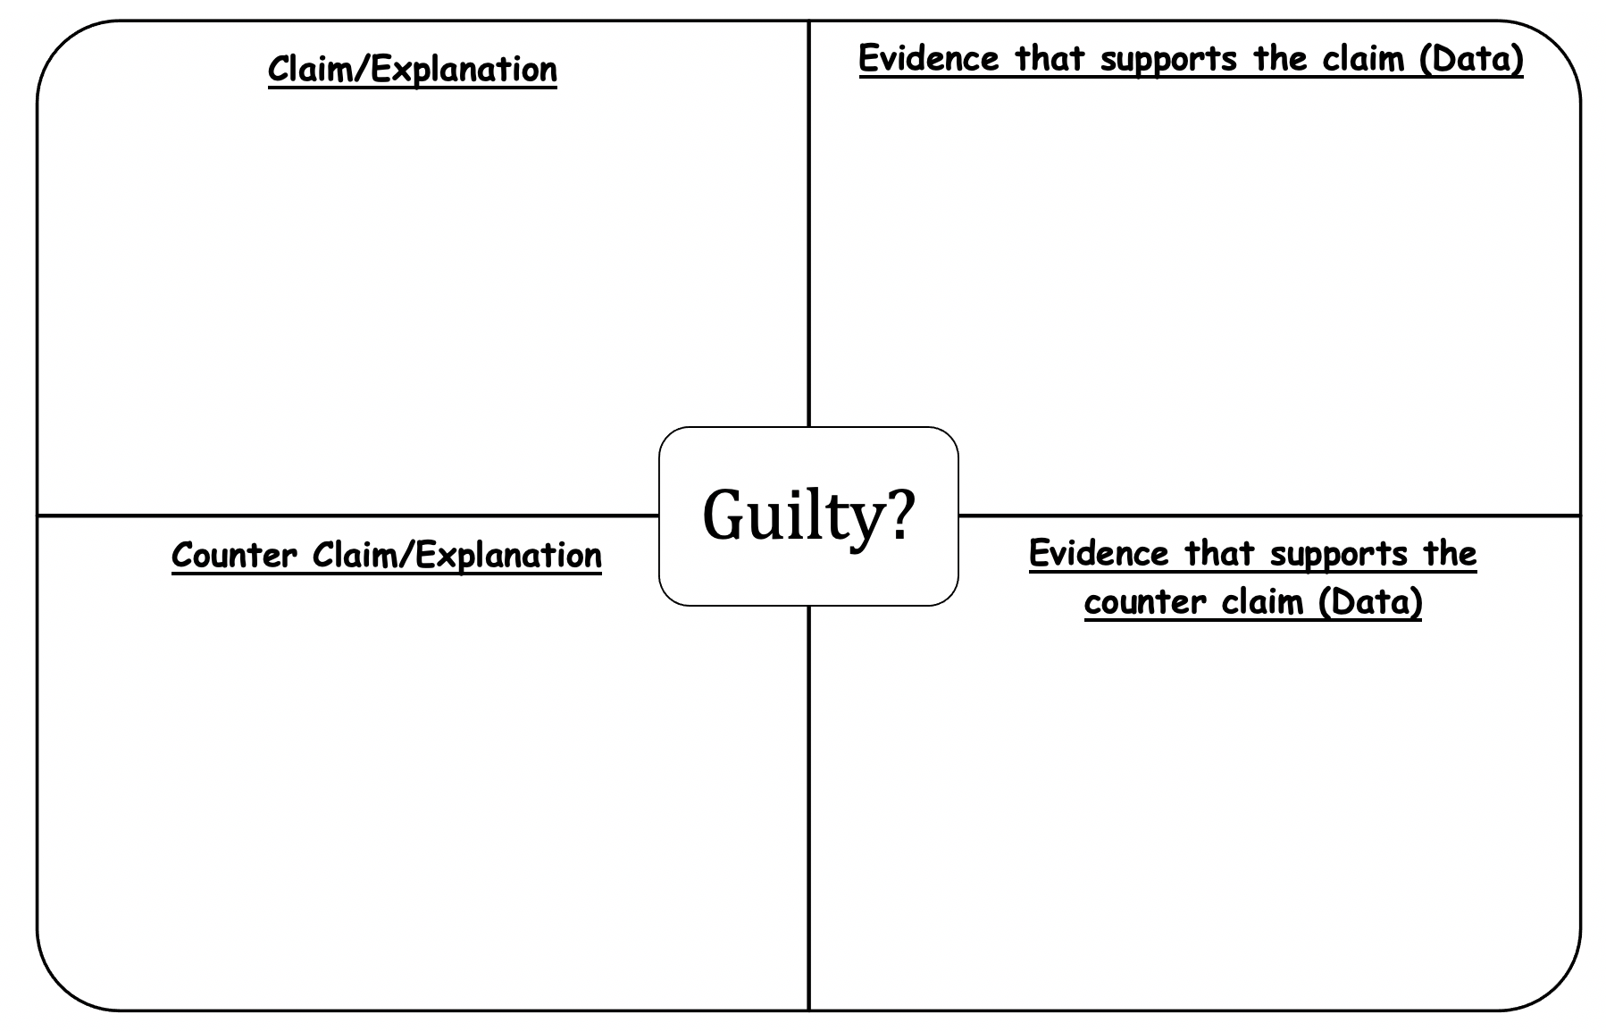
Is Mr Briggs guilty of speeding?

Slide 6
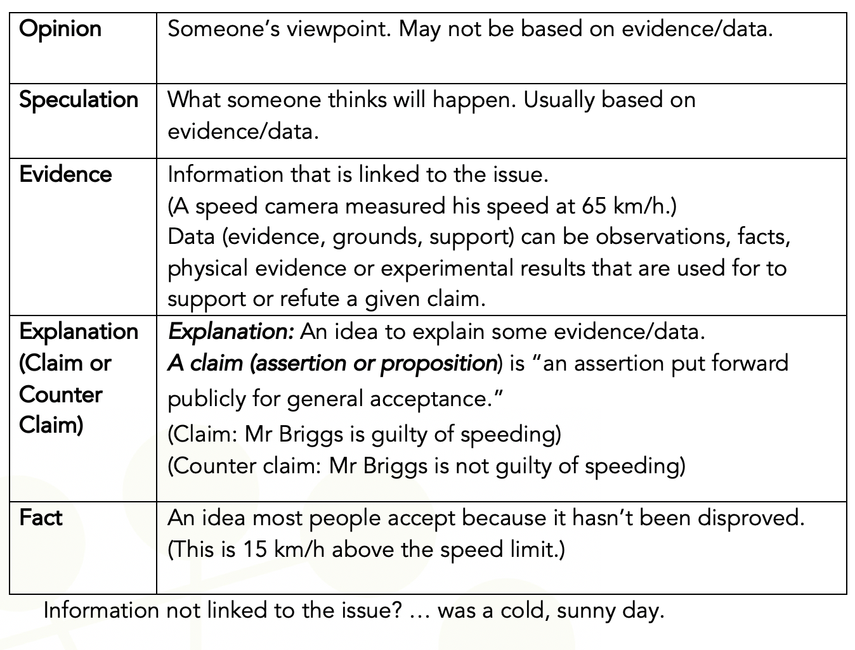
Activity 1.1: Is Mr Briggs guilty of speeding?

Slide 7
Module 2 focuses on the following topics
Media Literacy
Reasoning, Argumentation and Critical Thinking
Using media reports as starting point to discuss environmental SSIs
Notes:
Image from Pixabay: It is not necessary to quote the source

Slide 8
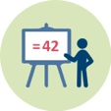
Activity 1.2: What are the features of a scientific argument?
What are the differences between explanation and argument?
What are the features of a scientific argument?

Slide 9
Argumentation
Scientific knowledge is characterised by proper scientific explanations or arguments.
While an explanation should make sense of a phenomenon and explain the phenomena or event based on other scientific facts; in an argument, however, there is not so much a feature or behaviour to be explained but a claim to be justified (Osborne & Patterson, 2011).
A scientific argument involves the coordination of evidence (data) and theory (claim) (product of observation vs. product of interpretation of those observations) to support or refute an explanatory conclusion, model or prediction (Osborne et al., 2004a).
In IO2, Toulmin’s model of argumentation, among others, are used to analyse media reports of scientific research related to environmental SSI. Based on this model, the nature of an argument can be framed in terms of claims, data, warrants, backings, rebuttals, and qualifiers (Toulmin, 1958) (see Figure 1).

Slide 10
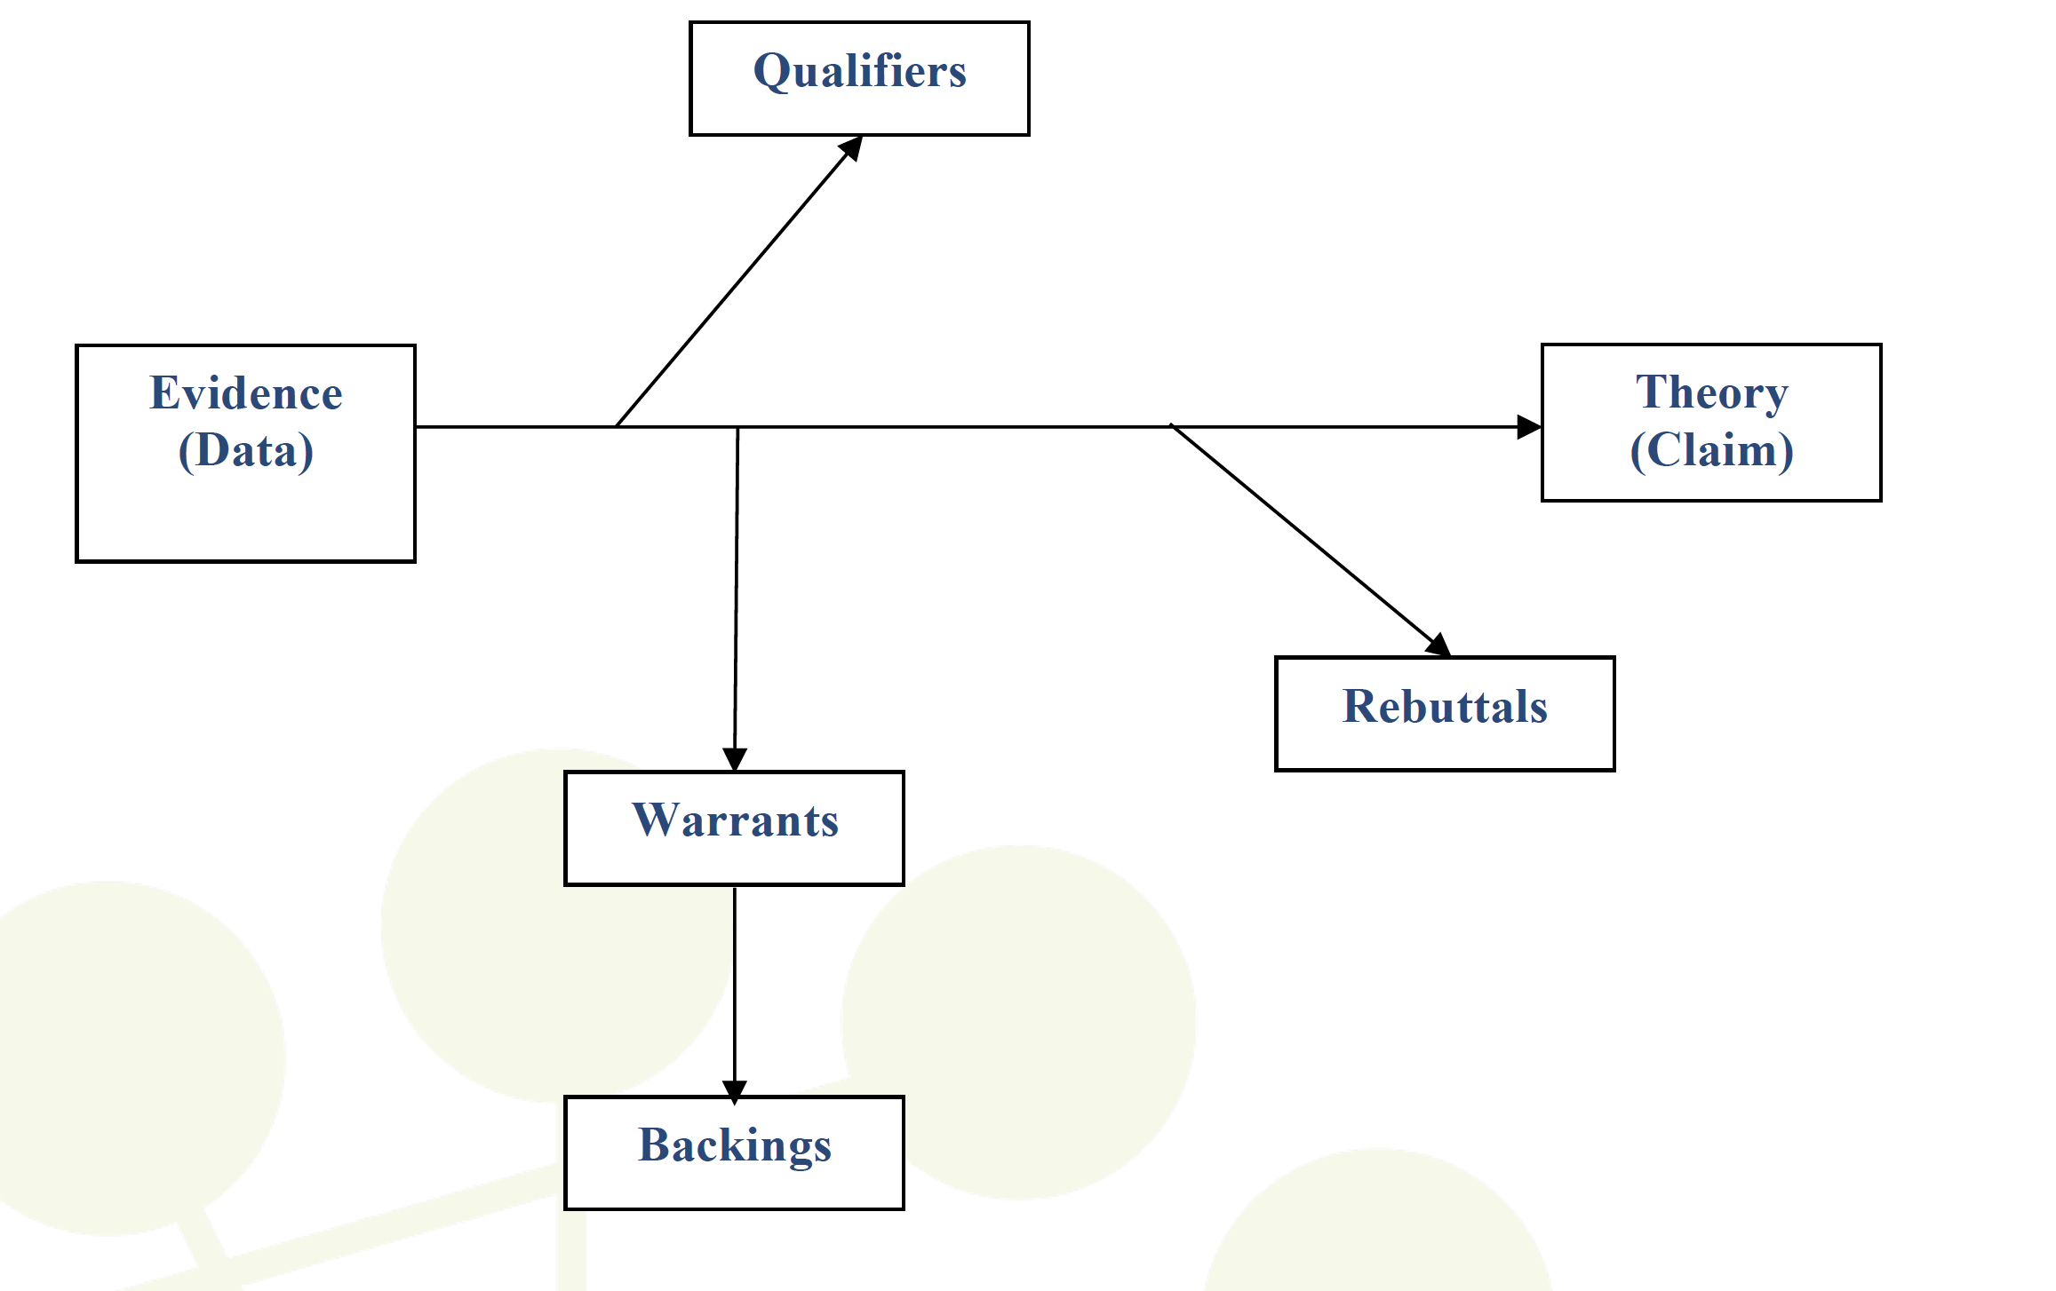
Figure 1. Toulmin’s model of argumentation (Toulmin, 1958)

Slide 11
Toulmin’s model of argumentation (Toulmin, 1958)
A claim (assertion or proposition) is “an assertion put forward publicly for general acceptance.”
Data (evidence, grounds, support) can be observations, facts, physical evidence or experimental results that are used for to support or refute a given claim.
Warrant (inferential leap) is the principle, provision or chain of reasoning that provides a link between the data and the claim.
Backings are “generalizations making explicit the body of experience relied on to establish the trustworthiness of the ways of arguing applied in any particular case.” For example, An Inconvenient Truth is a wonderful documentary on climate change [claim], because it won two Oscars [data]. Being nominated for and winning Academy Awards are reliable indicators for a good documentary [warrant], because the majority [qualifiers] of the public likes documentaries with Academy Awards [backings].
Rebuttals are “the extraordinary or exceptional circumstances that might undermine the force of the supporting arguments.” For example, Newton's law of universal gravitation only applies in weak gravitational fields; it does not apply in strong gravitational fields [rebuttals].
Qualifiers are “phrases that show what kind of degree of reliance is to be placed on the conclusions, given the arguments available to support them.” Phrases like “probably”, “definitely”, “it depends”, “possibly”, “usually” express the degree of conditionality asserted.
Notes:
In IO2, Toulmin’s model of argumentation, among others, will be used to analyse media reports of scientific research related to environmental SSI. Others have also used this model for methodological purposes (e.g. see Erduran et al., 2004). Based on this model, the nature of an argument can be framed in terms of claims, data, warrants, backings, rebuttals, and qualifiers (Toulmin, 1958). It should be noted that, in order to interpret statements about environmental SSI or risk assessment, an understanding the concepts of correlation, cause and effect is also required. Correlation is a statement of numerical facts; it does not necessarily imply causation and effects.

Slide 12
Argumentation
In the context of media reports of environmental SSIs, a set of expectations and questions evoked by the written text would help the reader to learn argumentation structure.
Wolfe et al. (2009)’s argumentation scheme would be useful for doing so (see Figure 2).

Slide 13
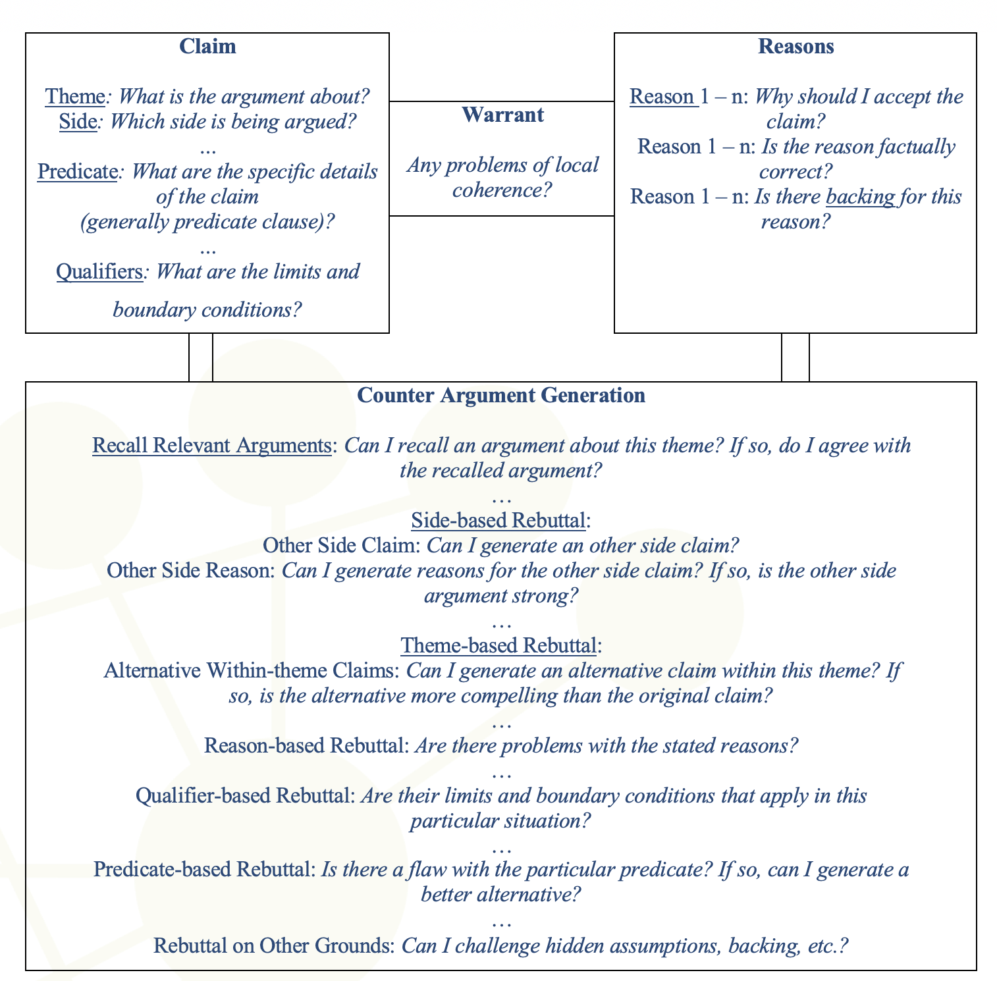
Figure 2. Argumentation Scheme (Wolfe, Britt & Butler, 2009)

Slide 14
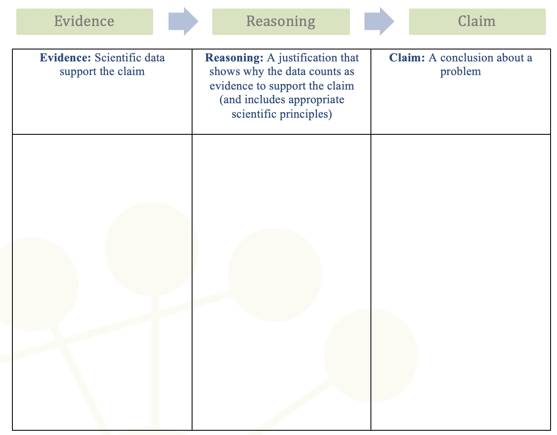
Figure 3. The claim, evidence and reasoning (CER) framework (McNeill & Krajcik, 2012)

Slide 15
2. Analyzing media reports of environmental SSIs
REASONING, ARGUMENTATION & CRITICAL THINKING

Slide 16
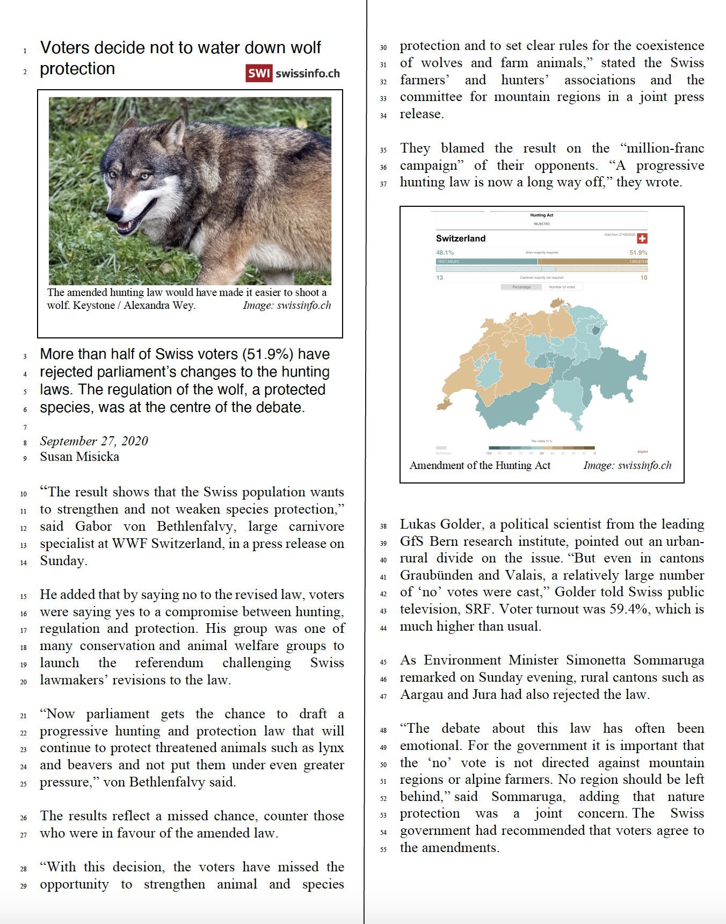
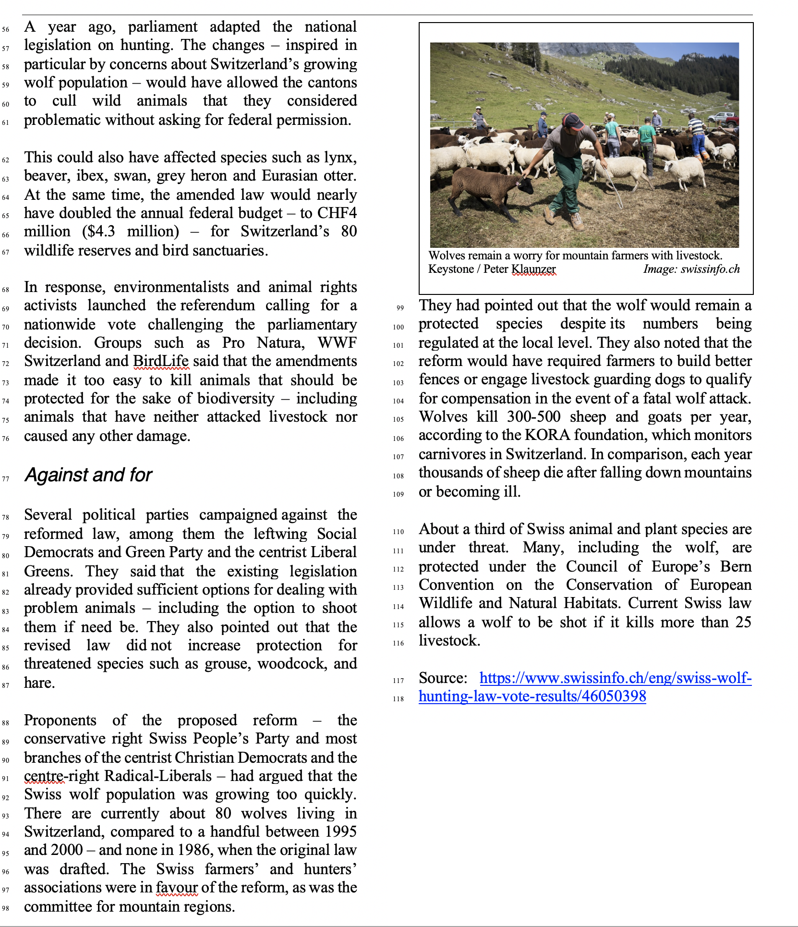
Activity 2.1: Voters decide not to water down wolf protection
Notes:
Source: https://www.swissinfo.ch/eng/swiss-wolf-hunting-law-vote-results/46050398

Slide 17
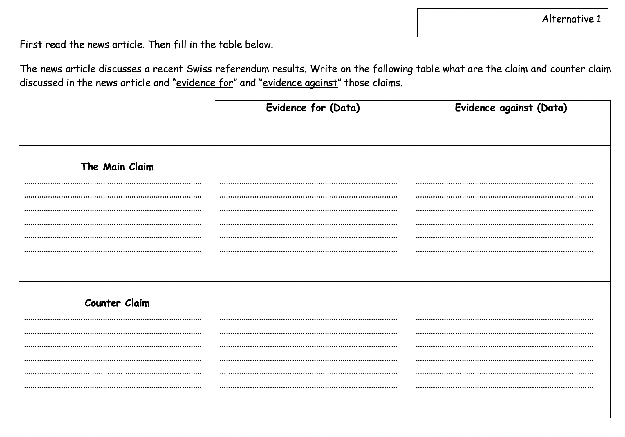
Activity 2.1: Voters decide not to water down wolf protection

Slide 18
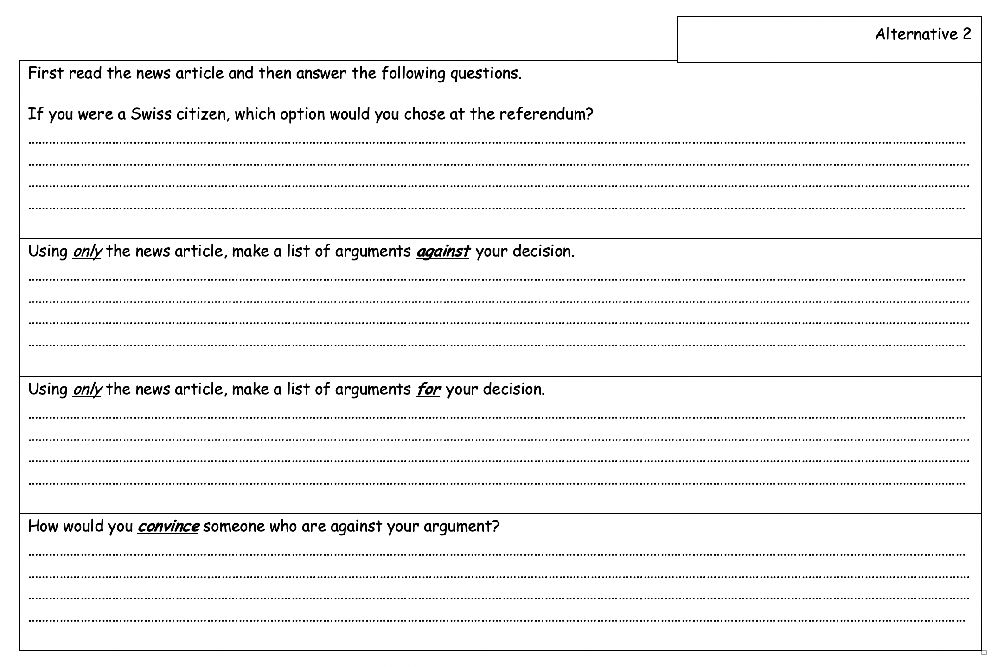
Activity 2.1: Voters decide not to water down wolf protection

Slide 19
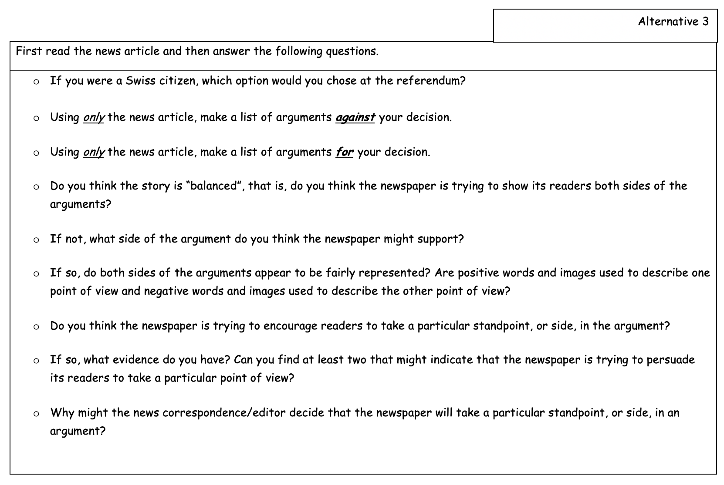
Activity 2.1: Voters decide not to water down wolf protection

Slide 20
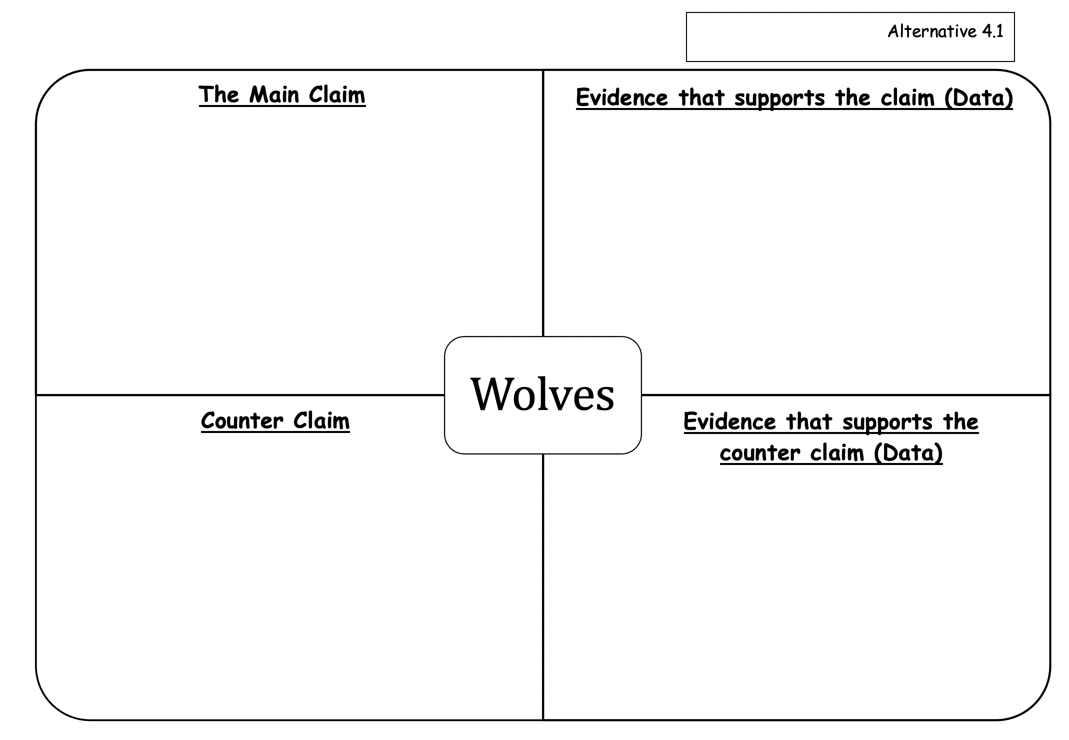
Activity 2.1: Voters decide not to water down wolf protection

Slide 21
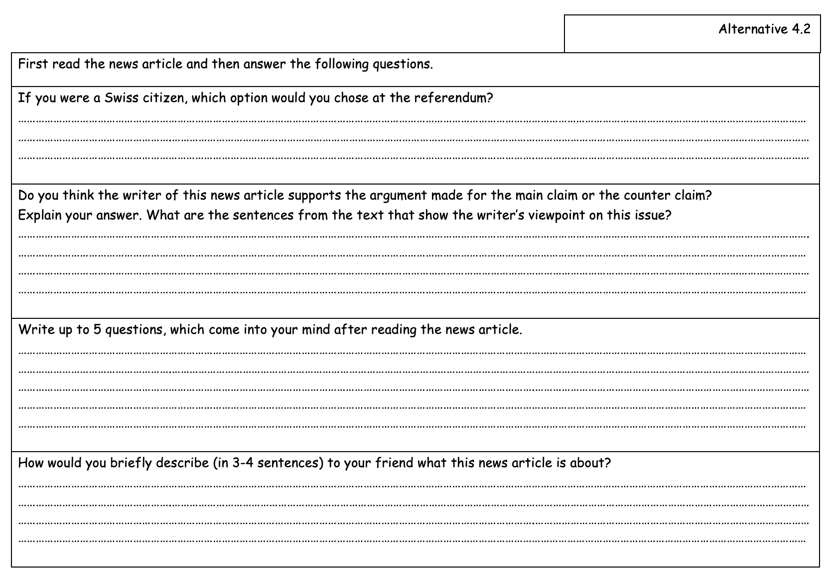
Activity 2.1: Voters decide not to water down wolf protection

Slide 22
Asking the right questions (Browne & Keeley, 2007)

Slide 23
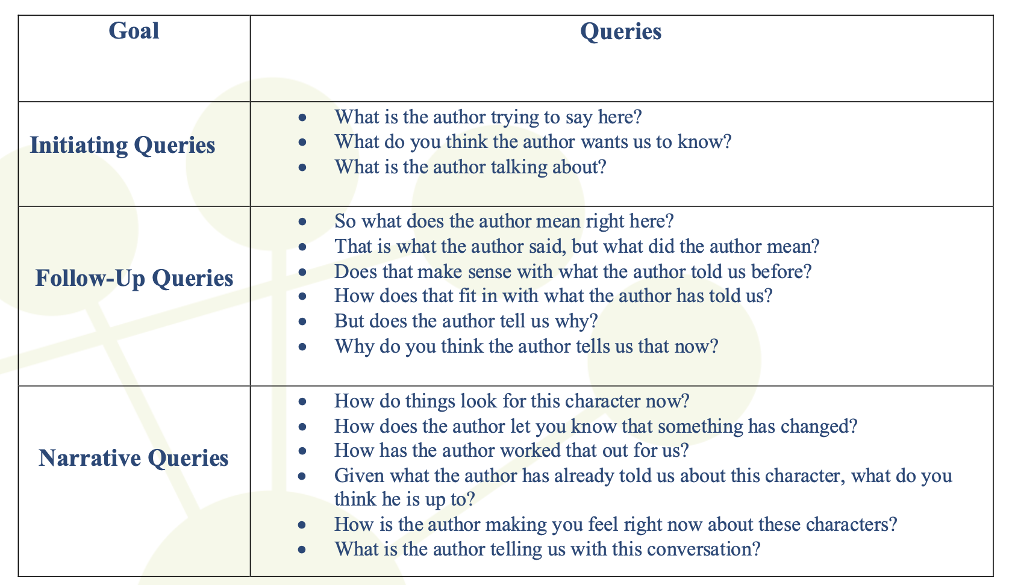
Examples of queries to guide the discussion (Beck & McKeown, 2006)

Slide 24
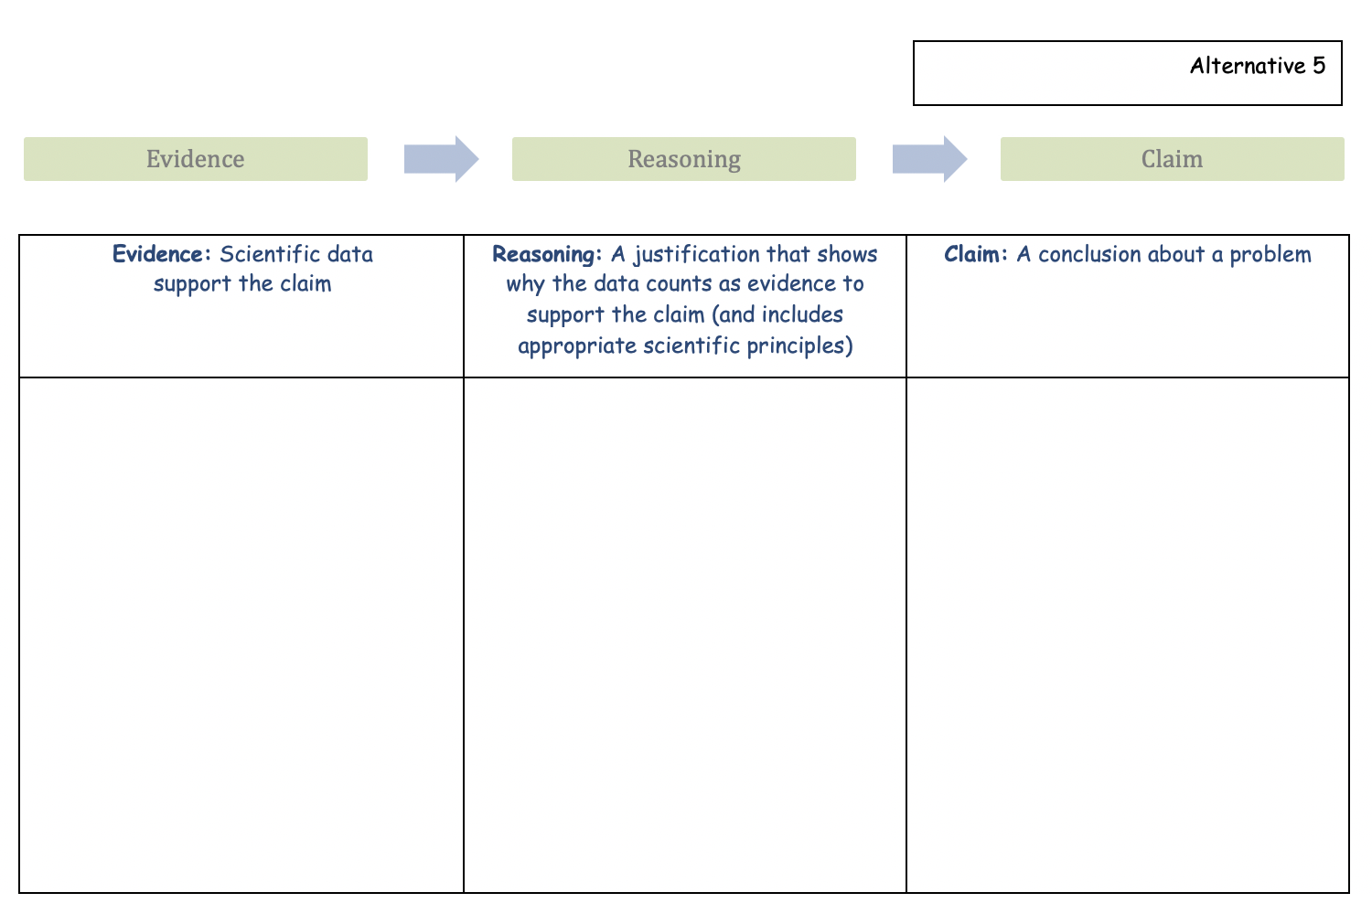
Activity 2.1: Voters decide not to water down wolf protection

Slide 25
3. How may media reports of environmental SSIs be used as a tool for teaching reasoning, argumentation and critical thinking?
REASONING, ARGUMENTATION & CRITICAL THINKING

Slide 26
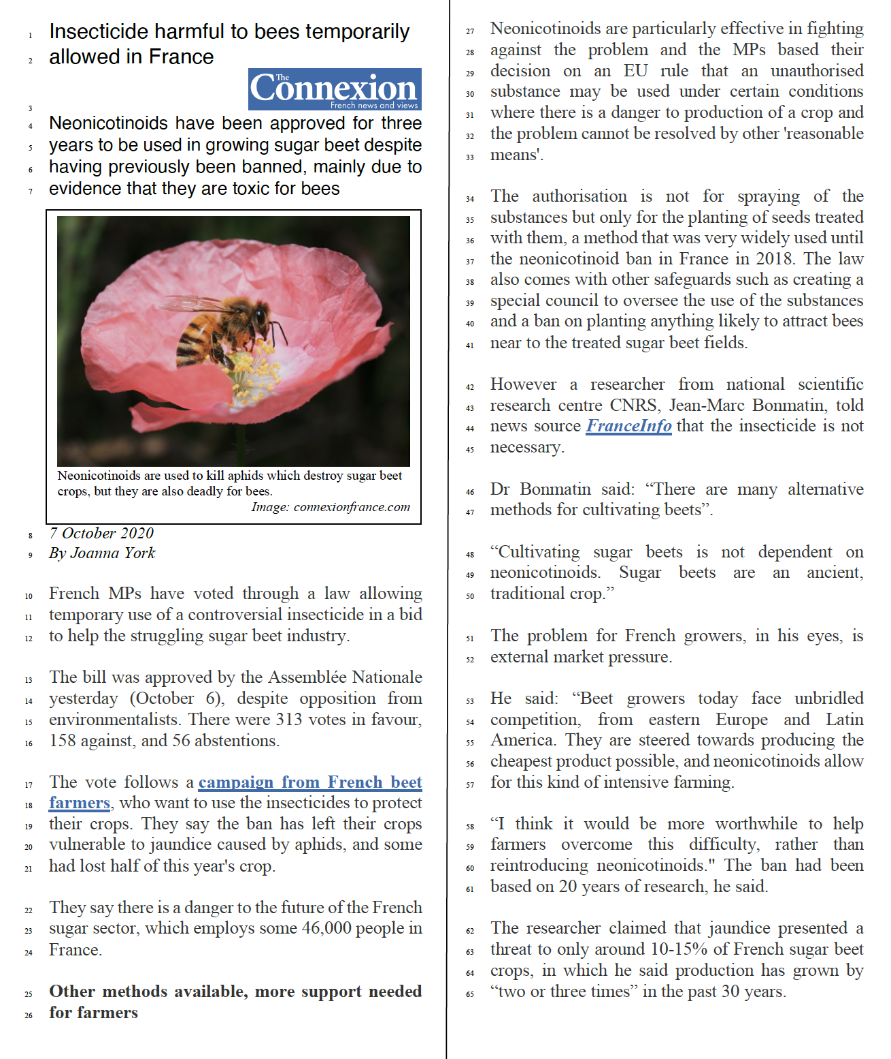
Activity 3.1: Insecticide harmful to bees temporarily allowed in France
Notes:
Source: https://www.connexionfrance.com/French-news/French-law-approves-insecticide-deadly-for-bees

Slide 27
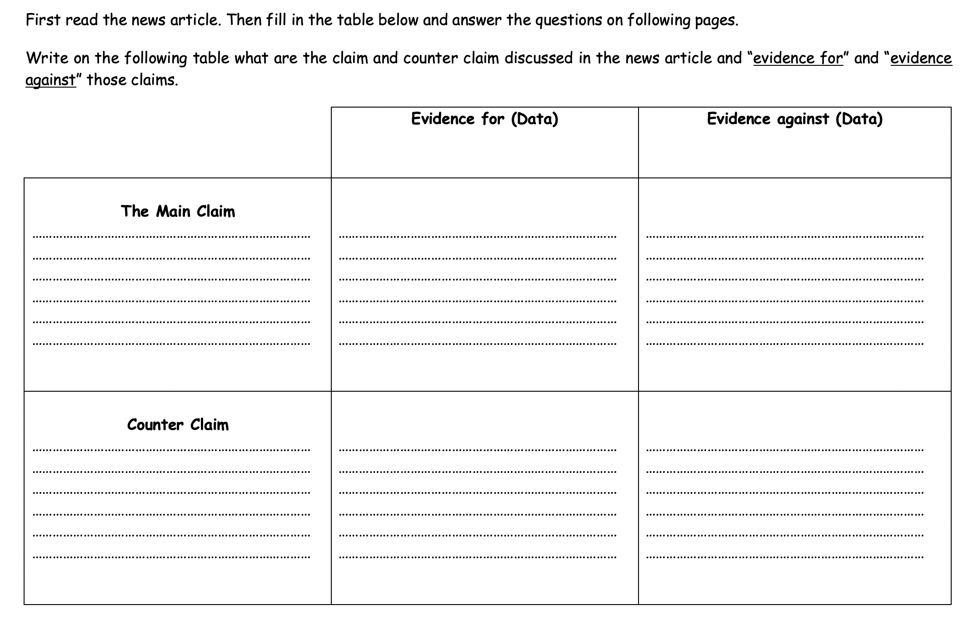
Activity 3.1: Insecticide harmful to bees temporarily allowed in France
Notes:
https://padlet.com/emergenteu/jlyjst7hawkilidz

Slide 28
Activity 3.1: Insecticide harmful to bees temporarily allowed in France
https://padlet.com/emergenteu/jlyjst7hawkilidz
Notes:
https://padlet.com/emergenteu/jlyjst7hawkilidz

Slide 29
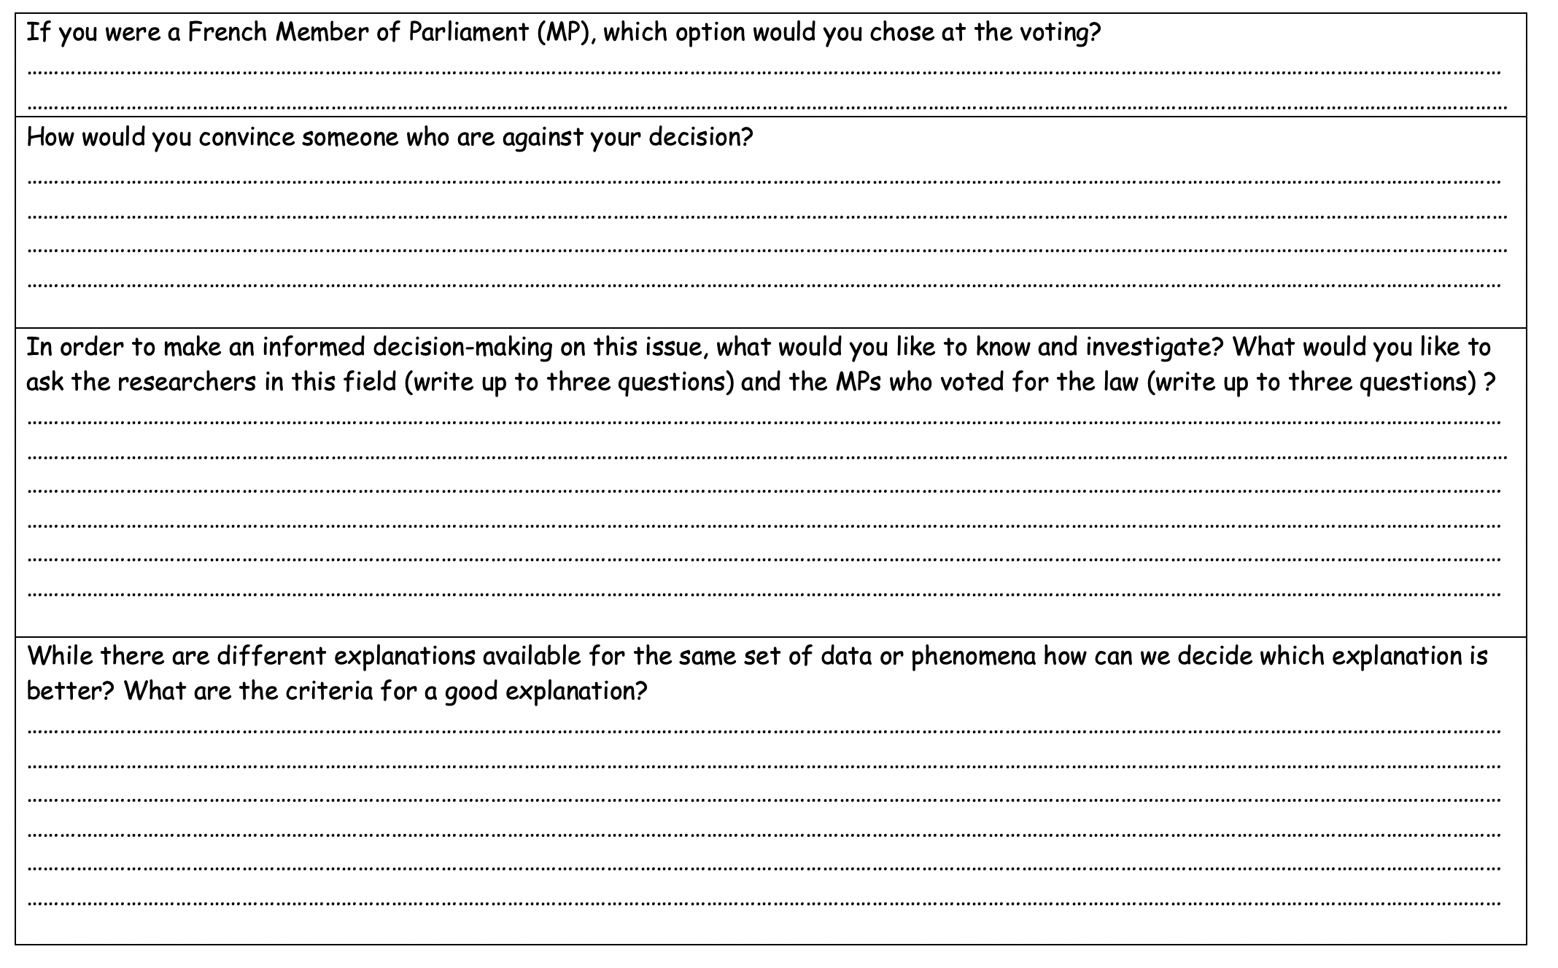
Activity 3.1: Insecticide harmful to bees temporarily allowed in France

Slide 30
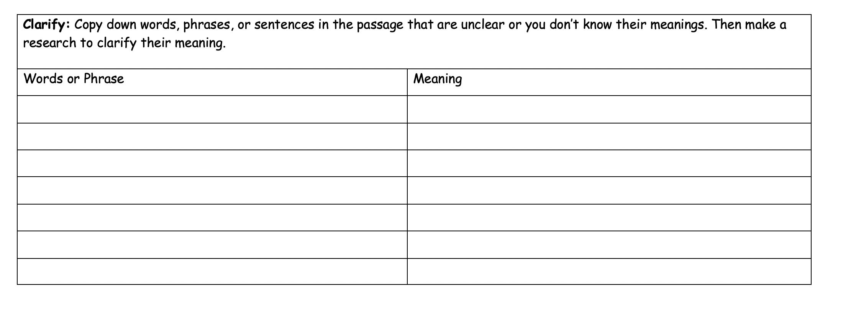
Activity 3.1: Insecticide harmful to bees temporarily allowed in France

Slide 31
Asking the right questions (Browne & Keeley, 2007)

Slide 32
Activity 3.2: What do students learn when dealing with media reports of environmental SSIs ?
What do students learn when dealing with such a task (Activities 2.1 & 3.1)?
Should media reports of environmental SSIs be included in science and mathematics lessons? Why?
What from this module was most valuable for you? If you had to tell someone else the three most significant from this module, what would they be?

Slide 33
What do students learn when dealing with media reports of environmental SSIs ?
Research suggests that:
Using news articles during teaching helps students to understand science and nature of science (NOS) (Cakmakci & Yalaki, 2018; Shibley, 2003).
Using media reports in the classroom make the science curriculum appealing and motivating to students (Jarman & McClune, 2007; Ratcliffe & Grace, 2003, Street, 2002 ). Raising the level of students’ interest in science is likely to affect their engagement and achievements in science (Hidi et al., 2004).
Media reports of scientific research can be used to develop skills associated with aspects of reasoning and scientific literacy (Jarman & McClune, 2002; Elliott, 2006).
Students are motivated to think critically about science information presented in a recent news article (Jarman & McClune, 2007; Ratcliffe & Grace, 2003). That facilitates their critical thinking and argumentation competences (Oliveras, Márquez, & Sanmarti, 2013).

Slide 34
Activity 3.3: How to design a lesson on the use of media reports of environmental SSIs?
Plan a science lesson on the use of media reports of environmental SSIs to promote students competences on reasoning, argumentation and critical thinking.
Present the task to the overall group.
Notes:
Soll das E

Slide 35
reasoning, ARGUMENTATION & CRITICAL THINKING
Promoting future teachers’ competences in reasoning, argumentation and critical thinking through the use of media reports on environmental SSIs
Gultekin Cakmakci, Hacettepe University STEM & Maker Lab
www.hstem.hacettepe.edu.tr/en

