Slide 1
teachers’ beliefs about teaching socio-scientific issue
IO8

Slide 2
1. How our beliefs, cultural background and identities affect our decisions

Slide 3
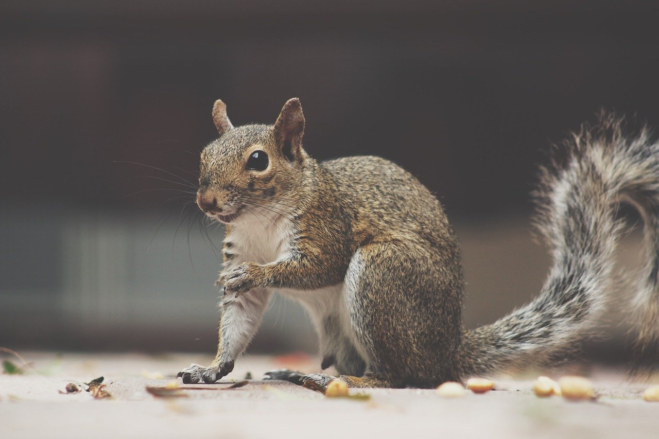

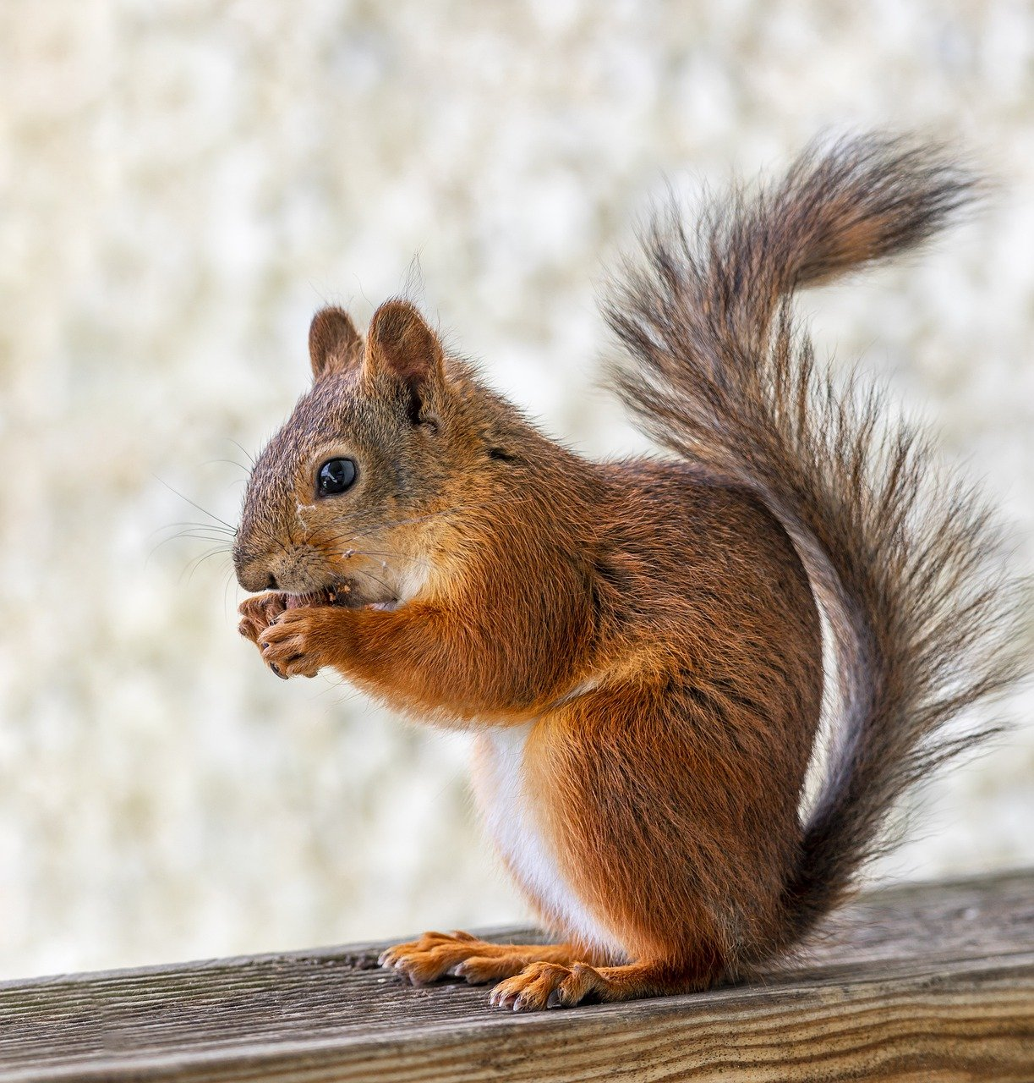

Activity 1.1: The invasion of the species
The native squirrel is Europe is the red squirrel. However, in 1876 the grey squirrel was introduced from North America and its population has increased rapidly. Your local authority has decided that the grey squirrels are causing problems to the local community and should be trapped and removed from the area.
Step 1: Do you agree or not with this decision? Use the line of agreement on the wall to state your opinion.
Step 2: Why did you agree or disagree? What kind of evidence do you have for your decision? First take notes in the worksheet, and then discuss in pairs or groups.
Step 3: Write your explanation on why you agree or disagree (after the group work) in the worksheet. Present the response during the whole classroom discussion.
Step 4: Reflect on the responses of people in the room. Why do some people agree and some others’ disagree?
https://pixabay.com
Notes:
Image from Pixabay: It is not necessary to quote the source

Slide 4

Activity 1.1: The invasion of the species
Step 5: Search online for grey squirrel as an invasive species in Europe. Find information about their food, reproduction and diseases and compare with that for the red squirrel. Keep notes on the worksheet.
Step 6: Now that you have the data, do you agree or not with the decision to trap and remove the red? Did you change your opinion?
Step 7: Reflect on the reasons that have let you to the decision to change, or not to change your initial response. What kind of evidence did you use in each situation?

Slide 5
Activity 1.1: The invasion of the species
When we are asked to make a decision on an issue on which our knowledge is limited, or an issue on which we have personal interests, the response we offer reflects our beliefs, cultural background and identities. This is our personal opinion, usually not supported by evidence.
After exploring evidence we can then change our opinions and provide evidence-based explanations and decisions.
Often, even after exploring evidence, our beliefs and identities are so well structured that will not allow us to change our initial opinion (Evagorou, Jimenez-Aleixandre & Osborne, 2012).
This is often the case in socio-scientific issues in general, and environmental socio-scientific issues in particular (Evagorou & Puig, 2017)

Slide 6
Activity 1.2: Role play
Each group will be assigned with one role. In your groups work to collect evidence to support you role. You can see details about each role in the table below.
Remove the grey | Do not remove the grey
Local authorities (they destroy the parks) | Friends of animals (it is cruel)
People in the area (they destroy our gardens) | School children (they are cute)
Ecologists (invasive species) | Shops (tourists love them)
Notes:
Image from Pixabay: It is not necessary to quote the source

Slide 7
Activity 1.2: Role play
Discuss in a whole classroom setting under your role. Each group will have a representative (15 minutes).
Reflect on the process:
  What difficulties did you have when debating from a specific role?
  What does that tell you about a person’s beliefs and identity during the discussion of an environmental socio-scientific issue?
  What impact did the role have on what you could say during the discussion?

Slide 8


Activity 1.3. Case study
In your groups read the two case studies from two classrooms discussing the socio-scientific problem of the squirrels and discuss the questions:
Why did students in Class A and B offer different responses after they learned more information about the red and the grey squirrel?
Can you hypothesize about some explanations they provided?

Slide 9
Activity 1.3. Case study
After reading some of the explanations they provided respond again to the following:
Why did students in Class A and B offer different responses after they learned more information about the red and the grey squirrel?
How can students‘ or your own beliefs, cultural backgrounds and identities can affect how one discusses a socio-scientific issues?

Slide 10
Activity 1.3. Case study
What we know about beliefs, cultural background and identities
Identity is defined “as a means through which individuals interact with and explain their world” (Zeidler et al., 2005, p. 368)
“students’ cultural experiences influence their decisions – students’ personal identities are not fixed but are fashioned through students’ social, intellectual, and moral growth” (Zeidler et al., 2005 p. 368).
Previous studies have explored ways to develop students’ moral reasoning (Simmoneaux, 2008; Zeidler & Sadler 2008; Zeidler & Keefer, 2003)

Slide 11
Activity 1.3. Case study
What we know about beliefs, cultural background and identities
Simonneaux and Simonneaux (2008) presented to college students a socioscientific issue that was relevant to their own lives and explored their views on that.
The authors concluded that the closer the connection between the issue under study and students’ identities, the more students’ beliefs systems are affected, making them in that way to ignore evidence, and provide weaker justifications that are mostly based on personal values.

Slide 12
Activity 1.3. Case study
What we know about beliefs, cultural background and identities
López-Facal and Jiménez-Aleixandre (2008) examined how students’ personal and cultural identities can affect their discussions of an SSI.
The authors concluded that often students project their identities, either personal or cultural, onto the actors in the SSI, and in that way making it more difficult for them to reason about an issue without the distraction of their own individual belief systems undermining more objective reasoned justifications

Slide 13
Activity 1.3. Case study
What we know about beliefs, cultural background and identities
According to Levinson (2008) when two people talk about an SSI and they disagree, commitment to one’s point of view is one of the factors that influence their decision or justification and according to Levinson with commitment “the ‘personal’ is contrasted with the subjective’” (p.862).
“Commitment introduces the element of belief and the personal and differentiates it from the subjective assertion. The nature of the belief is reflected in its universability and acceptance, distinguishing it from a point of view that can be rational […]” (p.862)

Slide 14
Activity 1.5. Understanding your own beliefs
Choose one topic from each area as presented in the next slide. For this topic discuss some beliefs that you have and might hinder how you talk about this issue. The beliefs might be: personal interests, moral concerns, cultural knowledge, limited knowledge.
Discuss how your beliefs might affect how you teach one of this topics.

Slide 15
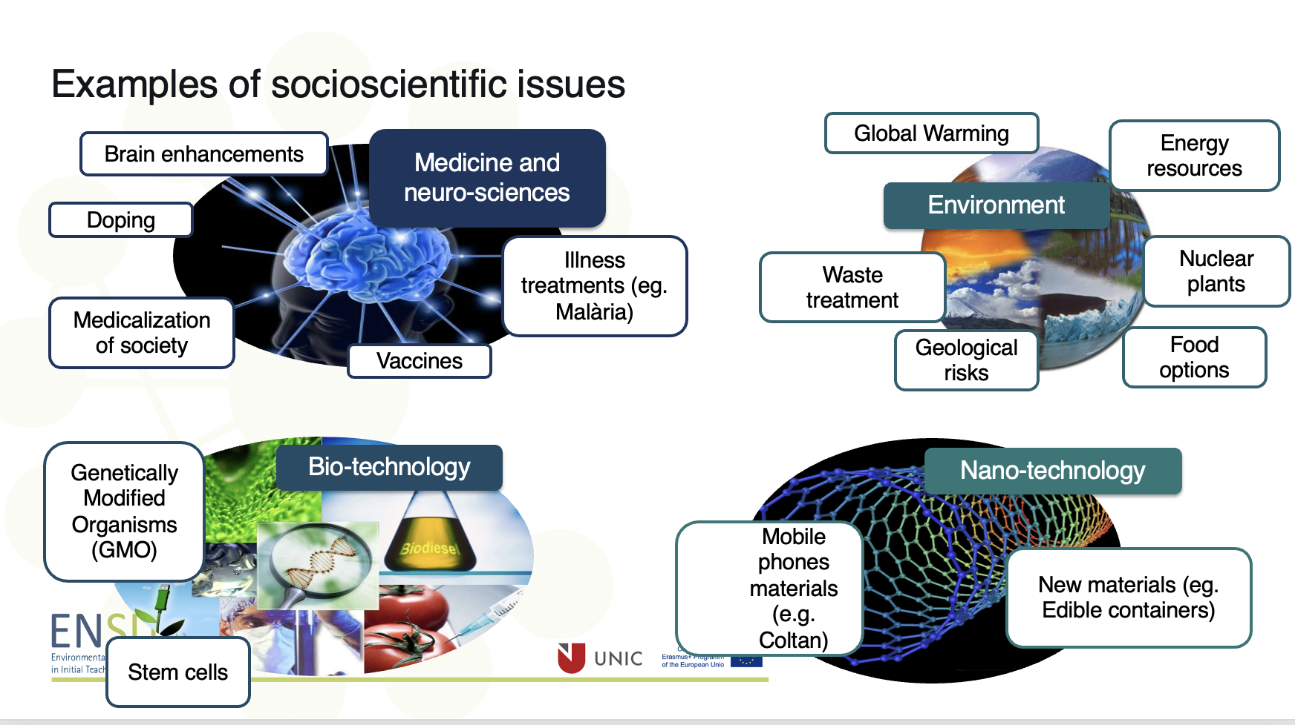
Activity 1.5. Understanding your own beliefs
Picture from PreSEES project

Slide 16
2. Designing an SSI lesson taking into account beliefs, cultural background and identities?

Slide 17

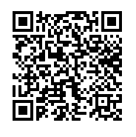
Activity 2.1: What are your own beliefs? A questionnaire on SSI beliefs
Step 1. Complete the questionnaire on your own by scanning the QR code.
Step 2. Discuss your responses in your group and reflect.
Step 3. Discuss what difficulties you might have as a teacher when introducing an SSI in your class because of the differences in beliefs.

Slide 18
Activity 2.2: What strategies can you use to support students
Teachers can be reluctant to teach SSI due to concerns about their abilities, time constraints and lack of support materials (Pitiporntapin & Srisakuna, 2017; Saunders & Rennie, 2013).
Teachers’ own belief systems, their cultural or religious background and the personal identities influence how they discuss an SSI (Kilinc, Demiral & Kartal, 2017, Sadler et al., 2006)
Teachers often turn to teacher-centred activities emphasising on content or facts of science as a way to cope with the pedagogical challenges of SSI (Day & Bryce, 2011).

Slide 19
Activity 2.2: What strategies can you use to support students
Teachers often have a content-centred interpretation of SSI; they teach SSI in order to teach content; reduce SSI to specific content (Tidemand & Nielsen, 2017).
Some teachers lack confidence in monitoring student discussion (e.g Bryce & Gray, 2004) and find it difficult to facilitate students’ search for, and critical examination, of information (Ekborg, Ottander, Silfver & Simon; 2013)
Science teachers tend to devalue SSI-relevant assessment criteria (e.g. Steffen & Hößle, 2017) and they instead tend to focus on the science disciplinary content when assessing students (Christenson, Gericke & Rundgren, 2017; Tidemand & Nielsen, 2017)

Slide 20
Activity 3.1: Design a lesson plan with an emphasis on beliefs
Follow the directions in the worksheet
Notes:
Soll das E

