Slide 1

IS IT MATHEMATICS?
Modelling with functions
doc. dr. sc. Matija Bašić
prof. dr. sc. Željka Milin Šipuš
Mathematics Department, Faculty of Science
University of Zagreb

Slide 2
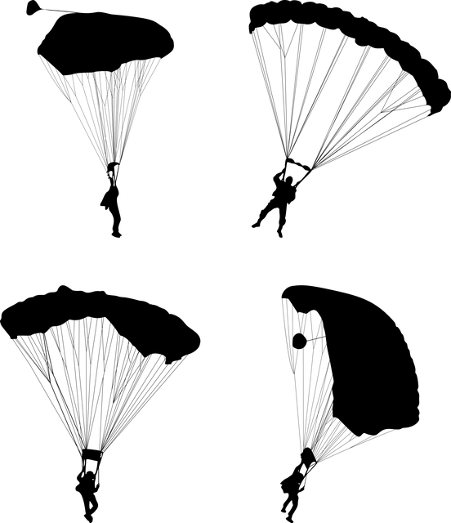
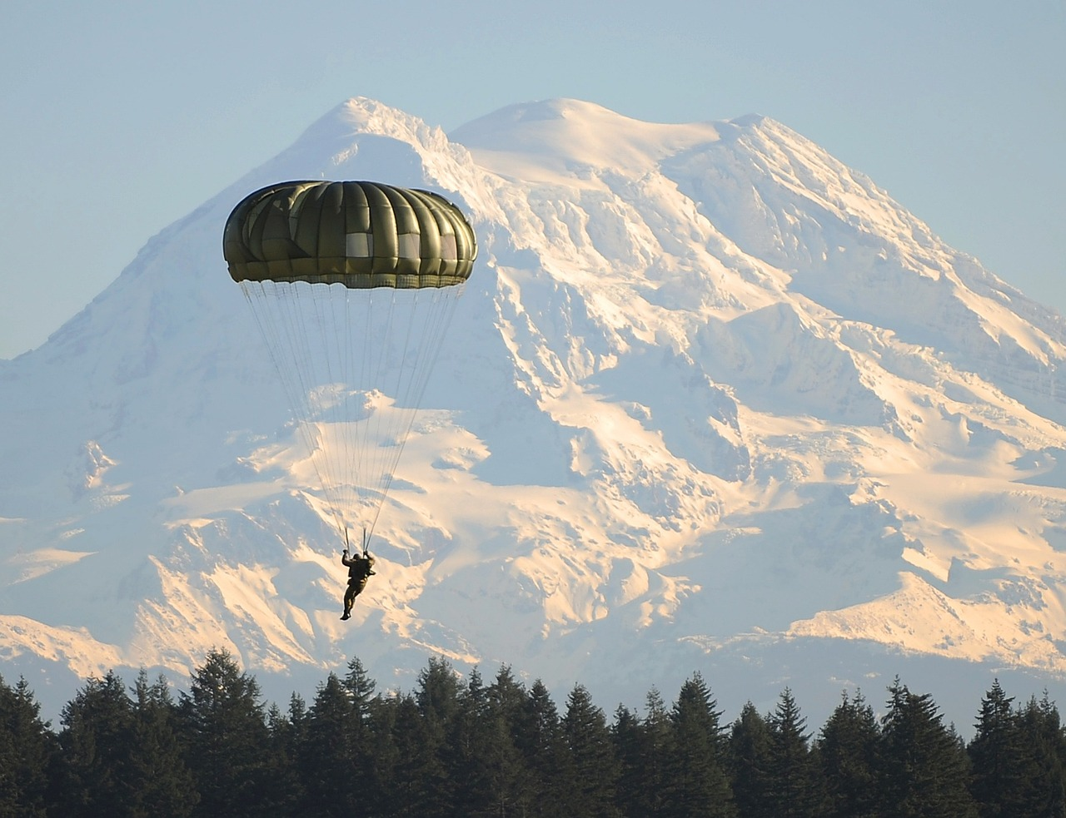
Parachute jump
Consider the problem of modelling a parachute jump.
What could be the motivation of jumper? What is their goal?
If we want to make an idealized model, which aspects of the jump can be neglected and which are important to keep?
Which assumptions lead to the physical and mathematical description of the situation?
Which dependencies could you describe in this situation? For example, can you describe the level of adrenaline in the blood of a jumper during the jump?

Slide 3
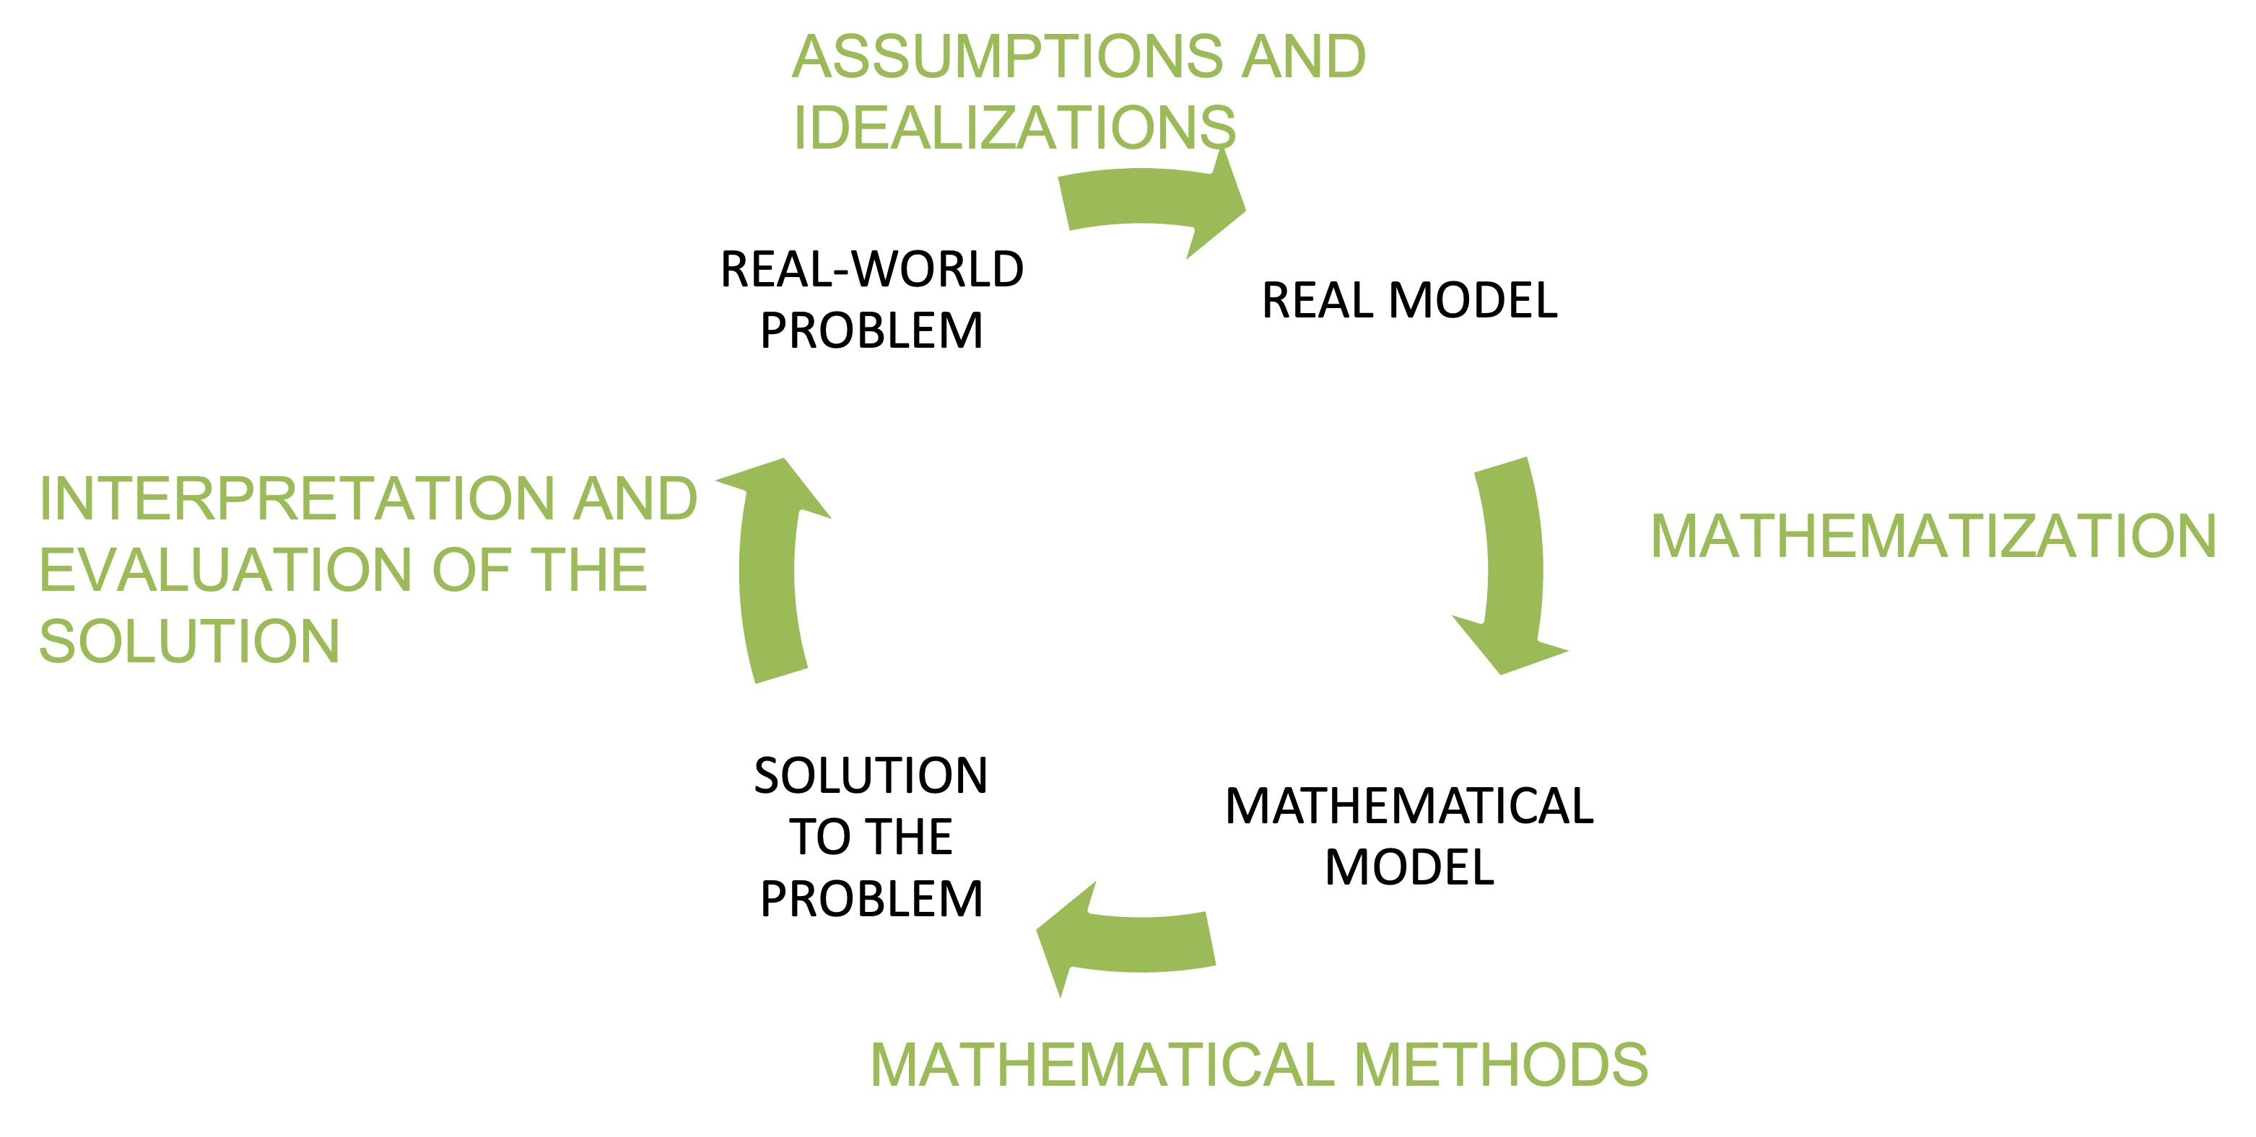
Mathematical modelling

Slide 4
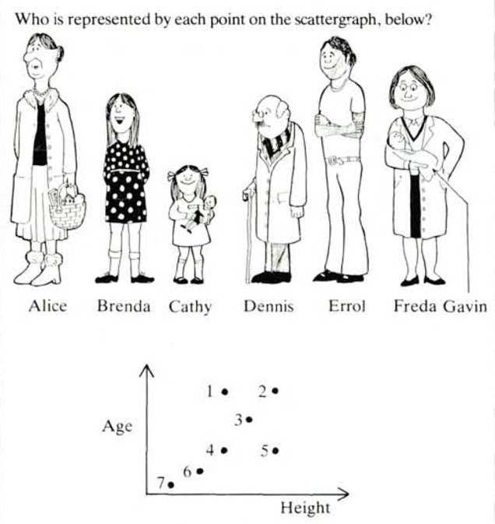
Concept of a function
Is it a function or a relation?
Or both?
Find examples of functions in your everyday life

Slide 5
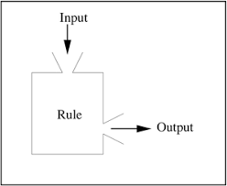
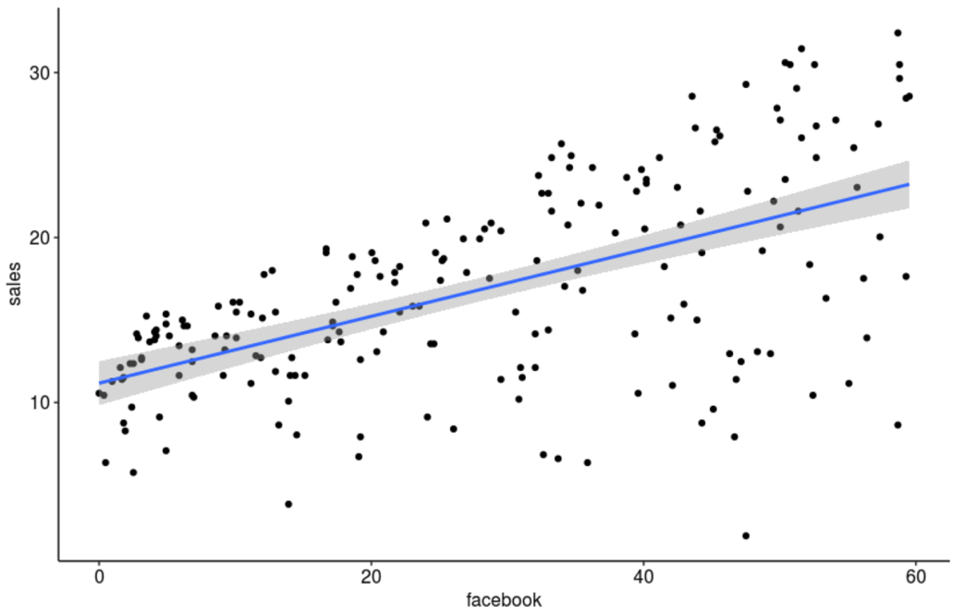
Functional thinking
Four stages of developing functional thinking:
  Input-output action
  Covariational process
  Relational correspondence
  Part of a structure/scheme

Slide 6
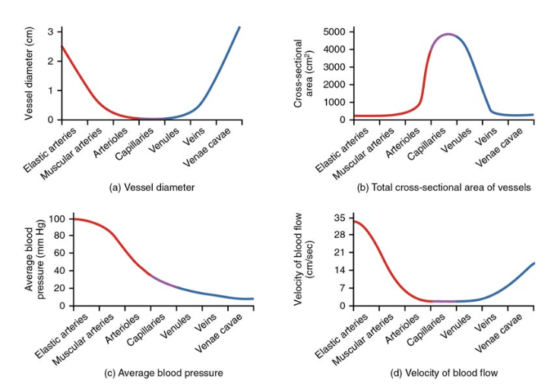
Interpreting graphs
Describe the graphs in words.

Slide 7
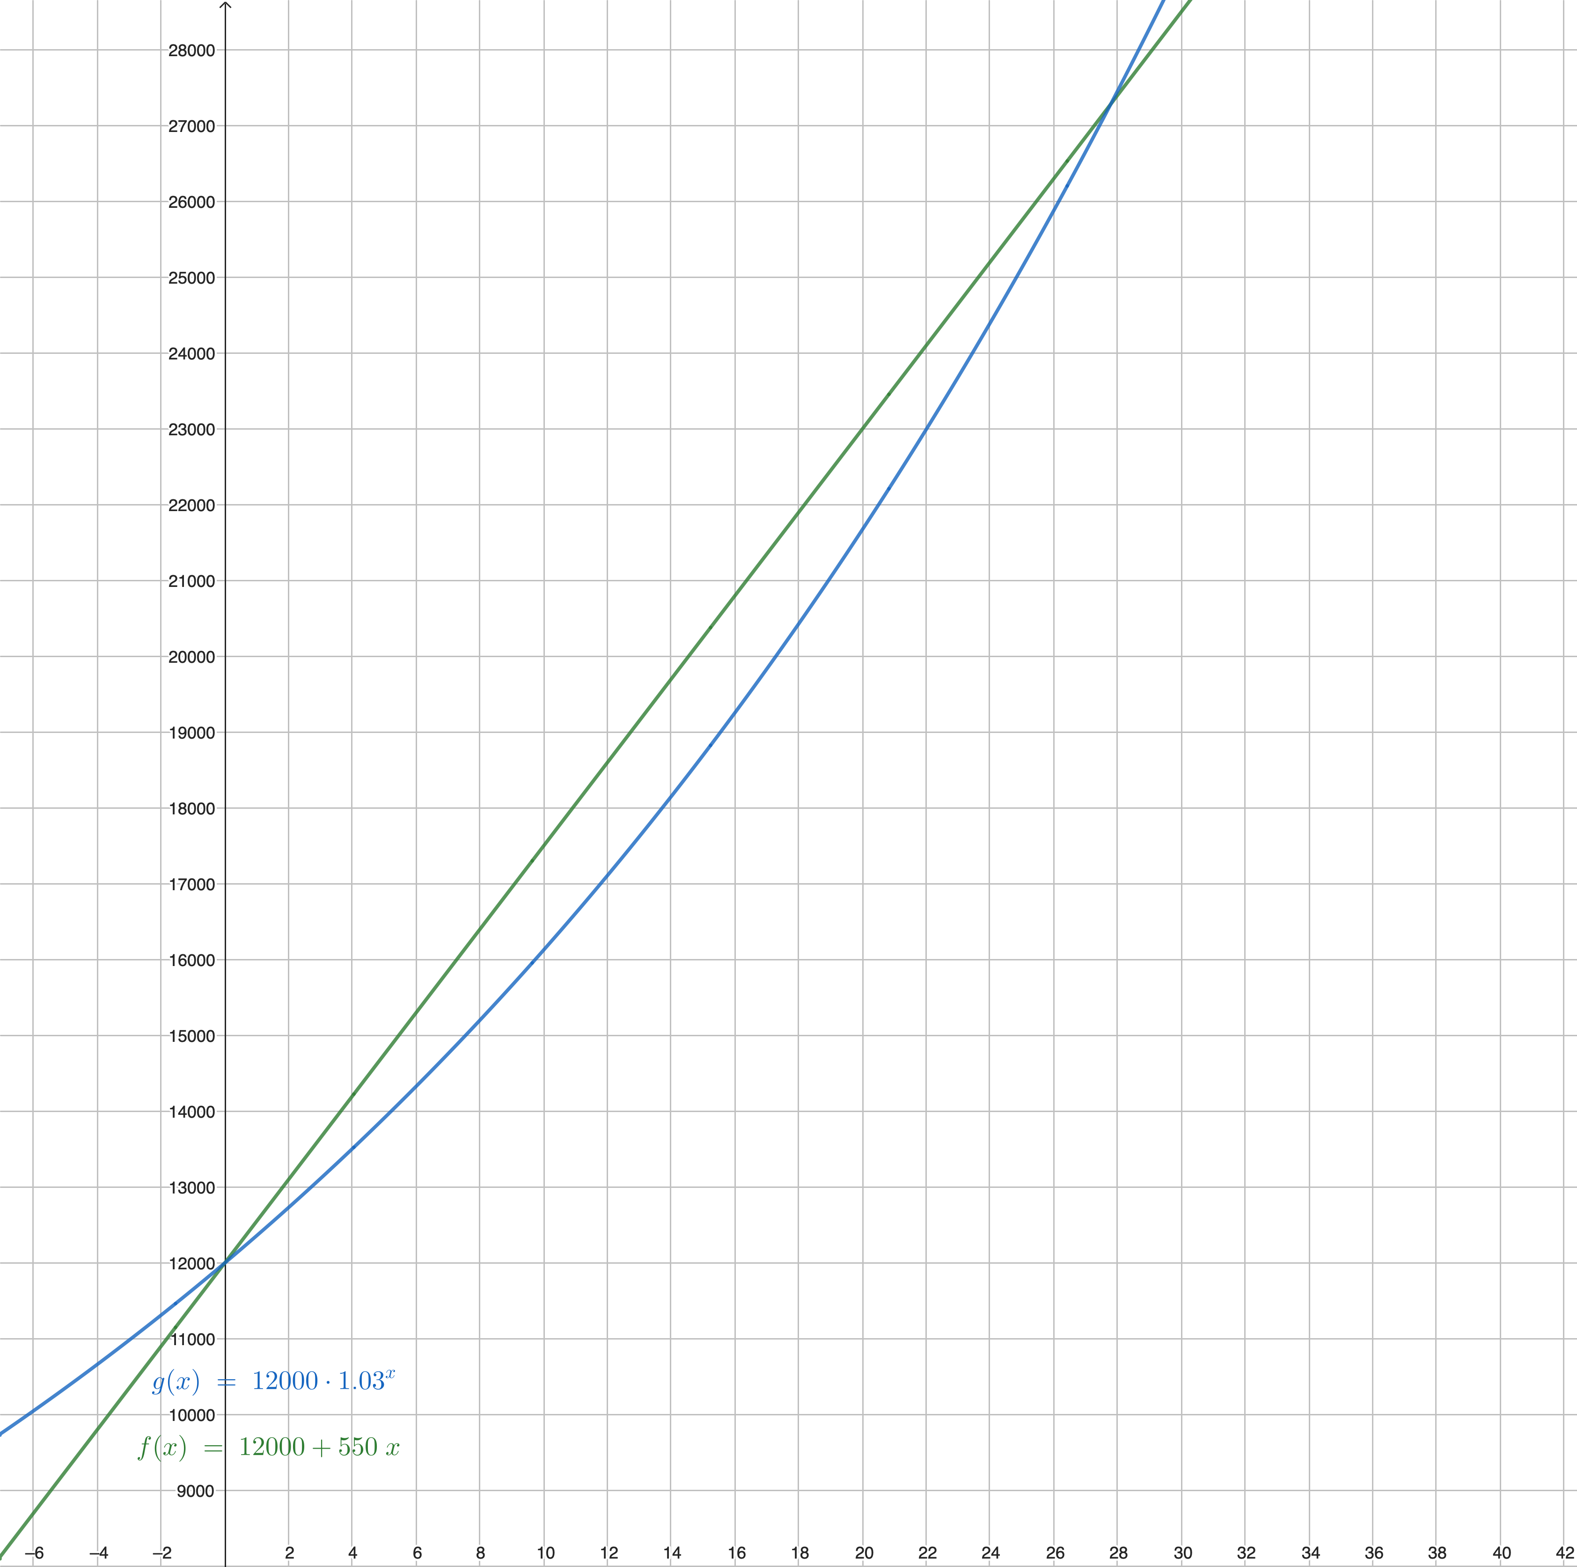
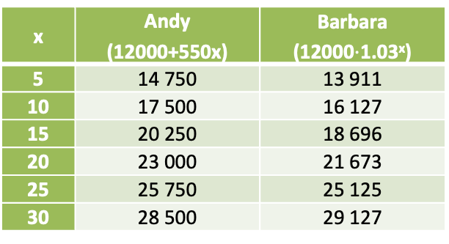
Comparing growth
x | Andy (12000+550x) | Barbara (12000$⋅$1.03^{x})
5 | 14 750 | 13 911
10 | 17 500 | 16 127
15 | 20 250 | 18 696
20 | 23 000 | 21 673
25 | 25 750 | 25 125
30 | 28 500 | 29 127
What might be surprising to students?
Was it surprising to you at first?
Is it possible to calculate the intersection points of the two graphs?

Slide 8
Linear models
It is easy for doctors to remember:
The mass of an infant from birth to the end of the first year of life triples.
Is it also valid afterwards?
Can the length / height of the infant be assessed in this way?
(For a while we call it length, and then the child walks, so we call it height…)
The models are used for assessment, prediction… We need simple models!

Slide 9
Linear models - how do we make predictions?
Imagine you want to consider how your company’s sales depend on the investment you make into advertising.
What is the effect of Facebook advertising on the company’s sales, given the effects of YouTube and newspaper advertising?

Slide 10
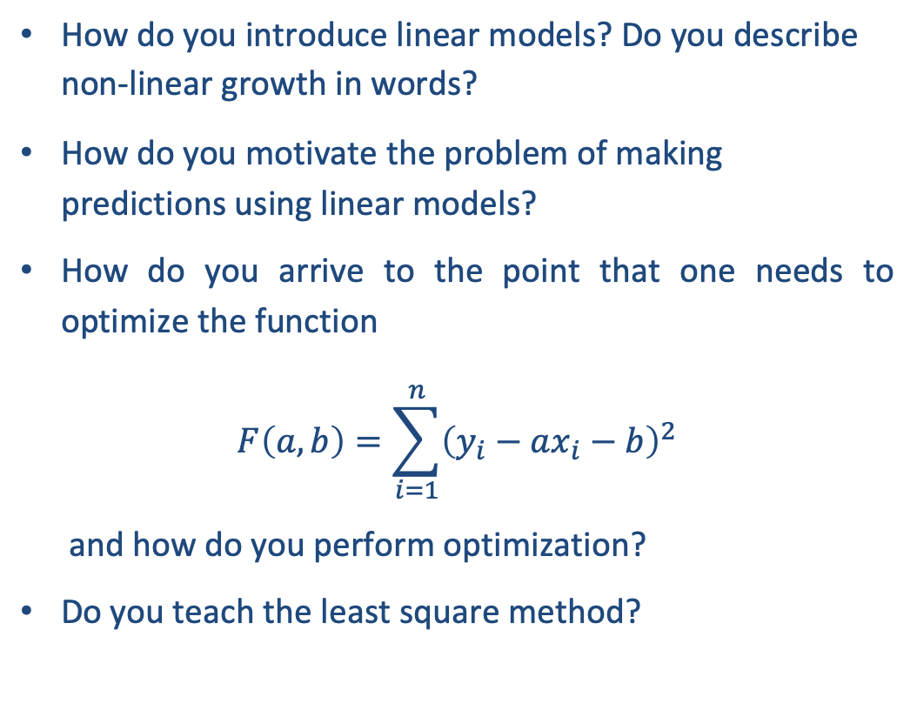
Linear models - how do we make predictions?
How do you introduce linear models? Do you describe non-linear growth in words?
How do you motivate the problem of making predictions using linear models?
How do you arrive to the point that one needs to optimize the function
$$F\left(a,b\right)=\sum_{i=1}^{n}{{\left(y_{i}−ax_{i}−b\right)}^{2}}$$
and how do you perform optimization?
Do you teach the least square method?

Slide 11
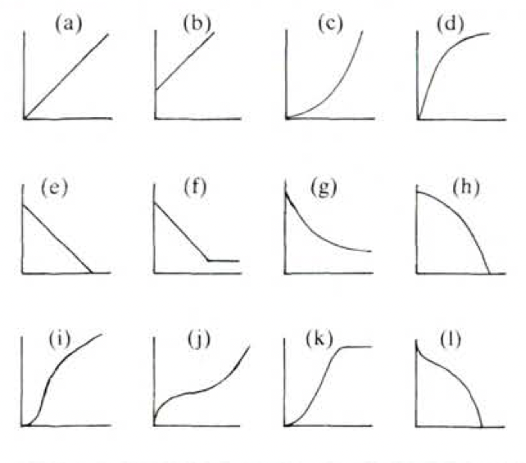
Drawing graphs from tables
Time (hours) | 1 | 2 | 3 | 4 | 5 | 6 | 7
Alcohol in blood (mg/100 ml) | 90 | 75 | 60 | 45 | 30 | 15 | 0
Year | 1880 | 1890 | 1900 | 1910 | 1920 | 1930 | 1940
Types of birds | 0 | 1 | 5 | 17 | 30 | 30 | 30
Time (minutes) | 0 | 5 | 10 | 15 | 20 | 25 | 30
Coffee temperature (°C) | 90 | 79 | 70 | 62 | 55 | 49 | 44
Turkey weight (kg) | 3 | 4 | 5 | 6 | 7 | 8 | 9
Baking time (h) | 2,5 | 3 | 3,5 | 4 | 4,5 | 5 | 5,5
Connect the tables with the
corresponding graphs!
Explain your reasoning.
Age (month) | 2 | 3 | 4 | 5 | 6 | 7 | 8
Fetus length (cm) | 4 | 9 | 16 | 24 | 30 | 34 | 38

Slide 12
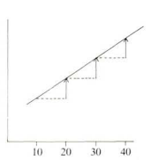
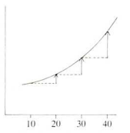
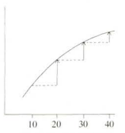
Linear and non-linear growth
Linear growth
Faster than linear growth
Slower than linear growth

Slide 13
Population growth
Imagine you are a fisherman that wants to grow fish in a waterway. You know that it takes some time for the population to grow, so you will wait a number of years and then start catching fish from the waterway. You will catch fish each year, hopefully for many years.
The graph shows a model of the growth in the combined weight of fish in the waterway.
How many years should the fisherman wait if he or she wishes to maximise the number of caught fish?

Slide 14
Racing car – even more graphs
This graph shows how the speed of a racing car varies along a flat 3 kilometer track during its second lap. What is the approximate distance from the starting line to the beginning of the longest straight section of the track?

Slide 15
Racing car
Here are pictures of five tracks. Along which one of these tracks was the car driven to produce the speed graph shown earlier?

Slide 16
Racing car
For each track appearing on the left-hand side sketch a sensible speed-graph.

